Slide 1
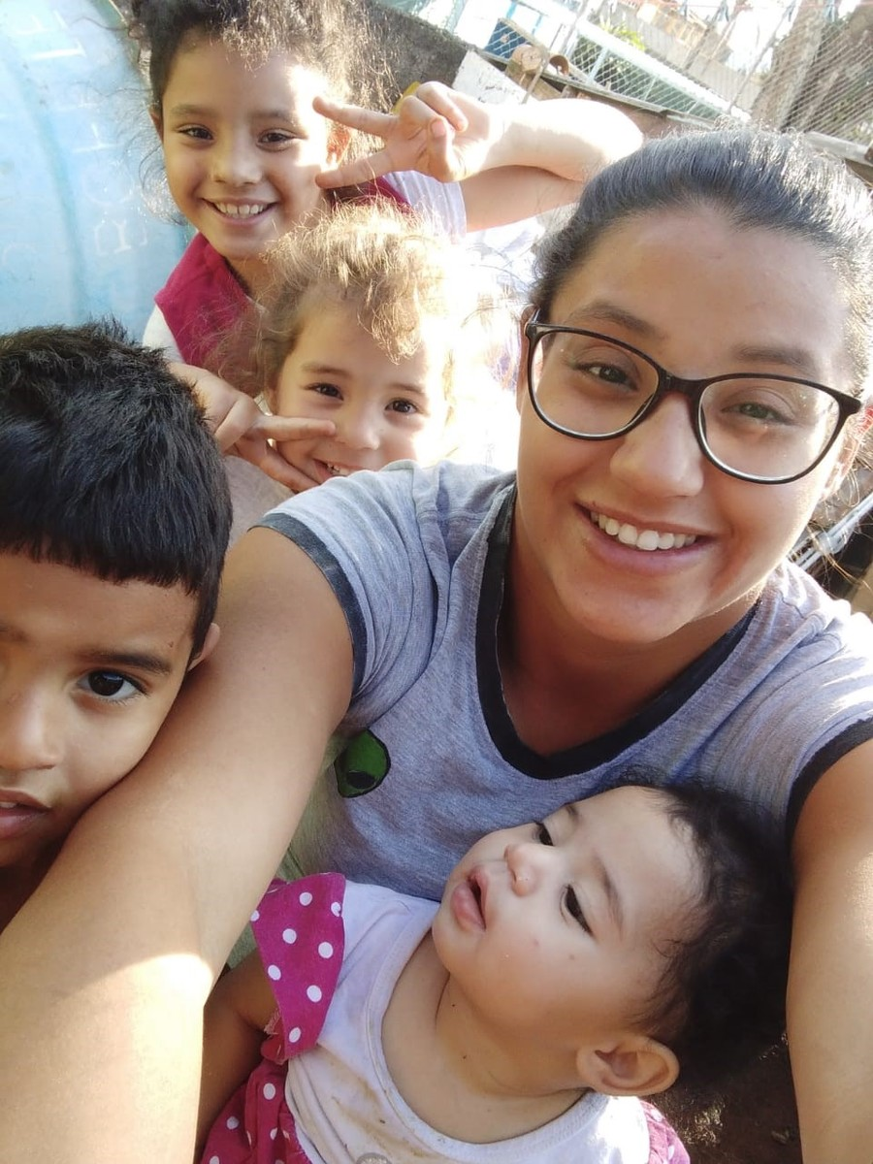
An Ecumenical Christian Prayer
(Pope Francis, Fratelli tutti, 287)
O God, Trinity of love,
from the profound communion
of your divine life,
pour out upon us a torrent of fraternal love.
Grant us the love reflected
in the actions of Jesus,
in his family of Nazareth,
and in the early Christian community.
Picture: Movement in the Defence of the Favelas

Slide 2
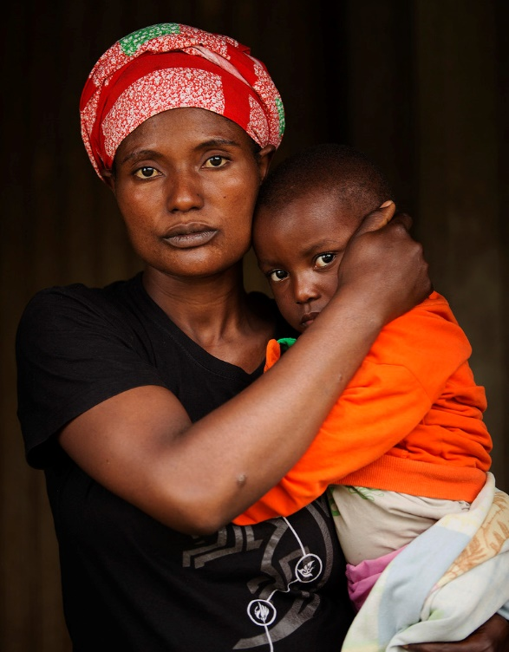
Grant that we Christians may live the Gospel,
discovering Christ in each human being,
recognising him crucified
in the sufferings of the abandoned
and forgotten of our world,
and risen in each brother or sister
who makes a new start.
Come, Holy Spirit, show us your beauty,
reflected in all the peoples of the earth,
so that we may discover anew
that all are important and all are necessary,
different faces of the one humanity
that God so loves.
Amen.
Picture: Simon Murphy

