Slide 1
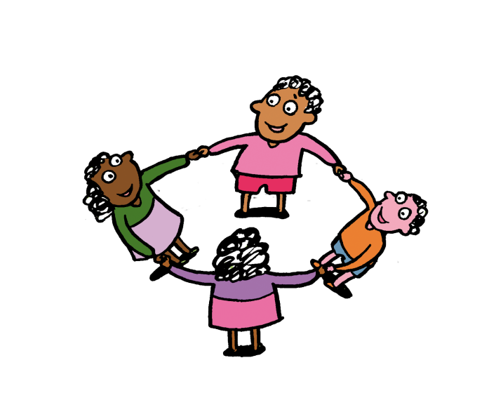
Year 1 Neighbours

Slide 2
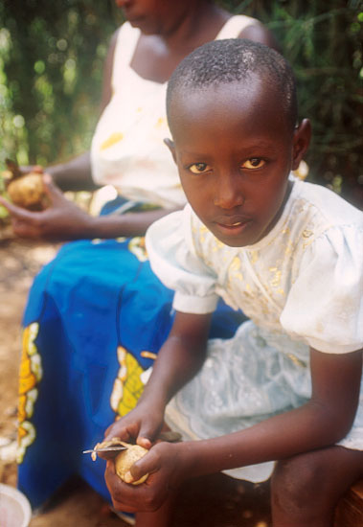
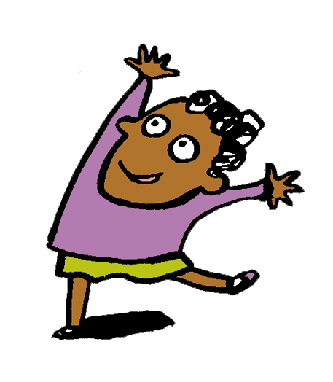
Hi!
My name is
Marie-Doriane.
I am your neighbour.

Slide 3
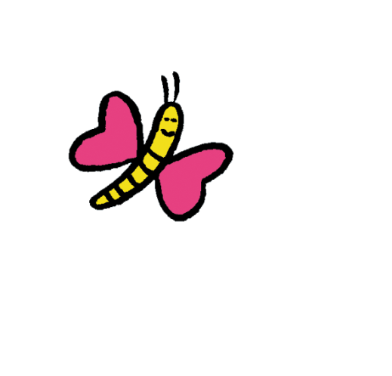
I am 8.
I live in a village called Gasalo, in Rwanda.
Rwanda is in Africa.
Notes:
Marie-Doriane Uwituze, 8 yrs, daughter of Liberate Muhagihana. Liberate is a mother of 3, looks after 4 orphans and works as a counsellor for AVEGA. AVEGA provides a forum for genocide widows to share their experiences, offer mutual support and find solutions to their problems.

Slide 4
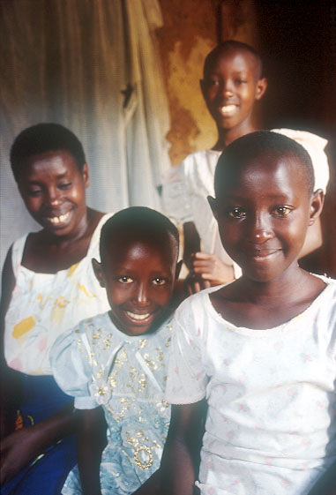
I have a big family!
There are 8 of us!
CAFOD helped us to have our own house.
My dad was killed. It makes me sad to think of him.
Notes:
(Facing LtoR) Liberate Muhagihana, mother of 3 and looks after 4 orphans: Marie-Doriane Uwituze, 8; Marie-Claire Umuhoza, 13 and Marie Louise Uwamahoro, 10.

Slide 5
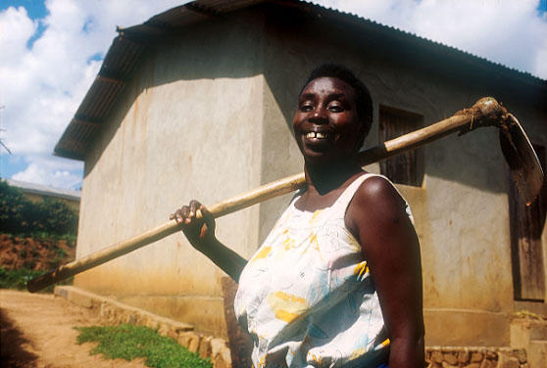
She works really hard in the fields.
She sells the crops she grows to have money to buy food and to pay for me to go to school.
This is my mum
Liberate.
Notes:
Liberate Muhagihana, mother of 3, looks after 4 orphans and grows own crops. She lost a husband and son during the genocide. Liberate has received counselling and now works as a counsellor for AVEGA. AVEGA provides a forum for genocide widows to share their experiences, offer mutual support and find solutions to their problems.

Slide 6
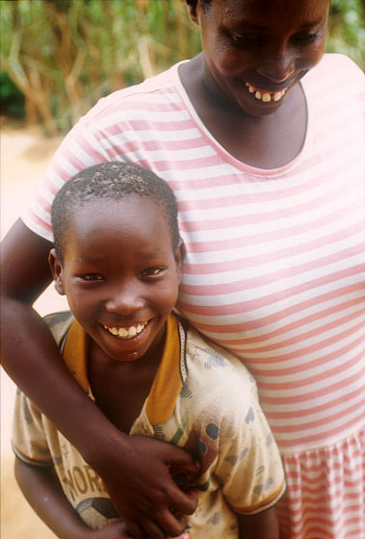
Our mum helps make our home happy.
She shares her love, her time and her care with us all.
We have lots of fun.

Slide 7
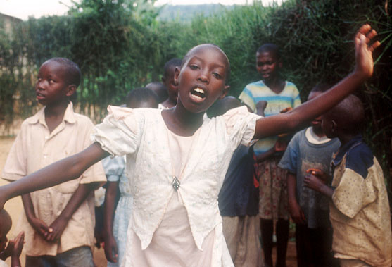
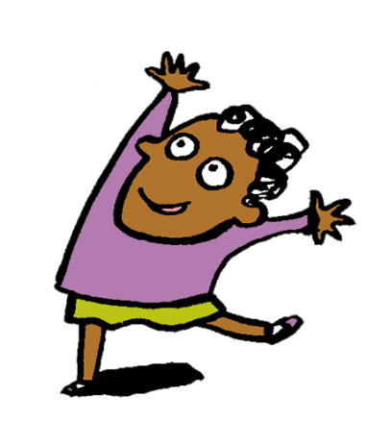
This is
my big sister
Marie-Claire dancing!
She is 13. She helps my mum clean the house.
She loves school.
Notes:
Marie-Claire Umuhoza, 13, daughter of Liberate Muhagihana. She loves school. Her favourite subjects are English, French
and Maths.

Slide 8
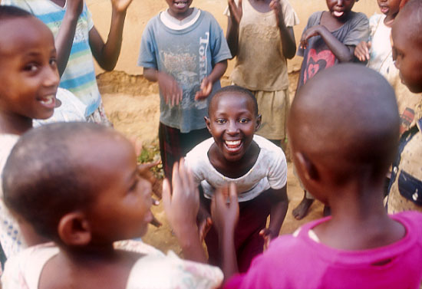
We love to play with our friends.
This is my sister Marie-Louise. She is 10.
She is playing a clapping game.
Do you know any clapping games?
Notes:
Marie Louise Uwamahoro, 10 yrs, daughter and youngest child of Liberate Muhagihana playing clapping game.

Slide 9
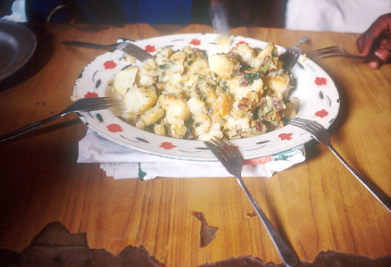
This is our lunch. It is made from onions, tomatoes, potatoes and green vegetables.
Yummy!
What’s your favourite lunch?

Slide 10
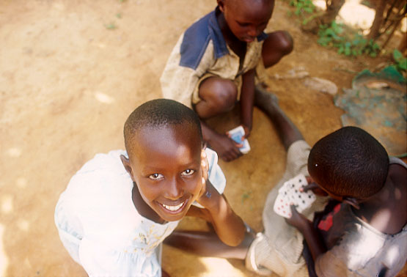
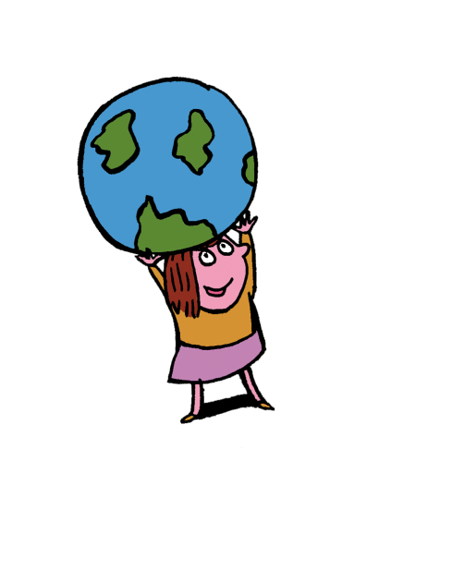
I hope you enjoyed reading my story.
We live far apart but we are neighbours.
We all belong to one world and one family.
Notes:
Marie-Doriane Uwituze, 8 yrs, daughter and youngest child of Liberate Muhagihana playing clapping game.

Slide 11
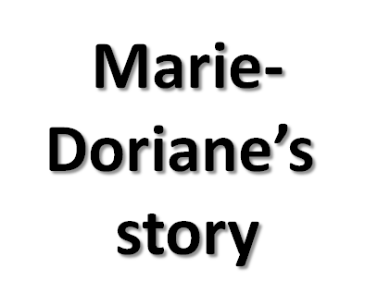
Photographs by: Annie Bungeroth
Illustrations: Per Karlen

