Slide 1
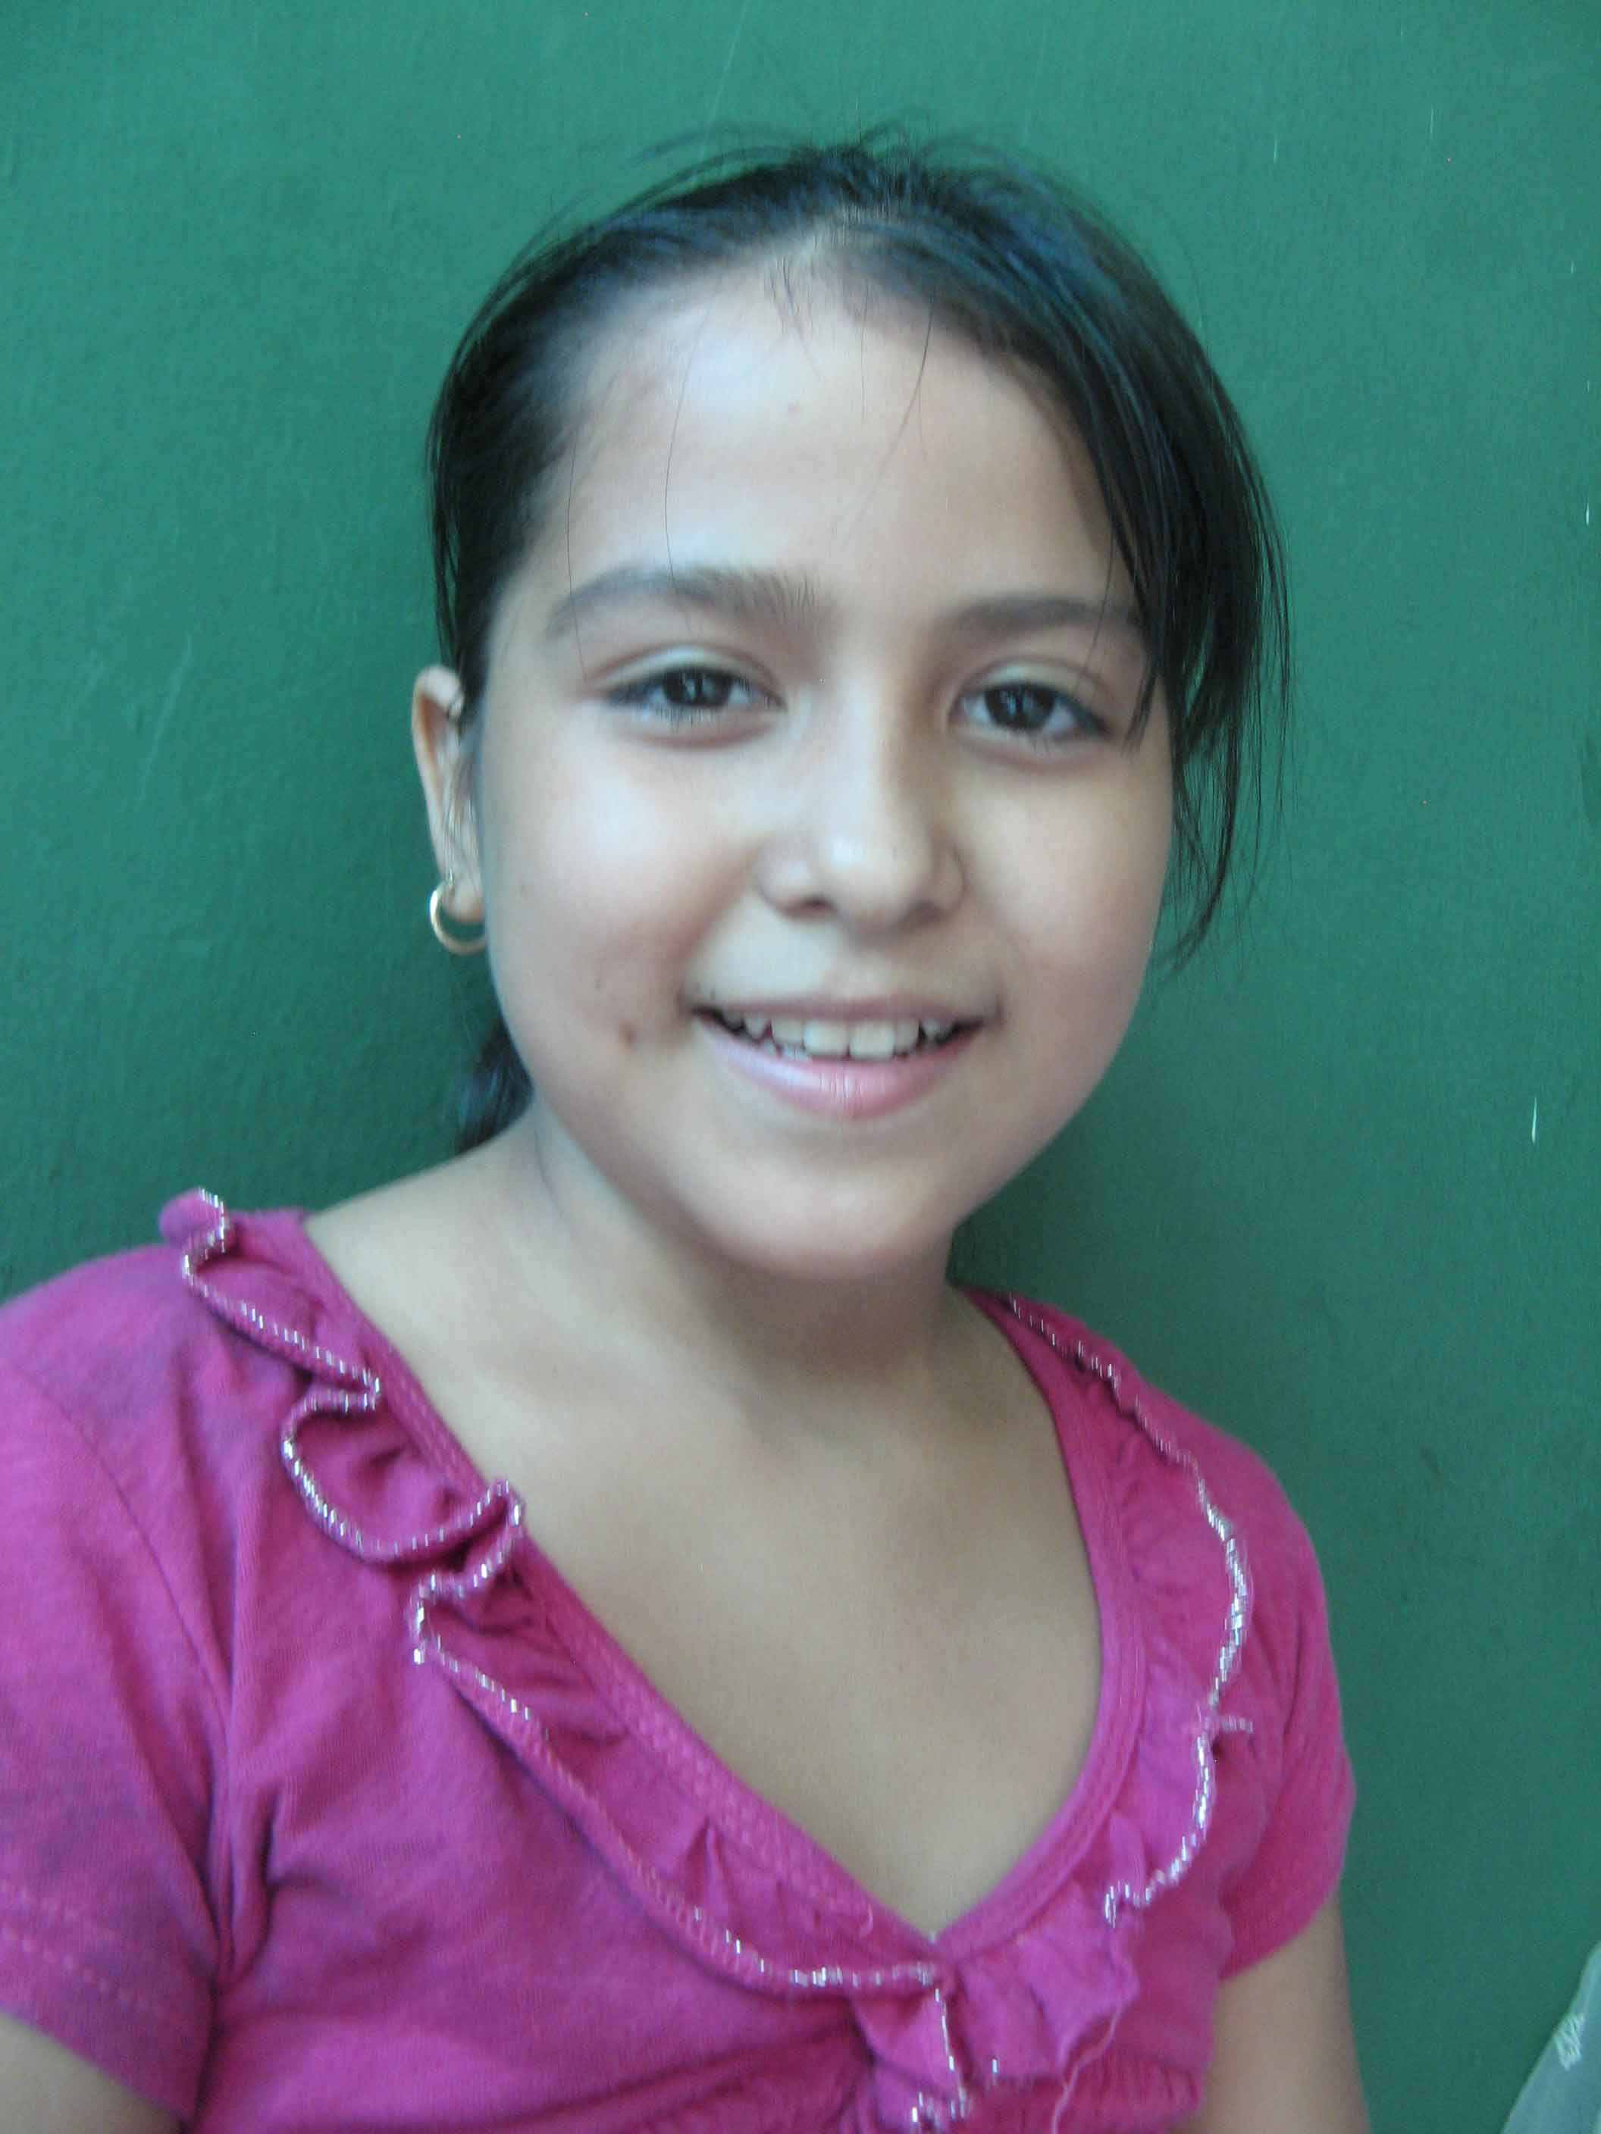
“Hi. My name is Maria.
I am 10.
I live in El Salvador in Central America.”
Notes:
Maria, who is 10, lives in El Salvador in Central America. At school Maria’s studies lots of subjects. She wants to improve her marks and get 10 out of 10 in everything.

Slide 2
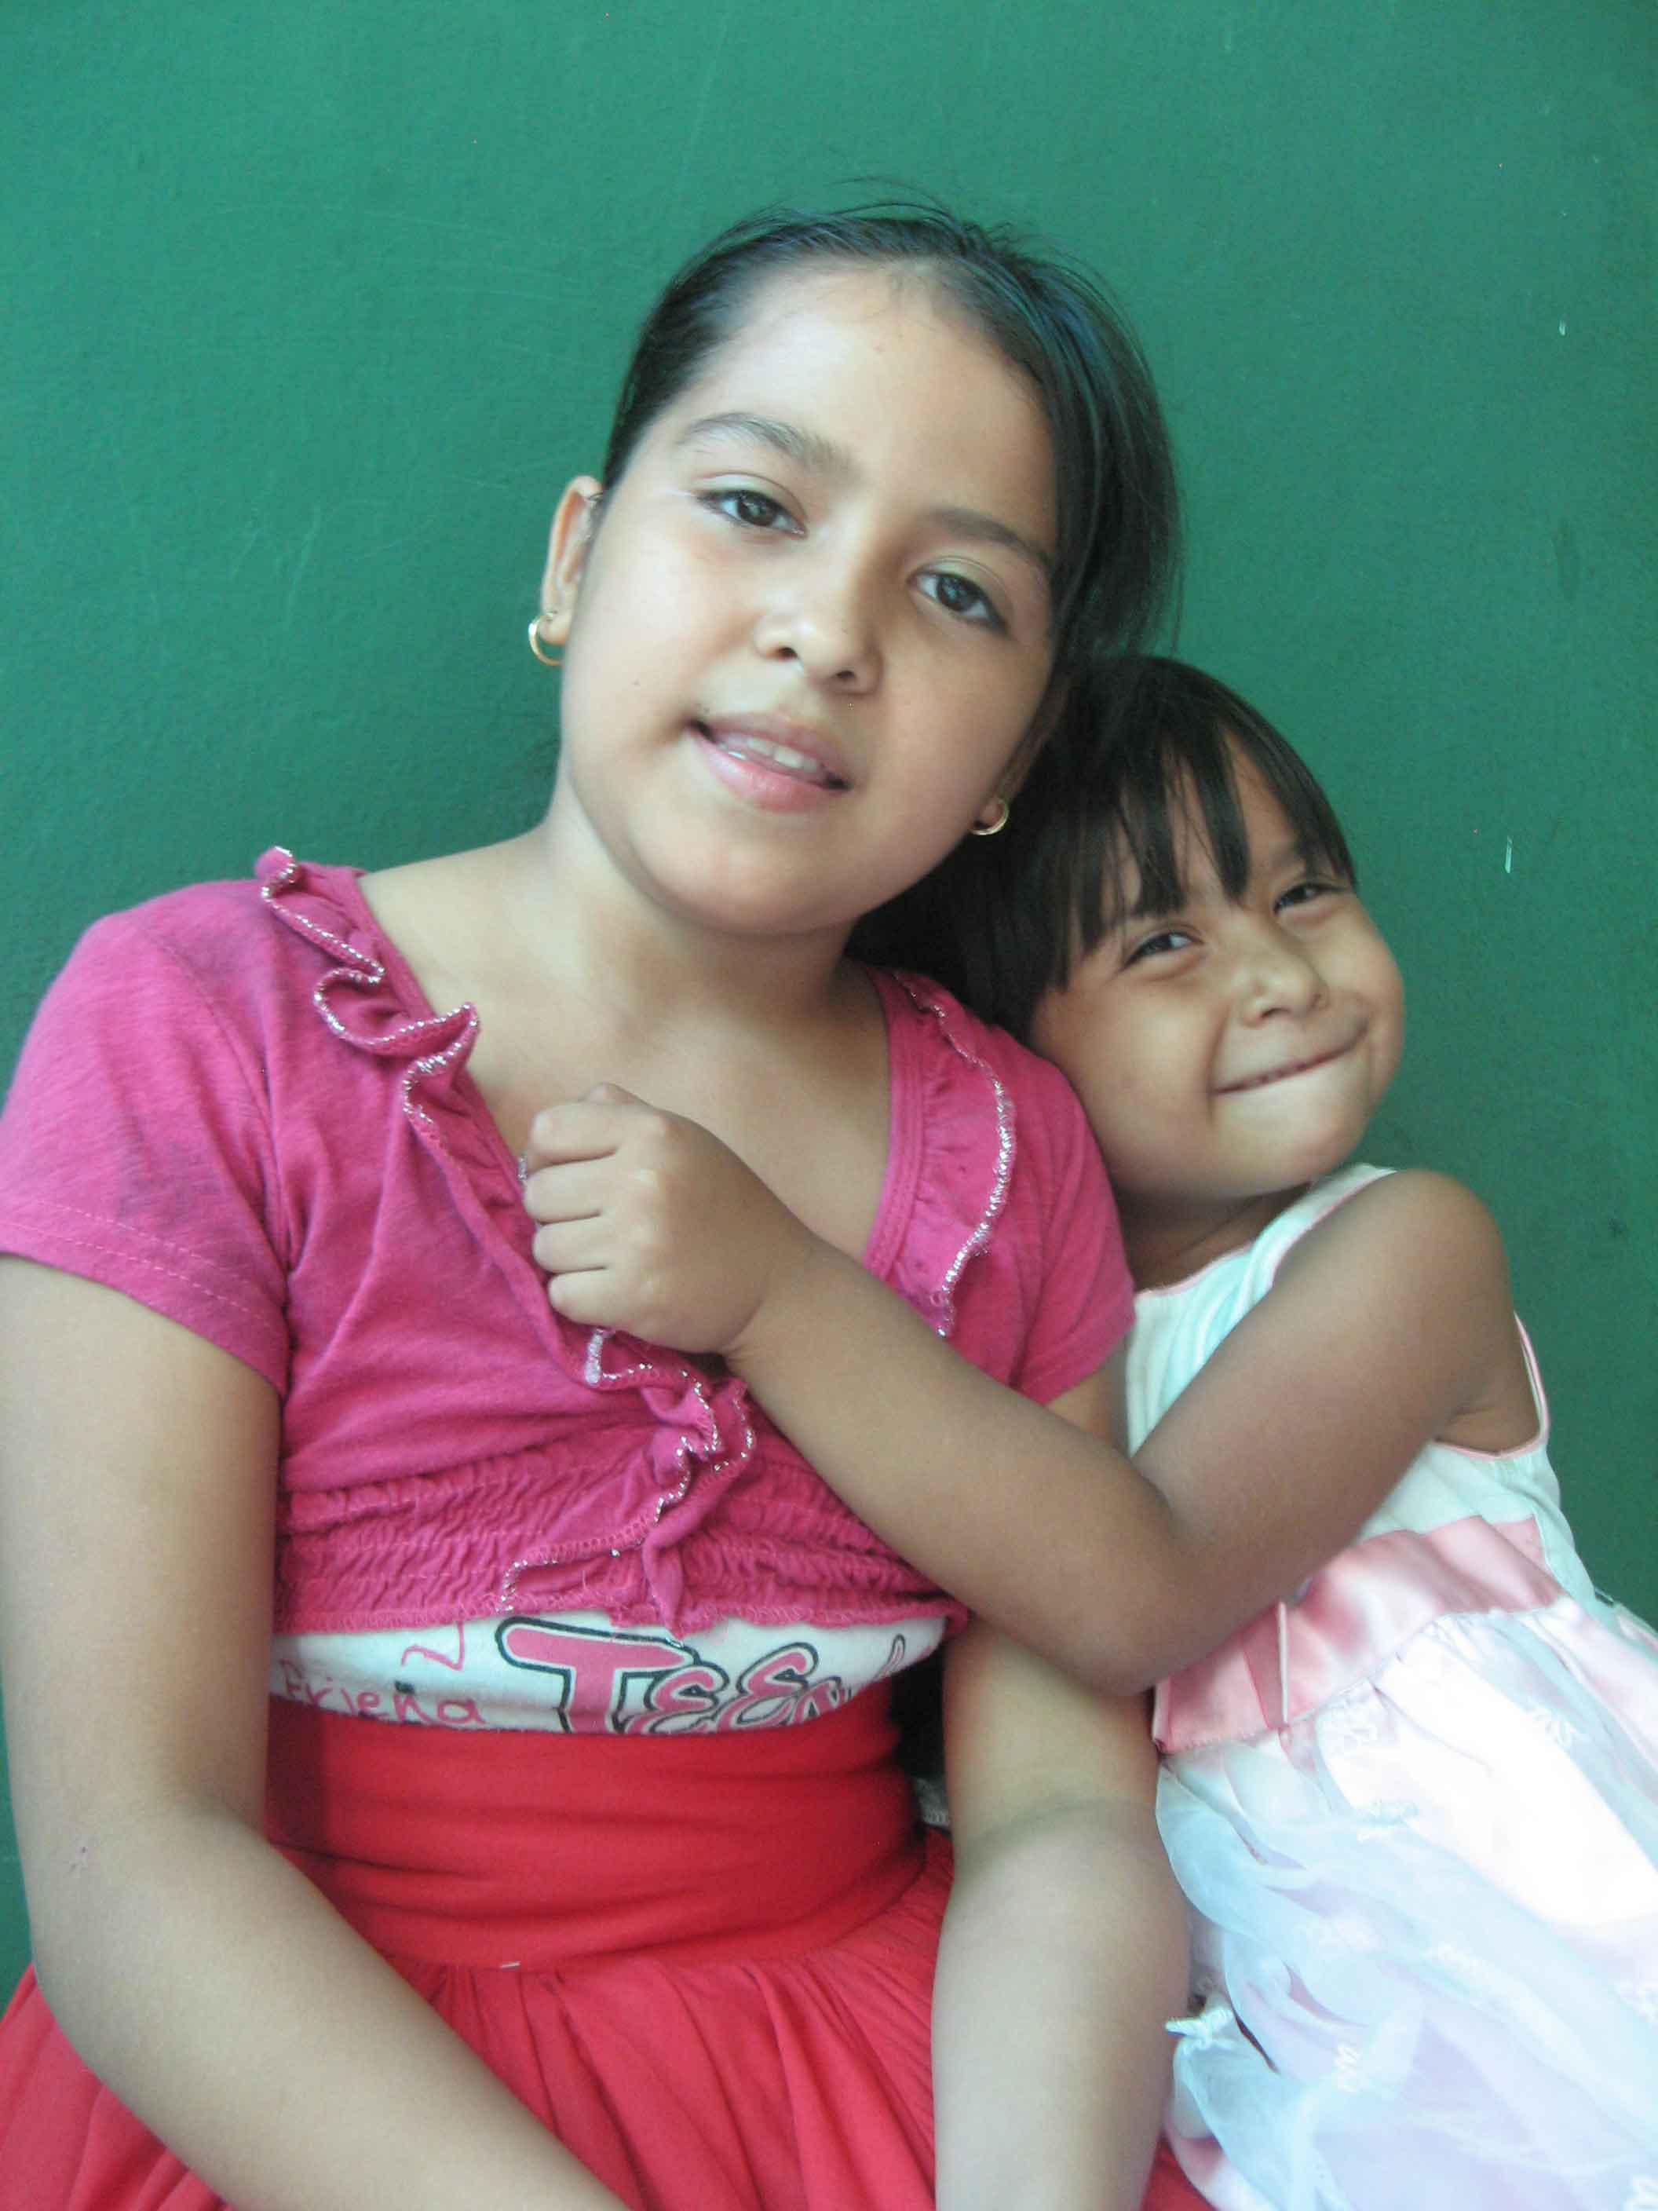
“I have one younger sister.
My mum and dad both work.”
Notes:
Maria has one younger sister, and her house is full of people who love her. Maria’s mum and dad both work.

Slide 3
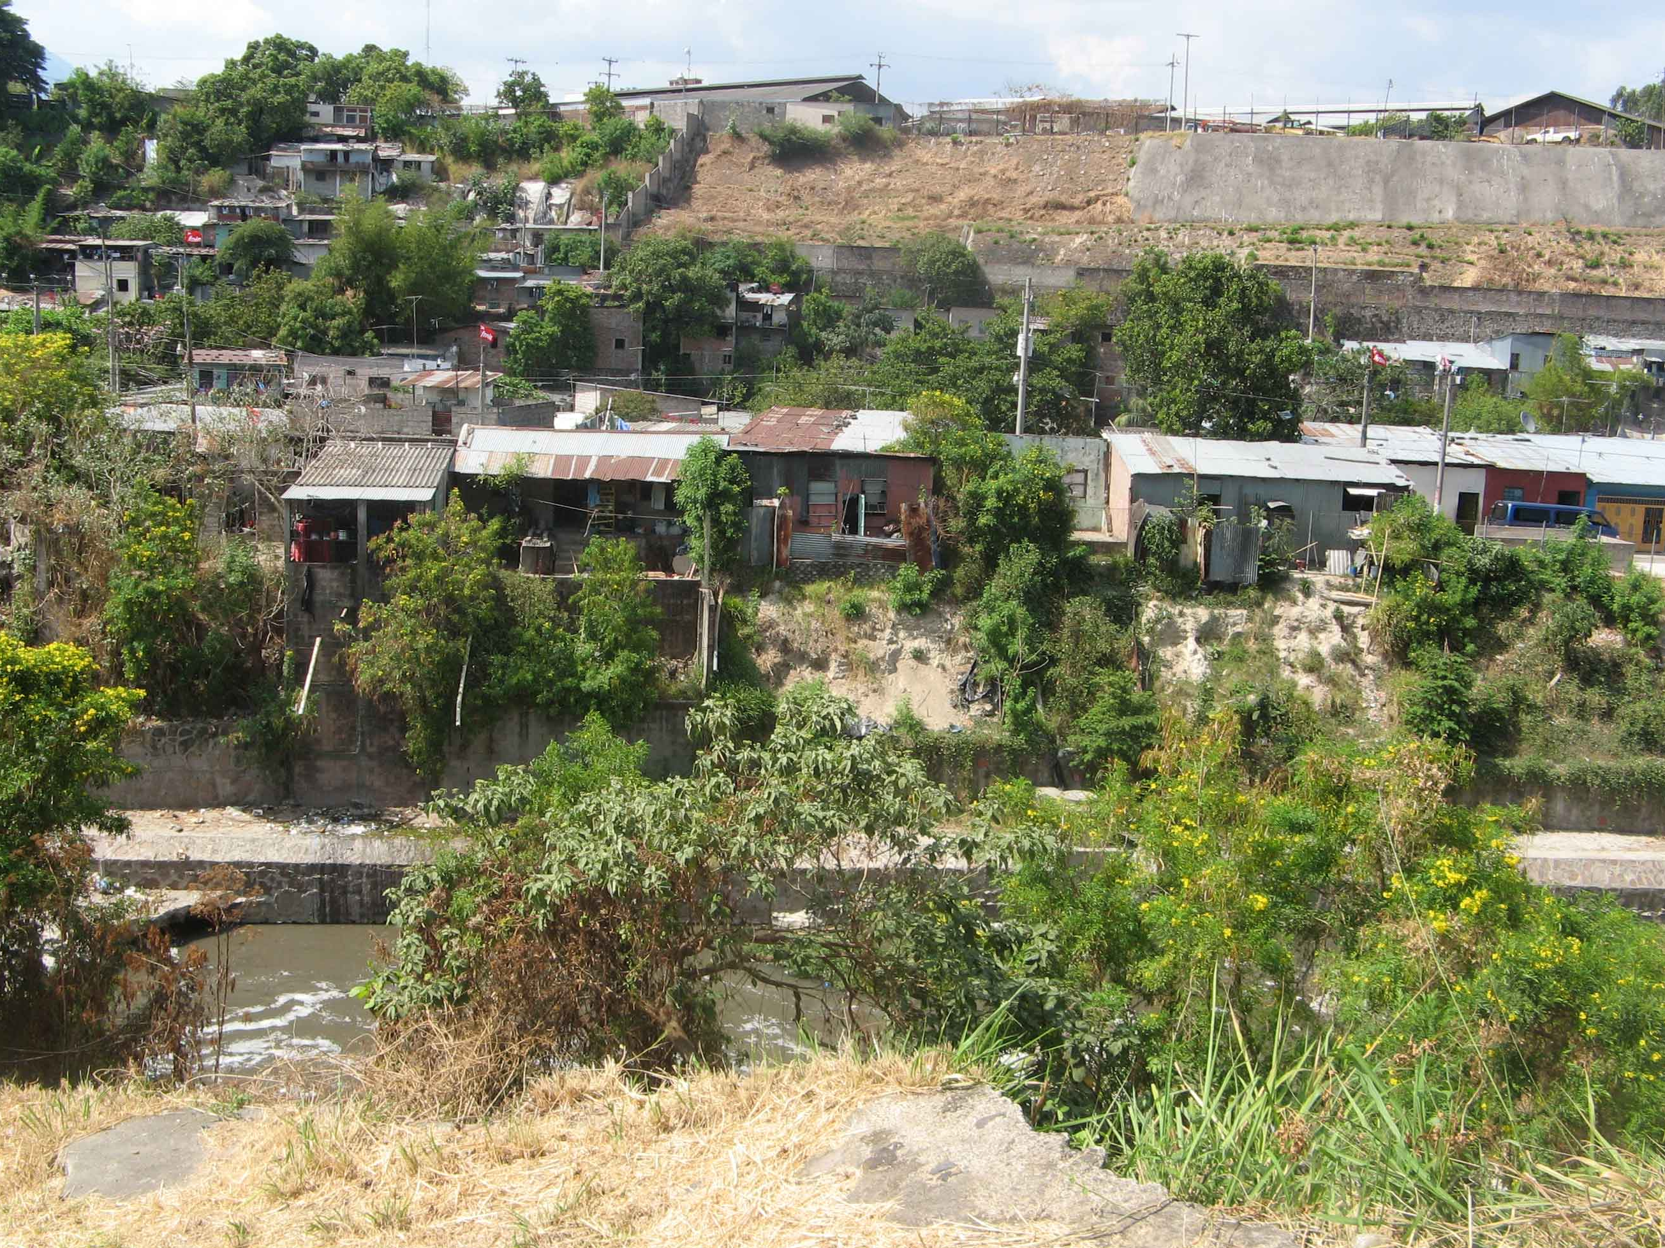
Maria lives in an informal settlement where there is poverty and violence.
Notes:
There is a lot of poverty and violence where Maria lives.

Slide 4
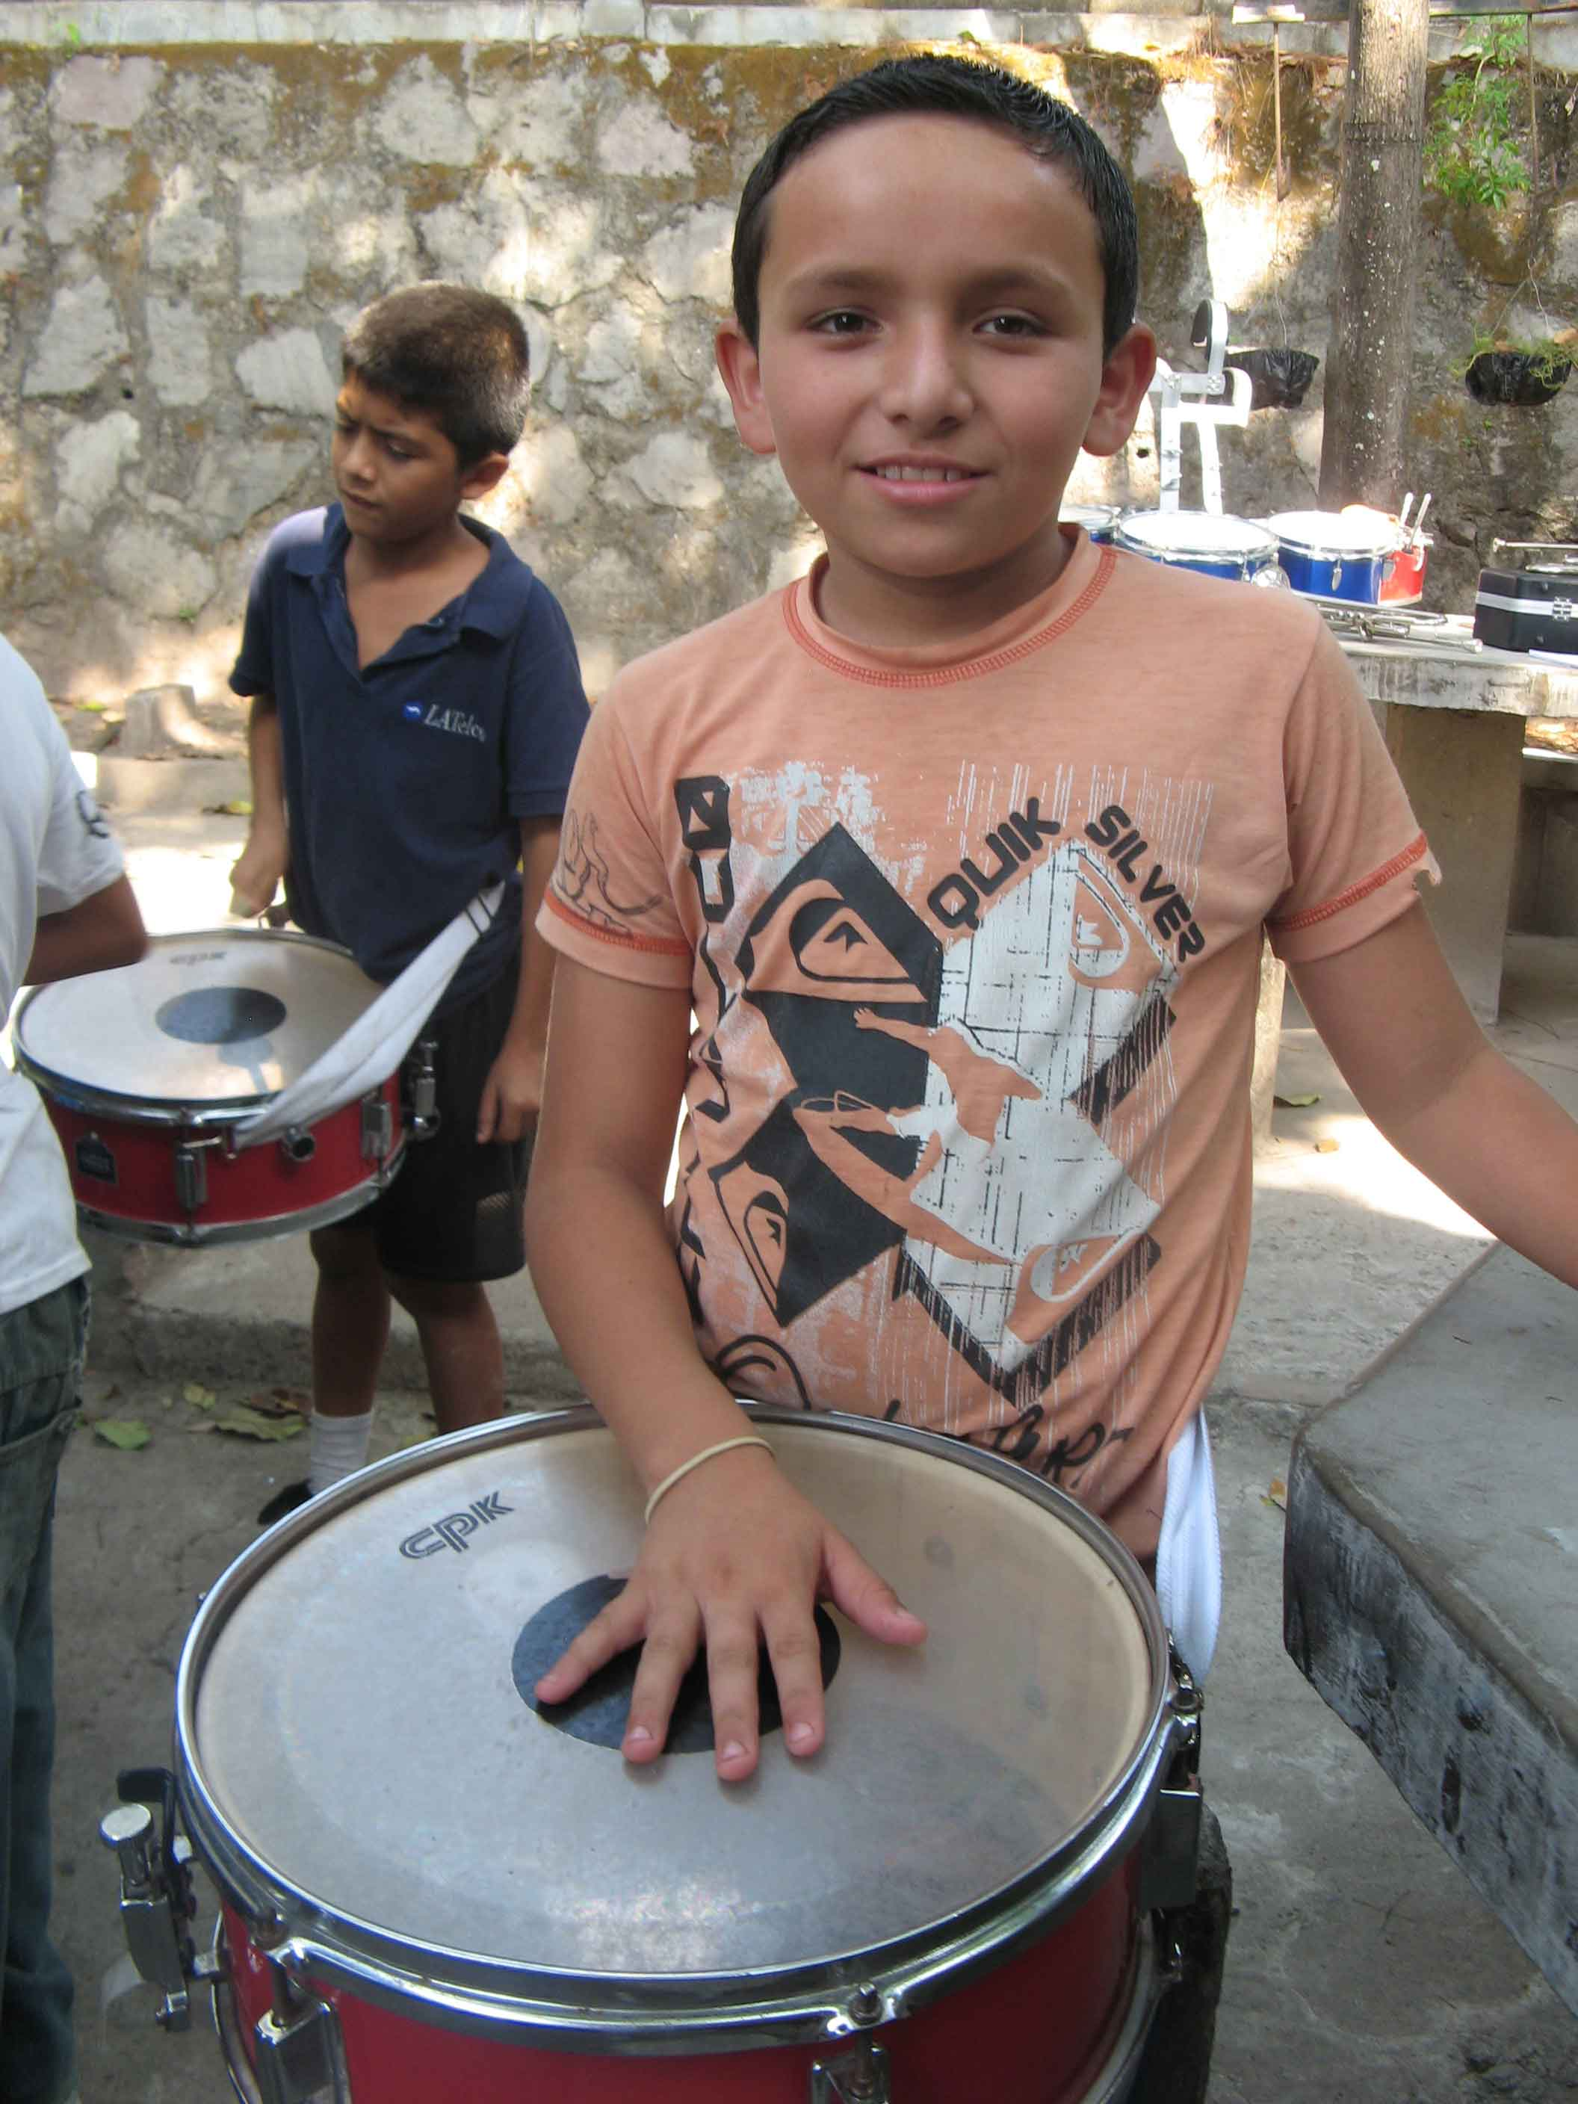
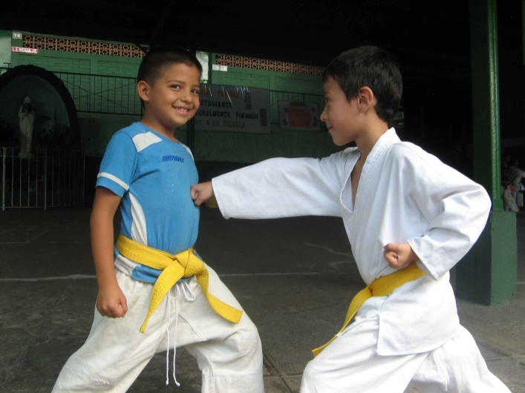
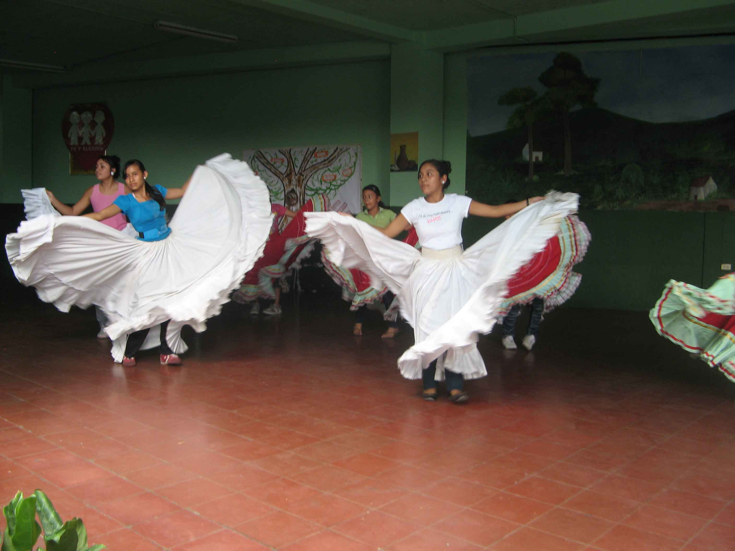
CAFOD is helping Maria’s community to live in peace through…
Music
Sport
Dance
Notes:
There is a lot of violence where Maria lives.
CAFOD’s partners, the Sisters of St Clare, are helping the community to develop more peaceful ways of living with each other. One way of doing this is through sport, music and dance activities for the children.

Slide 5
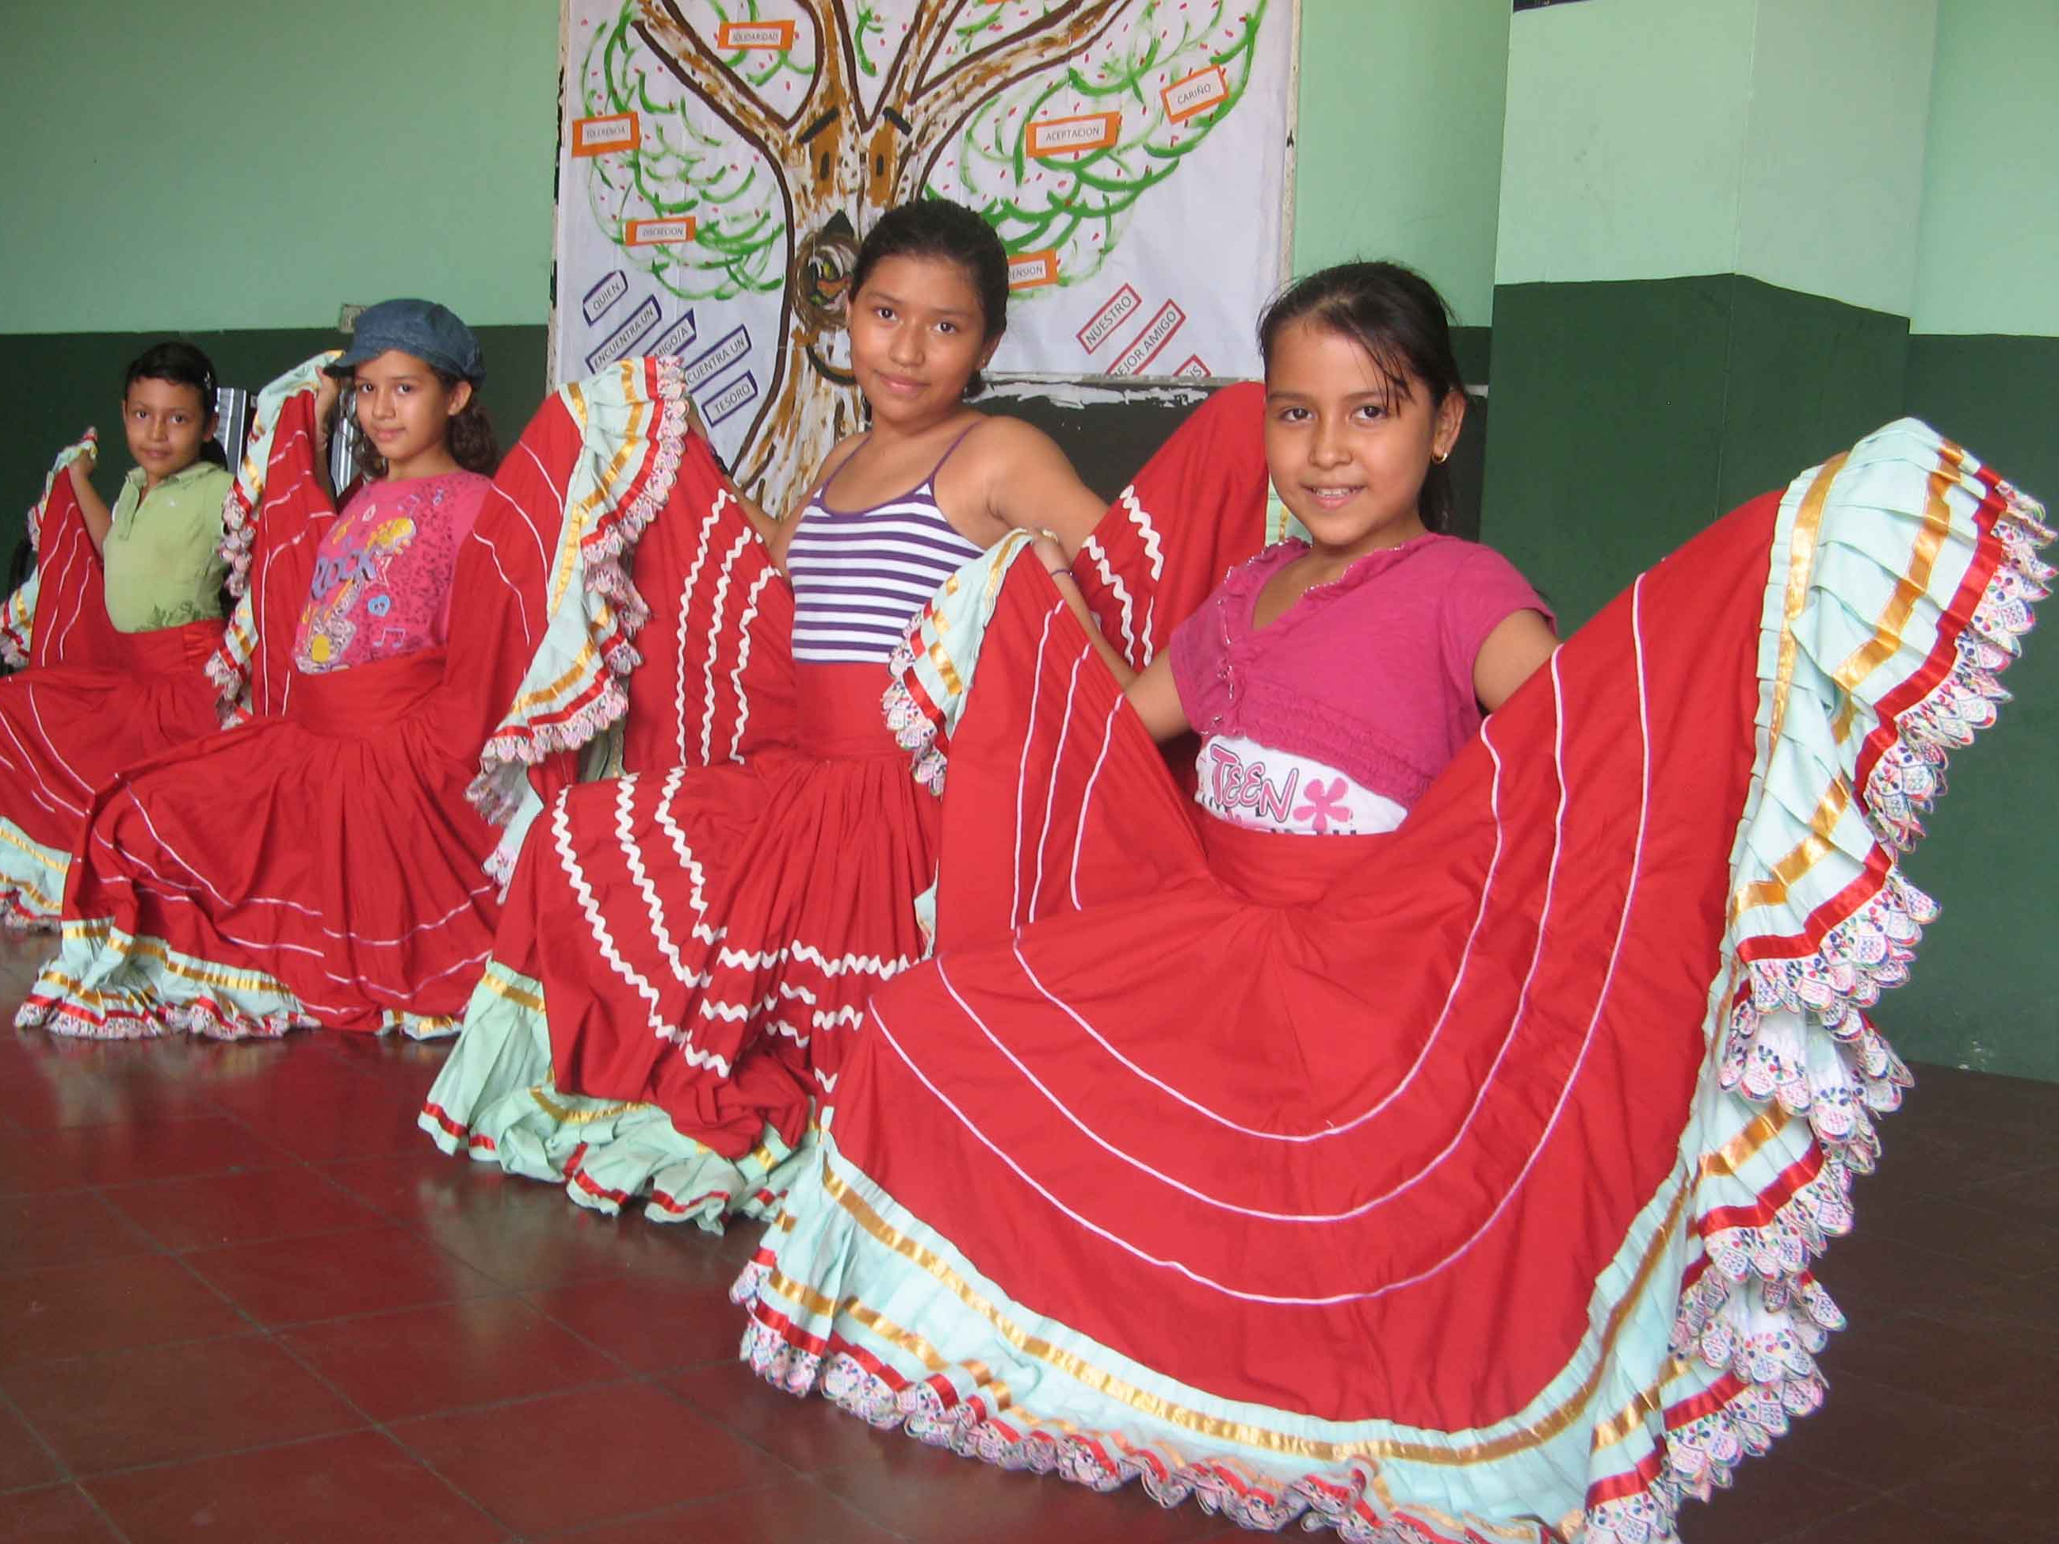
Maria learns to dance every Saturday at her local school.
The gangs frighten Maria, but sport helps to keep her away from the violence.

Slide 6
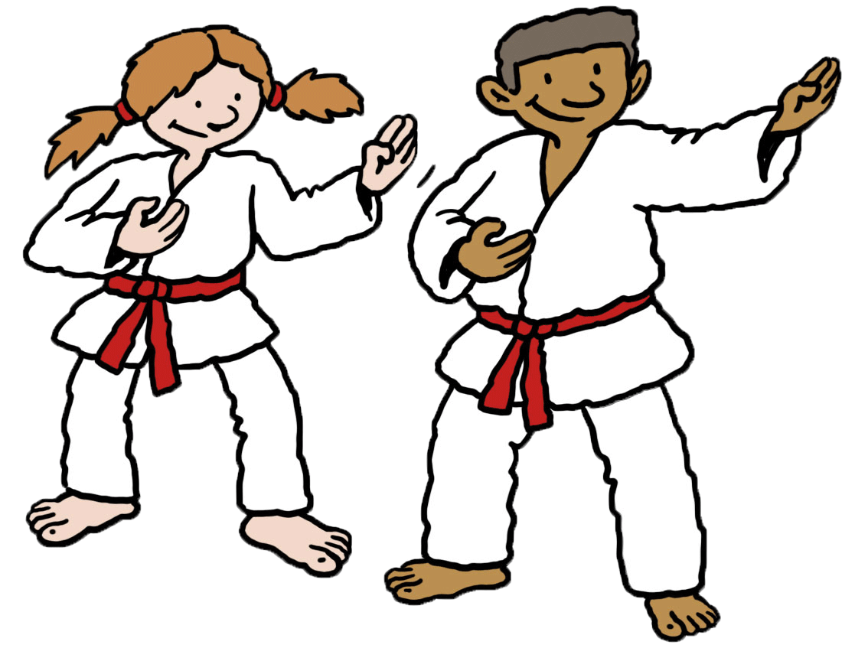
Children can learn lots of different sports at the school.
Notes:
At the school, children can enjoy lots of different sports like karate, basketball, volleyball and football. It gives them a chance to develop their talents. Playing sport together gives the children a sense of belonging, and helps them develop loyalty and responsibility to the group.

Slide 7
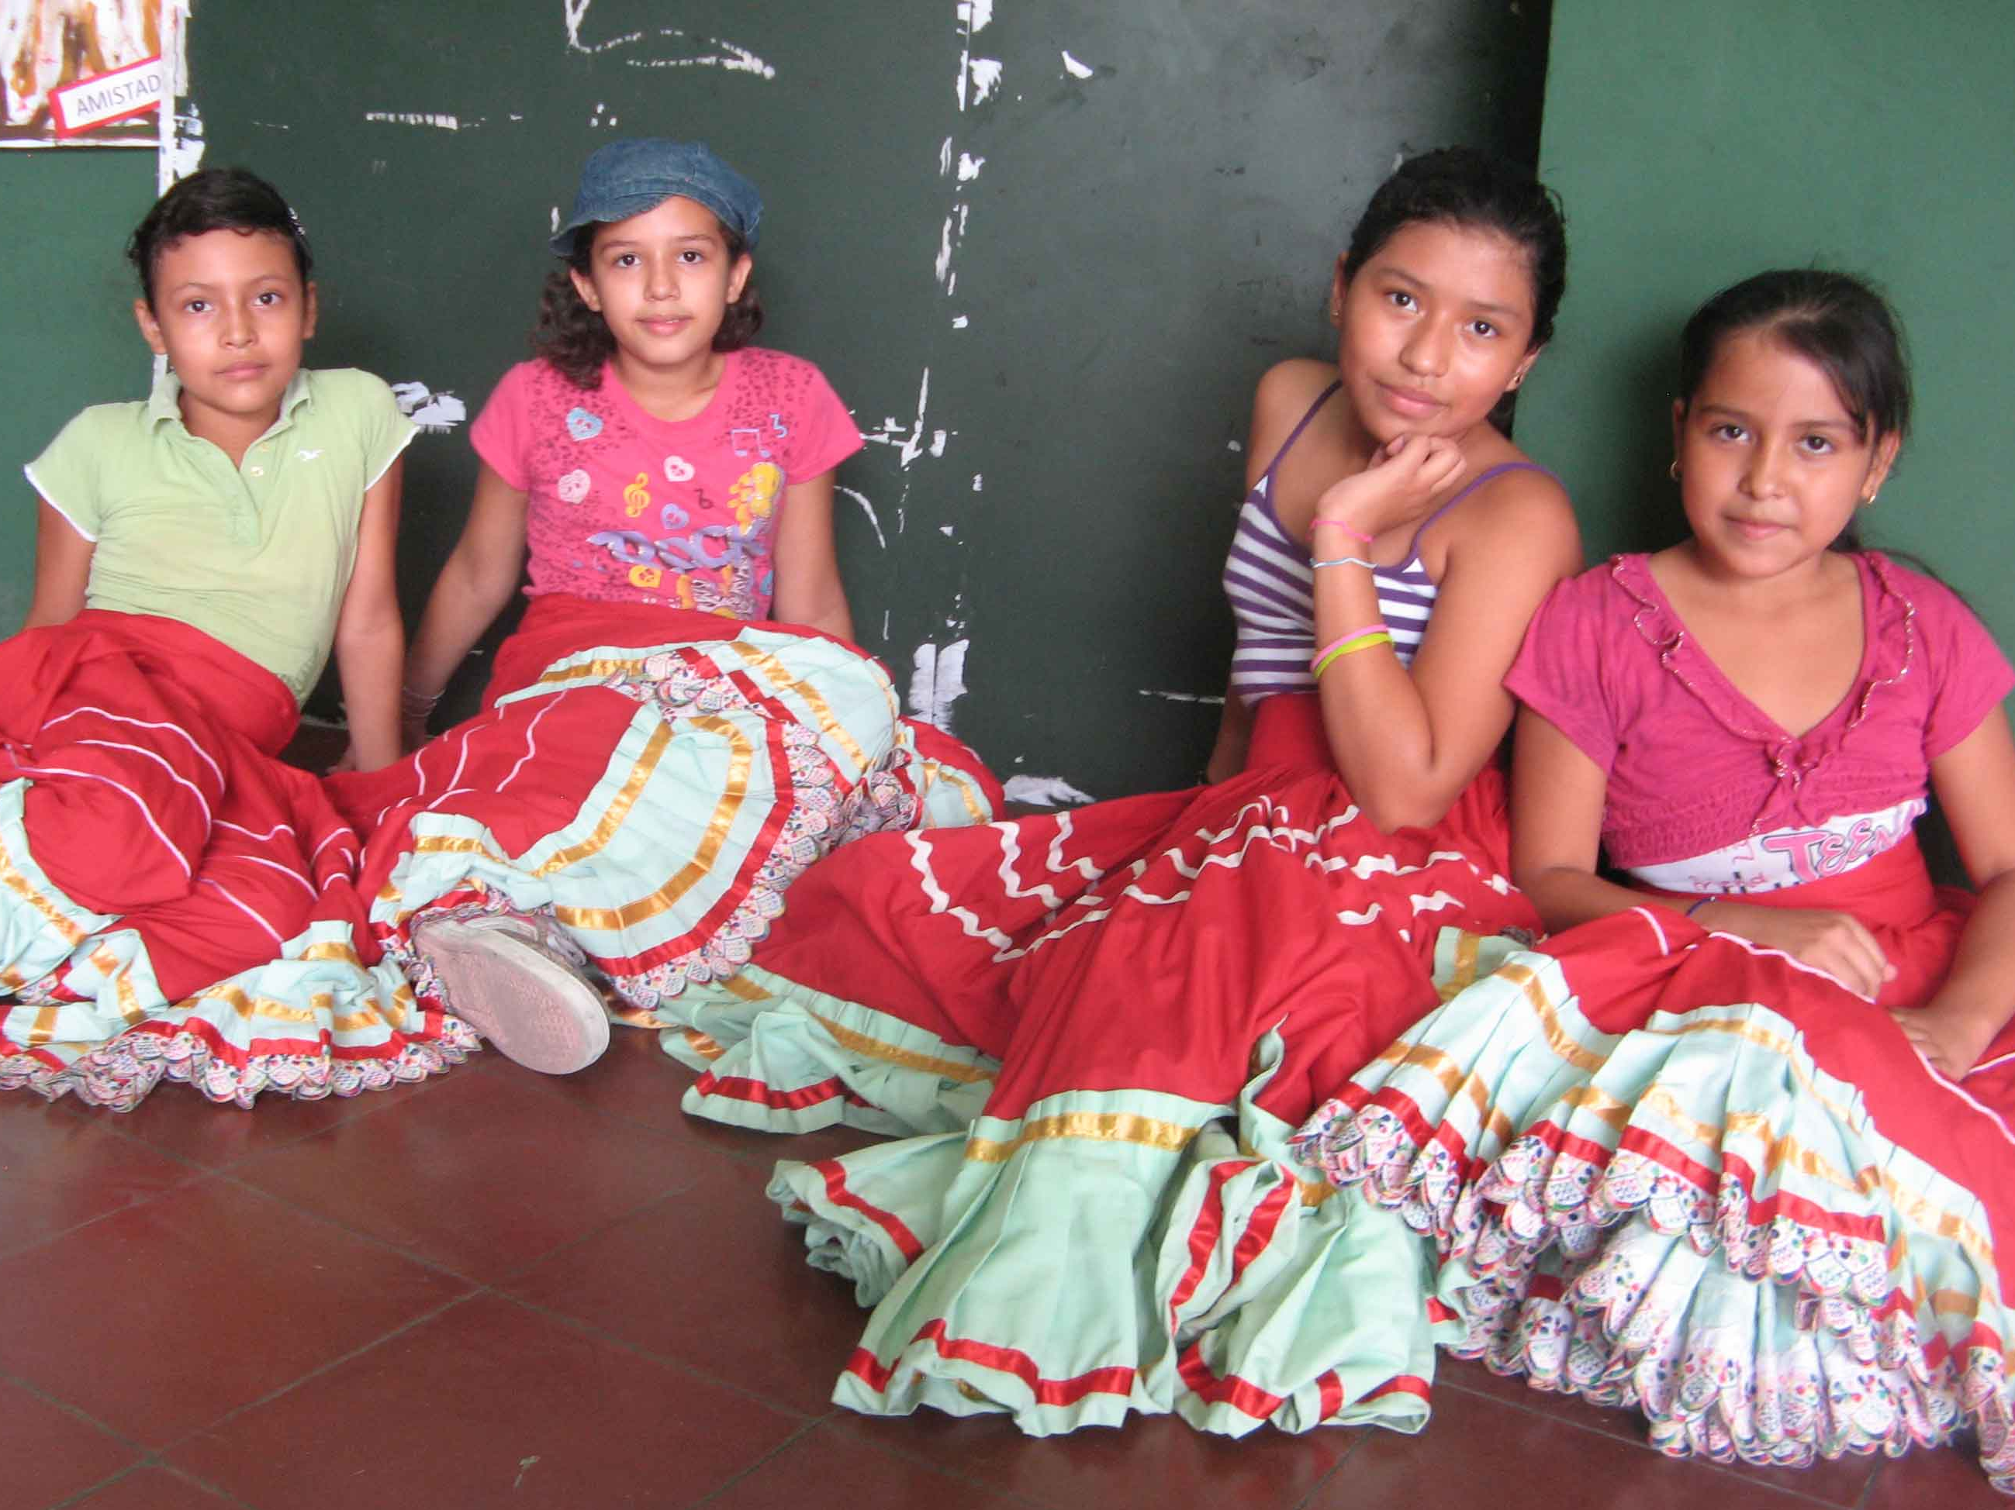
Maria loves dancing.
She enjoys the friendship of her group and feels safe.
“I have learned that if we get on well, we can live in peace and be far away from the violence”.
Notes:
Maria loves dancing, and has been learning to dance for three and a half years. At the dance classes, Maria enjoys the friendship of her group and feels safe.
Maria says, “I like dancing because it’s really fun and it keeps us away from the violence and all the bad things that might happen to us”.

Slide 8
Picture credits: Sarah Smith-Pearse
Illustrations: Ellis Nadler, Per Karlen

