Slide 1
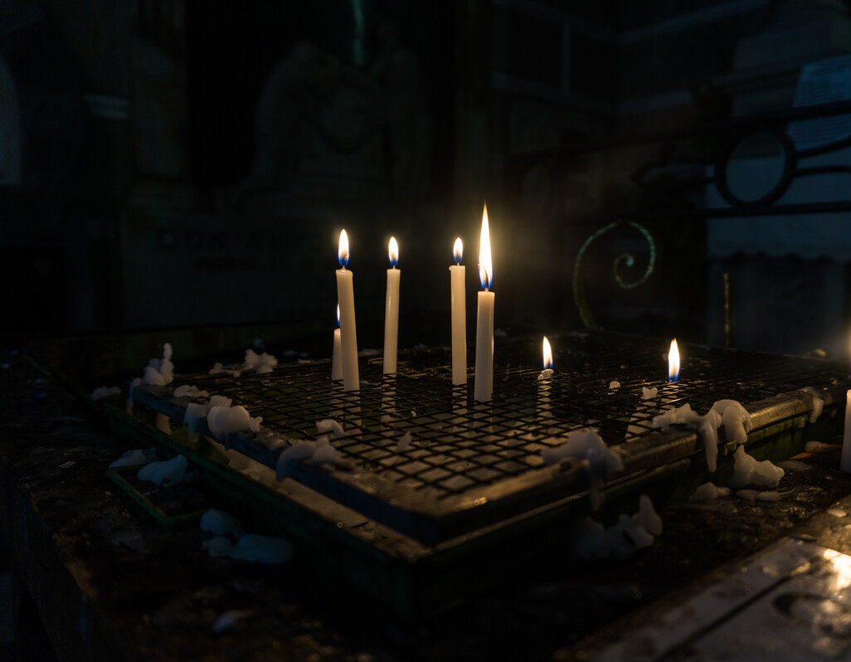

Advent Celebration of the word 2025
Notes:
Leader:
In the name of the Father, and of the Son, and of the Holy Spirit, Amen.
The four weeks of Advent are a time of preparation and of waiting – waiting for the return of Christ at the end of time; and waiting to celebrate once again the birth of Jesus in Bethlehem.
So, we gather to begin our time of waiting and preparation. Together we will share our story of God who - before time began – loved us, chose to come among us, and knew that we would gather here today. It is a story that ends in light but begins in darkness.
Photo credit: Hannah Caldwell, Candles in St Augustine Church Manila (2018)

Slide 2

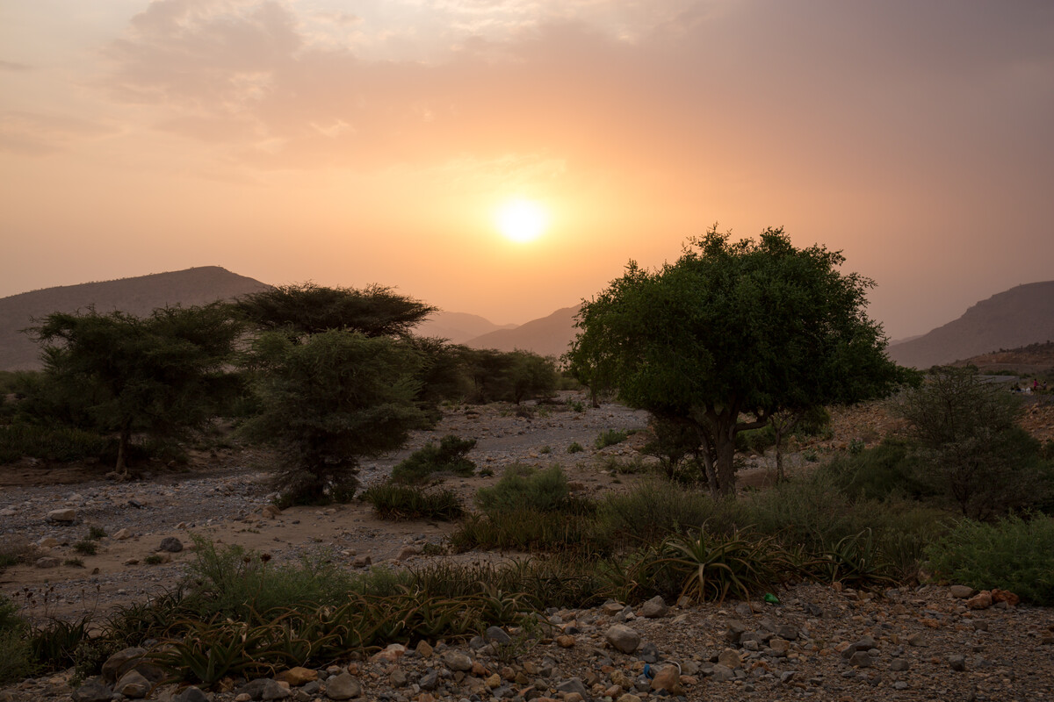
All:
That we who watch for that day may inherit the great promise in which now we dare to hope.
Notes:
All:
That we who watch for that day may inherit the great promise in which now we dare to hope.
Prayer credit: Roman Missal
Photo credit: CAFOD

Slide 3

Notes:
Leader: Let us take a moment to reflect on what it means to be to signs of hope.

Slide 4
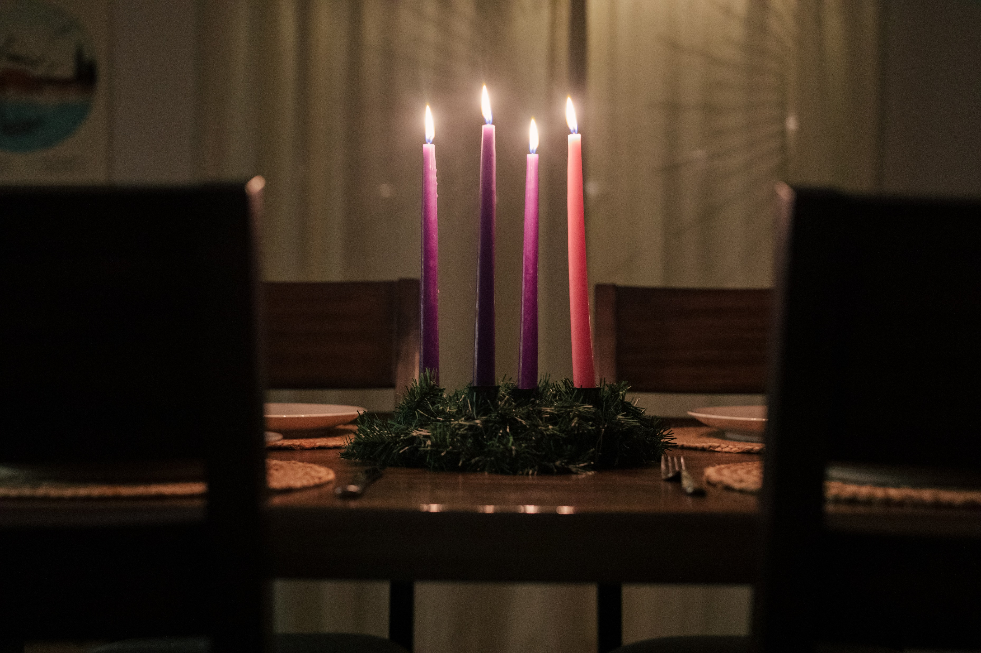
The lighting of the first candle
God of hope,
We look to you for our identity, our purpose and our fulfilment. We root ourselves in your love so we can reflect you in all that we do and say.
We pray for our friends, families and brothers and sisters across the world. May our words bring hope to desperate or uncertain situations. We might not always know the outcome but we faithfully bring it before you in prayer.
We surrender it to you, O God of hope. This Advent time we pray, ‘Come, Lord Jesus’.
Amen.
Notes:
Leader: (As the first purple candle is lit) As we light the first purple candle we are reminded that Advent is a journey from darkness to light and brings with it the reminder that even in the darkness of injustice, conflict and poverty there is always hope. Let us pray together:
All:
God of hope,
We look to you for our identity, our purpose and our fulfilment. We root ourselves in your love so we can reflect you in all that we do and say.
We pray for our friends, families and brothers and sisters across the world. May our words bring hope to desperate or uncertain situations. We might not always know the outcome but we faithfully bring it before you in prayer.
We surrender it to you, O God of hope. This Advent time we pray, ‘Come, Lord Jesus’.
Amen.
Prayer credit: Grant Whitty, Unsplash

Slide 5
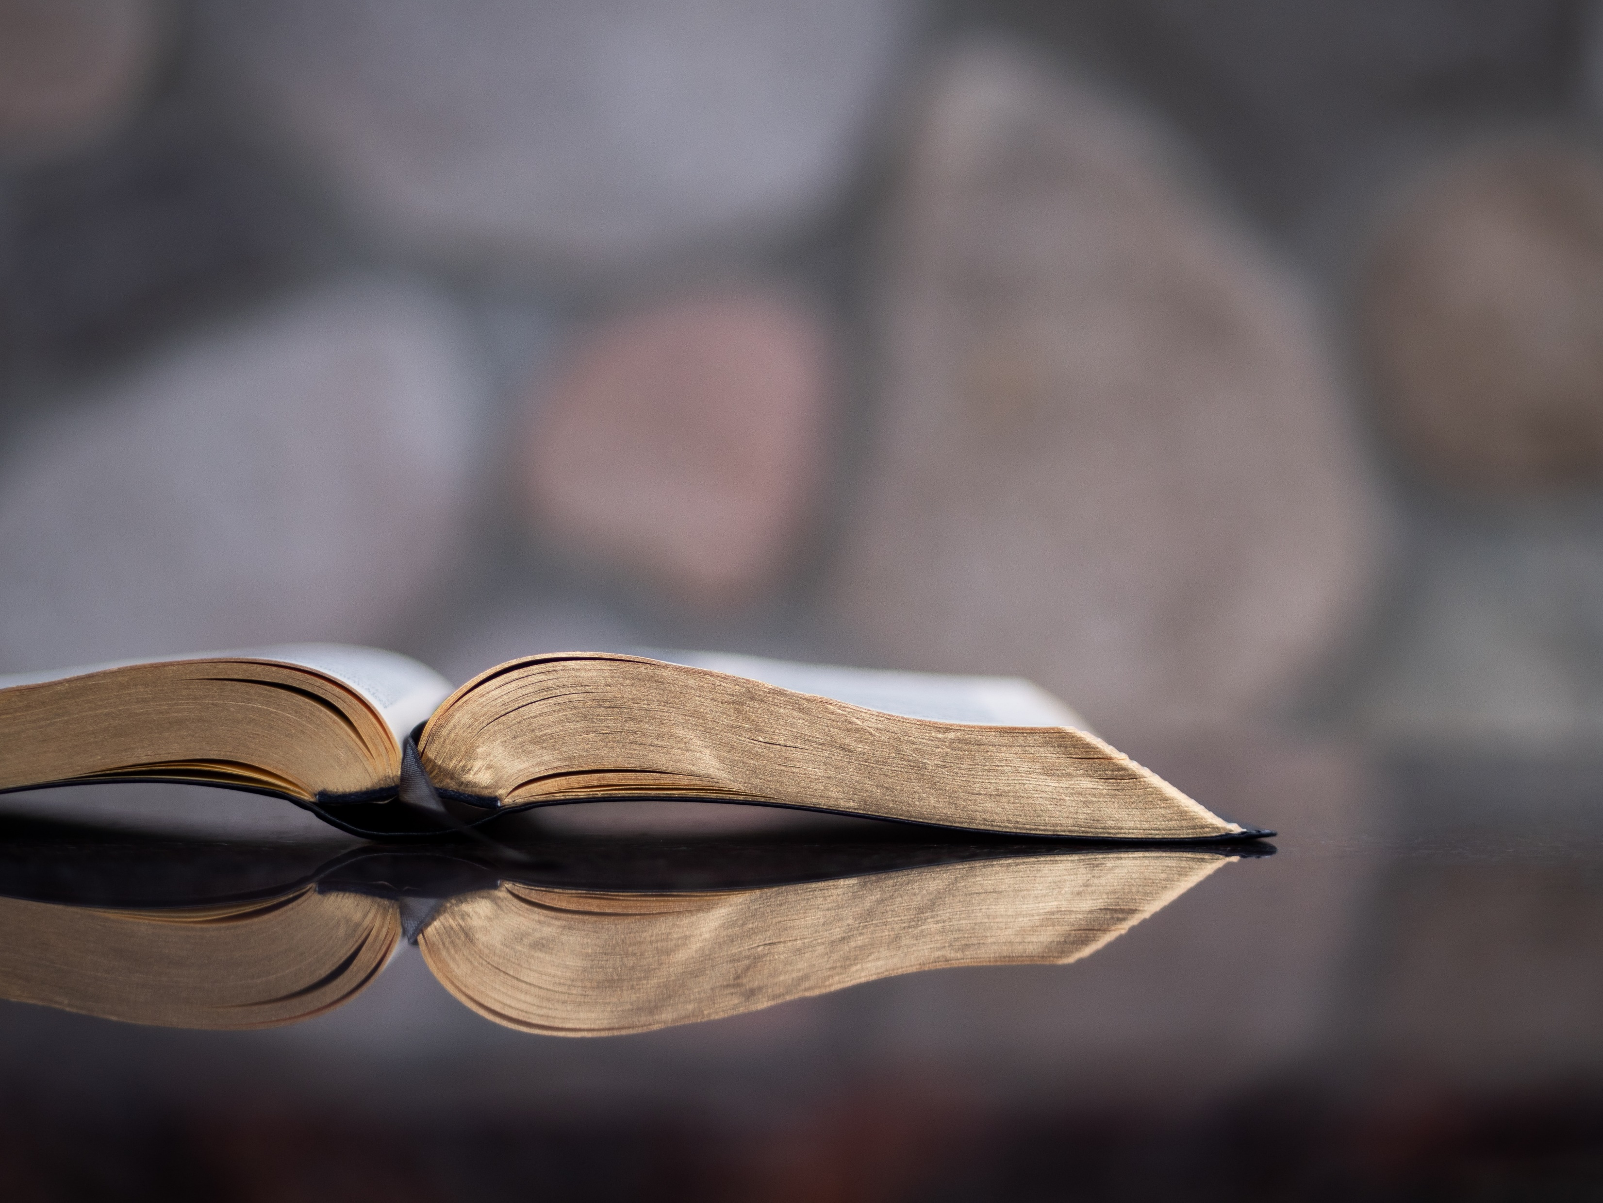
We are waiting for our Lord Jesus Christ to be revealed.
1 Corinthians 1: 7
Notes:
Scripture Reading: 1 Cor 1:3-9
³ Grace to you and peace from God our Father and the Lord Jesus Christ.⁴ I give thanks to my God always for you because of the grace of God that was given you in Christ Jesus, ⁵ that in every way you were enriched in him in all speech and all knowledge— ⁶ even as the testimony about Christ was confirmed among you— ⁷ so that you are not lacking in any gift, as you wait for the revealing of our Lord Jesus Christ, ⁸ who will sustain you to the end, guiltless in the day of our Lord Jesus Christ. ⁹ God is faithful, by whom you were called into the fellowship of his Son, Jesus Christ our Lord.
Photo credit: Aaron Bird, Unsplash

Slide 6
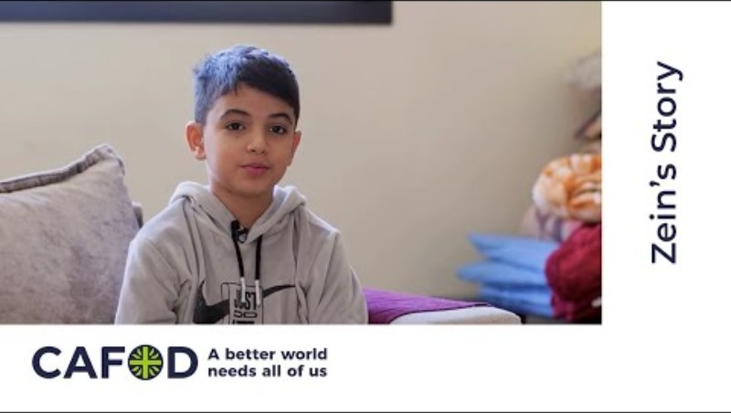
Notes:
Leader: Advent is a journey that we each make, a journey that is often full of the bright lights of distraction – present buying, food shopping, decorating our homes. However, this year we have seen more and more people displaced through war, conflict and natural disasters. We are going to hear from Zein from Lebanon.

Slide 7
Time for silent prayer for all those who have had to leave their homes and flee from war.
Notes:
Suggested music: The Brilliance, Advent Collection.

Slide 8
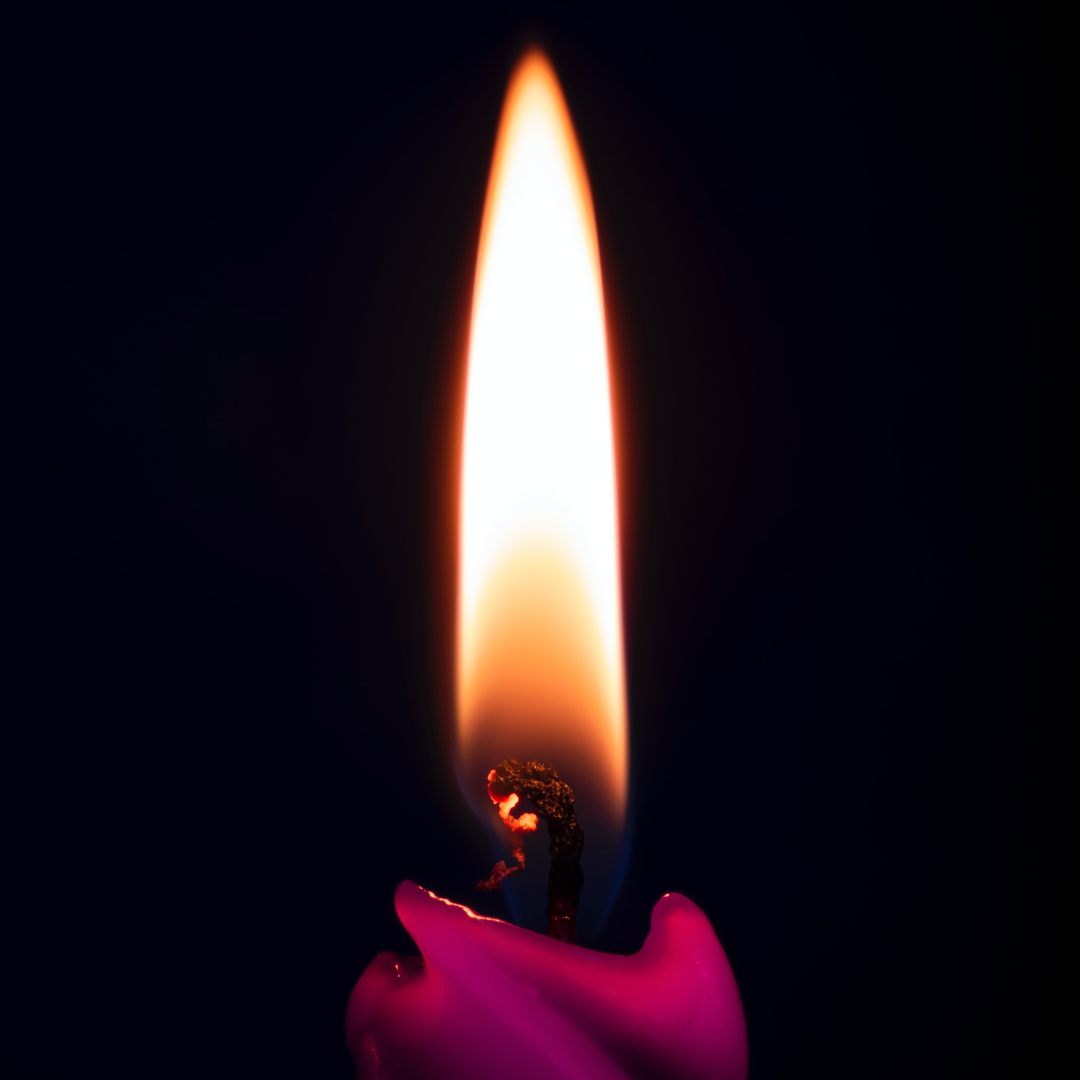
The lighting of the second candle
God of peace
As we prepare to celebrate your birth may we find time to quieten our hearts and our minds in this busy world.
We to look to you, the Prince of Peace.
Your peace informs us.
Your peace soothes us.
Your peace releases us.
Your peace blesses us.
Your peace passes all understanding. It can transform hearts and lives. It has the power to bring healing to communities that are deeply divided. It is a gift to a broken world.
Lord, may we be witnesses to this indescribable peace.
Amen.
Notes:
Leader: (As the second purple candle is lit) As we light the second purple candle we are reminded that our journey to the stable continues. We are still very much in preparation mode with the reminder that we should prepare our hearts and minds as well.
Let us pray together:
All:
God of peace
As we prepare to celebrate your birth may we find time to quieten our hearts and our minds in this busy world.
We to look to you, the Prince of Peace.
Your peace informs us.
Your peace soothes us.
Your peace releases us.
Your peace blesses us.
Your peace passes all understanding. It can transform hearts and lives. It has the power to bring healing to communities that are deeply divided. It is a gift to a broken world.
Lord, may we be witnesses to this indescribable peace.
Amen.
Photo credit: Alexander Fastovets, Unsplash

Slide 9
We are waiting for a new heaven and new earth
2 Peter 3: 8-14
Notes:
Scripture Reading: 2 Pet 3:8-14
⁸ But do not overlook this one fact, beloved, that with the Lord one day is as a thousand years, and a thousand years as one day. ⁹ The Lord is not slow to fulfill his promise as some count slowness, but is patient toward you,^{[a]} not wishing that any should perish, but that all should reach repentance. ¹⁰ But the day of the Lord will come like a thief, and then the heavens will pass away with a roar, and the heavenly bodies^{[b]} will be burned up and dissolved, and the earth and the works that are done on it will be exposed.^{[c]} ¹¹ Since all these things are thus to be dissolved, what sort of people ought you to be in lives of holiness and godliness, ¹² waiting for and hastening the coming of the day of God, because of which the heavens will be set on fire and dissolved, and the heavenly bodies will melt as they burn! ¹³ But according to his promise we are waiting for new heavens and a new earth in which righteousness dwells.¹⁴ Therefore, beloved, since you are waiting for these, be diligent to be found by him without spot or blemish, and at peace
Photo credit: Aaron Bird, Unsplash

Slide 10
Time to pray silently about anything that might be worrying you.
Notes:
Suggested music: The Brilliance, Advent Collection.

Slide 11
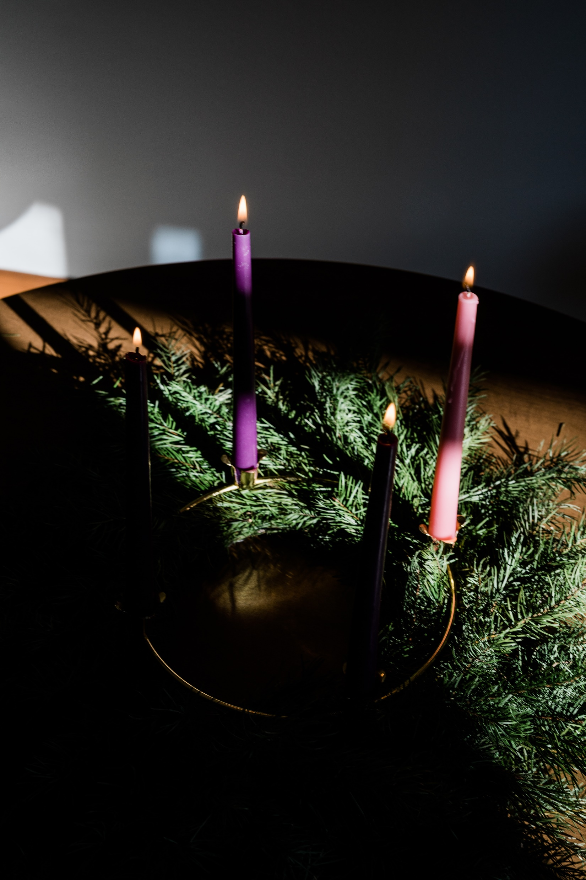
The lighting of the third candle
God of light,
Open our eyes to a new vision
of a kingdom that centres around you.
Your radiant light breaking through the darkness and bringing joy.
Let your light touch all those who walk in darkness at this time. We pray for all those living in conflict and the injustice of poverty.
May they find comfort in your promises. May they find strength in your presence.
May they find direction through your word.
As we wait expectantly for you, O Lord, please heal the divisions of this world as we seek true and lasting peace.
We hold before you all who cry out for peace.
Amen.
Notes:
Leader: (As the third (pink) candle is lit) Let us pray together.
All:
God of light,
Open our eyes to a new vision
of a kingdom that centres around you.
Your radiant light breaking through the darkness.
Let your light touch all those who walk in darkness at this time. We pray for all those living in conflict and the injustice of poverty.
May they find comfort in your word and promises. May they find strength in your presence.
May they find direction through your word.
As we wait expectantly for you, O Lord, please heal the divisions of this world as we seek true and lasting peace.
We name the countries who are experiencing war and conflict.
We hold before you all who cry out for peace.
Amen.
Photo credit: Grant Whitty, Unsplash

Slide 12
He has sent me to bring good news to the poor, he has sent me to bind up the broken-hearted…
Isaiah 6: 1
Notes:
Scripture Reading: Isaiah 61: 1-2a
The Spirit of the Lord God is upon me, because the Lord has anointed me to bring good news to the poor;^{[a]} he has sent me to bind up the brokenhearted, to proclaim liberty to the captives, and the opening of the prison to those who are bound;^{[b]} ² to proclaim the year of the Lord's favor, and the day of vengeance of our God; to comfort all who mourn;
Photo credit: Aaron Bird, Unsplash

Slide 13

This year we have been focusing on being ‘Pilgrims of Hope’.
In silence, everybody is invited to write the ways they have seen hope sparkle this year. You can come up and place your response in the basket as a way of offering it up to God.

Slide 14
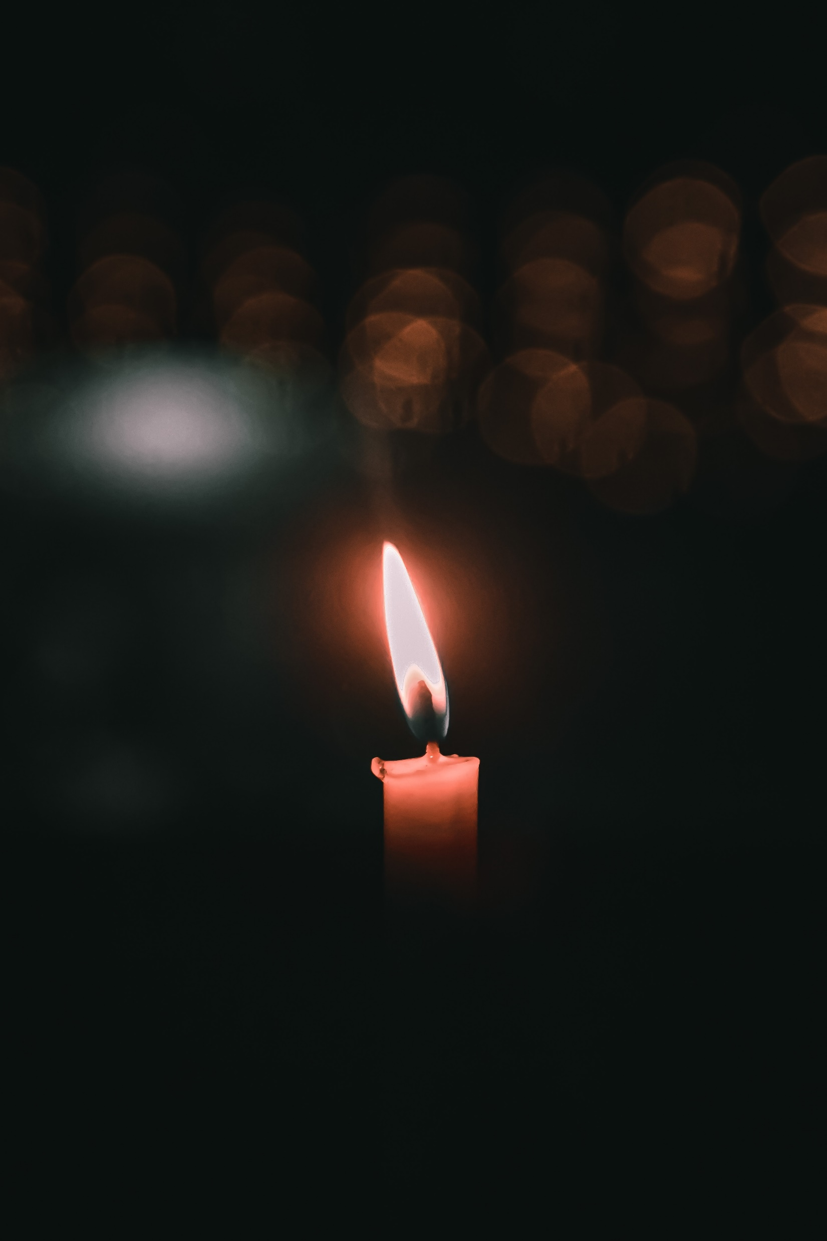
The lighting of the fourth candle
The lighting of the fourth candle
God of love and mercy,
You sent your son to be Emmanuel, God with us, and restored our relationship with you.
Merciful Lord, we pray for the natural world; the areas that are suffering because of our modern lifestyles. We cry out for our common home. May our lives convey the need to stand in solidarity with the whole of creation.
We long for a day when all of creation will be restored. We wait expectantly for you O Lord.
In your mercy, hear our prayer.
Notes:
Leader: (As the first purple candle is lit) Let us pray together:
All:
God of love and mercy,
You sent your son to be Emmanuel, God with us, and restored our relationship with you.
Merciful Lord, we pray for the natural world; the areas that are suffering because of our modern lifestyles. We cry out for our common home. May our lives convey the need to stand in solidarity with the whole of creation.
We long for a day when all of creation will be restored. We wait expectantly for you O Lord.
In your mercy, hear our prayer.

Slide 15
The mystery, which was kept secret for long ages, is now made clear.
Romans 16: 27-28
Notes:
Scripture Reading: Rom 16:25-27
²⁵ Now to him who is able to strengthen you according to my gospel and the preaching of Jesus Christ, according to the revelation of the mystery that was kept secret for long ages ²⁶ but has now been disclosed and through the prophetic writings has been made known to all nations, according to the command of the eternal God, to bring about the obedience of faith— ²⁷ to the only wise God be glory forevermore through Jesus Christ! Amen.
Photo credit: Aaron Bird, Unsplash

Slide 16

Notes:
The light of hope | CAFOD

Slide 17
All: God of light
God of hope
God of peace
God of love
Hear our prayer
Notes:
Leader: Let us say together our closing prayer.
All: God of light
God of hope
God of peace
God of love
Hear our prayer
Leader: We go out, taking with us the light of the world.
All: In the name of the Father, and of the Son, and of the Holy Spirit. Amen

