Slide 1
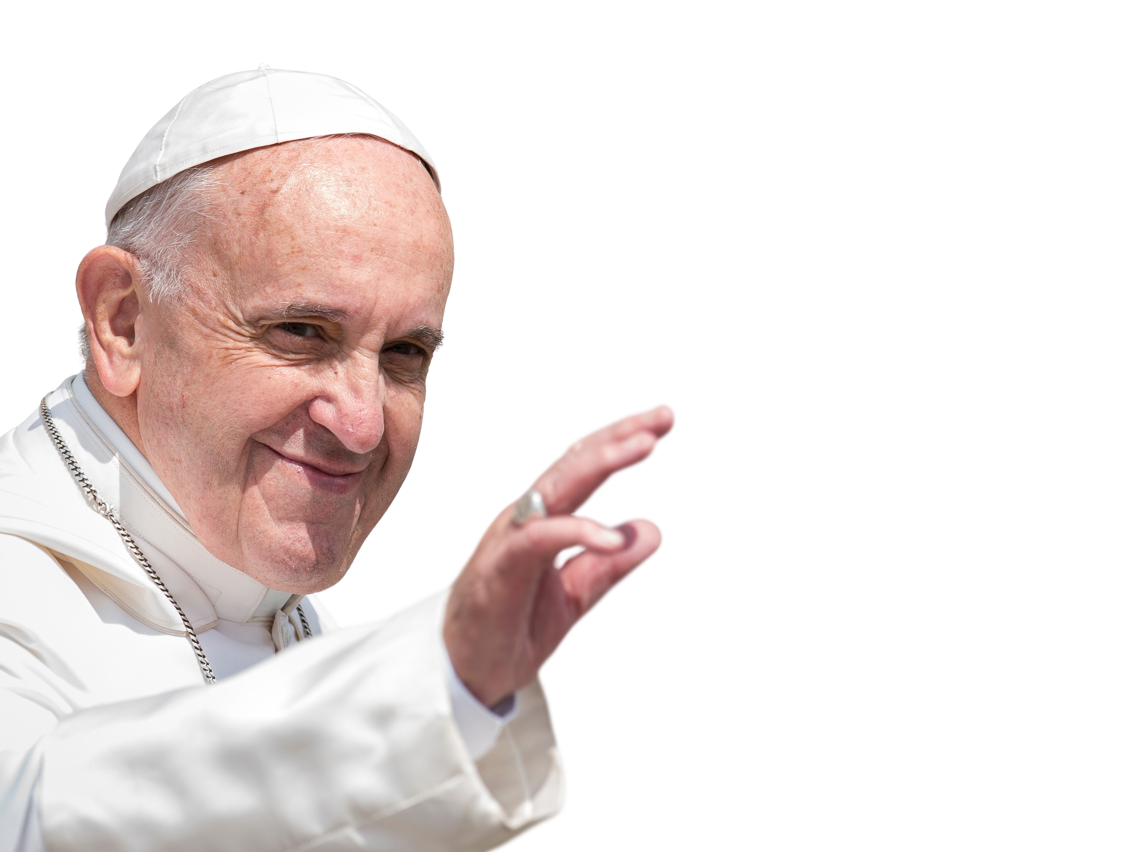
POPE FRANCIS
1936-2025

Slide 2
God in Heaven
We thank you for the gift of Pope Francis and for all the wonderful ways he inspired us to build a better world.
Help us to continue his work by being Pilgrims of Hope, like he was.
May he rest in your peace.
Amen.

Slide 3
POPE FRANCIS
1936-2025
Eternal rest grant upon him, O Lord,
and let perpetual light shine upon him.
May he rest in peace.
Amen.

