Slide 1
EYFS RED poster activities
Branch 1: Creation and Covenant
Notes:
Timings
This presentation has been designed to last for 10-15 minutes. It can be used as a stand-alone lesson or incorporated into a scheme.
Extension
Although this presentation was designed to simply engage pupils in discussion about key RED themes, the sessions can be developed in many ways. Some of the examples are included below:
Give pupils the poster (or a part of it) to discuss and annotate in groups
Provide pupils with their own A4 version of the poster to put in their own RE books (double page spread). This can be labelled in various ways, such as with references to scripture or Laudato Si’
Invite children to draw or list their own additions and suggestions to the poster
Offer children the opportunity to create their own poster, for example through artwork or through drama (creating freeze frames).

Slide 2
Poster themes and key words from RED: KS1
“God saw everything that he had made and, indeed, it was very good.” (Gen 1: 31) What do you love most about God’s world? | “We can all work together to protect the earth, our common home” (Based on Laudato Si’ 13) The world is God’s gift to us. How can we take care of it? | “We can all work together to protect the earth, our common home” (Based on Laudato Si’ 13) The world is God’s gift to us. How can we take care of it?
Creation (God, me, family) Stewardship Dignity (special, loved) | Creation Taking care of God’s world Laudato Si’ Pope Francis | Psalms Stewardship Caring for God’s world
 | U1.1.2, U1.1.3, U1.1.4, U1.1.5, D1.1.1, D1.1.2, R1.1.3, R1.1.4 | U2.1.2, U2.1.3, D2.1.2, R2.1.2, R2.1.2
EYFS | Year 1 | Year 2
CAFOD POSTER
THEMES
RED
FOR
Notes:
Note that the numbers in the RED row refer to the outcomes in the RED. The ones which are most relevant to these CAFOD posters are highlighted in bold.

Slide 3
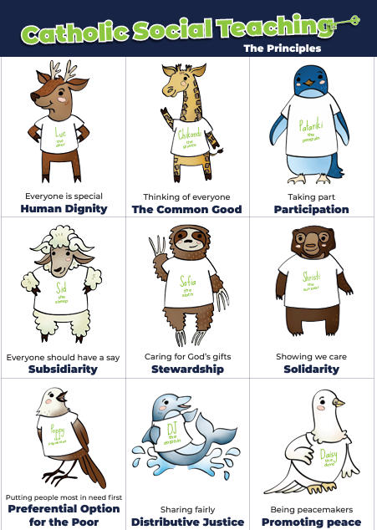
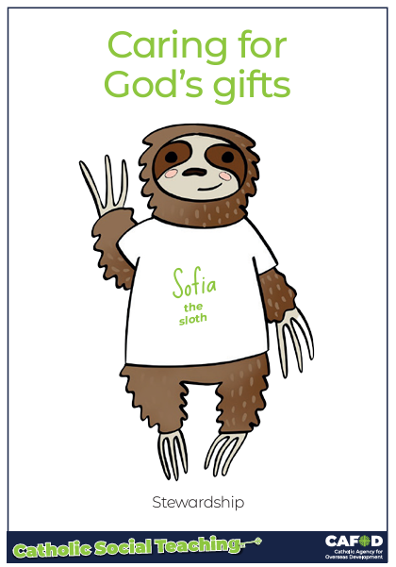
CST: Stewardship
Stewardship
This means:
Caring for all people
Caring for the world
.
Notes:
This gives a brief overview of CST which includes stewardship. These posters support CST and look more closely at stewardship and how we can be better stewards.
Catholic Social Teaching helps us to know how to treat each other and the world. One principle is ‘stewardship’. Sofia the sloth reminds us about Stewardship – it is about caring for God’s gifts.
This means:
Caring for all people
Caring for the world
Making things fair
Sharing with others
Looking after the poor and those in need
For teacher support for embedding CST throughout the school see:
https://cafod.org.uk/education/primary-teaching-resources/cst-pack-for-children

Slide 4
Key words:
God, creation me, family stewardship dignity special, loved
Key questions:
What do you love most about God’s world?
What is good?
Notes:
Explain that you will be looking at this poster. Read through the key words you will be exploring and the key question(s) you will be answering. Ask pupils if they can recognise how this poster links to the words from the Bible they have just heard.

Slide 5
“In the beginning God made the heavens and the earth….God saw everything that he had made and, indeed, it was very good.”
(Gen 1: 31)
Genesis 1: 31
Notes:
Read this piece of scripture before discussing the posters.
Optional: light a candle, play some gentle music and invite pupils to reflect on these words of scripture and what they mean. Read them from the Bible to demonstrate its importance and tell pupils that these words come from Genesis, the first book of the Bible.

Slide 6
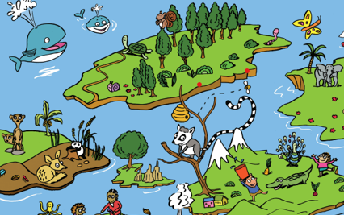
I wonder… what did God create? Use the poster to help you…
Notes:
Look at the poster – Ask pupils:
What did God make? (pupils might mention things from the poster like a lion, raccoon, squirrel, turtle, octopus, whale… or trees, plants, mountains and seas)
Can you think of anything else he made that was not on the poster?
Let’s see if it is on the next one…

Slide 7
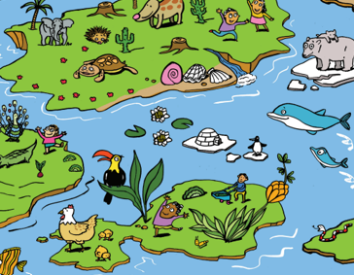
What else can you see that God created?
Could anything else be added to the pictures?
Notes:
Ask pupils:
Who/what might you add to the pictures? (For example: you, your family, friends, your pets, …)
Why do you think God was happy with what he made? (There are beautiful, interesting, fun, special things)
How can you do good things and show love?

Slide 8
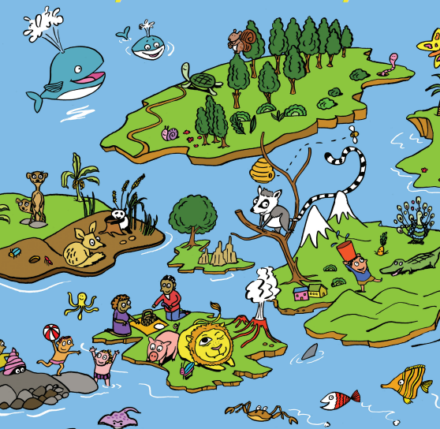
Tell others about the people in the picture. What are they doing? Why are they loved and special? Human dignity
Notes:
Discuss what makes us special and different from everyone else God created. Highlight some of the differences of pupils in the class and how they are special.
Emphasise that we are loved and special because God made us. It doesn’t matter how what we can do or cannot do, or how tall or small we are… God loves each of us more than we can imagine.
Discuss how we we look after and love each other as God loves us (we can take care of them if they fall, we can invite them to play in our games….)
Ask pupils how they can make sure others feel loved and special (answers will vary)

Slide 9
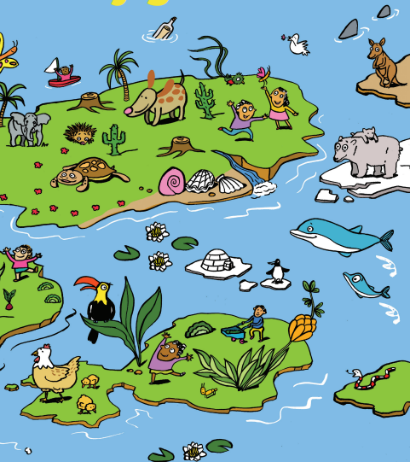
Tell others about the animals and plants. What are they doing? Why are they important?
Notes:
Discuss the animals and the plants and how we need them and they need us. We are all connected.
Every person, animal and plant has a very special job to do, even the tiniest of creatures like bees…
The world would not be the same without any of us. We are all special to God.
Ask: What special job can you do (at home, in the class…)

Slide 10
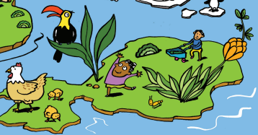
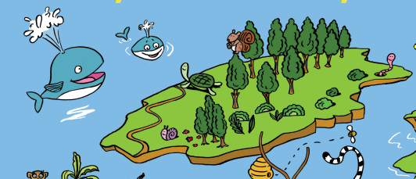
I wonder… how can we take care of our world?
Stewardship
Notes:
Discuss how we can take care of other people, animals and plants.
Explain that stewardship is a big word for taking care of the world so that it stays healthy and special.

Slide 11
Key words:
God, creation me, family stewardship dignity special, loved
Key questions:
What do you love most about God’s world?
What is good?
Notes:
Review the learning. Can you answer these key questions? Can you understand and use these key words?
What have you learned today or how have you grown and developed?

Slide 12
Thank you, God our father,
For making the world.
Thank you for
all the good things
and everything we love.
Help us to take care of
the world and other people.
Amen
Notes:
Optional: You may wish to say this prayer at the end of the lesson

Slide 13
Here are some more resources to follow up this lesson

Slide 14
Further resources
Whole school resources
CST pack and animation for children
Laudato Si poster and animation
What is CAFOD? Film for children

