Slide 1
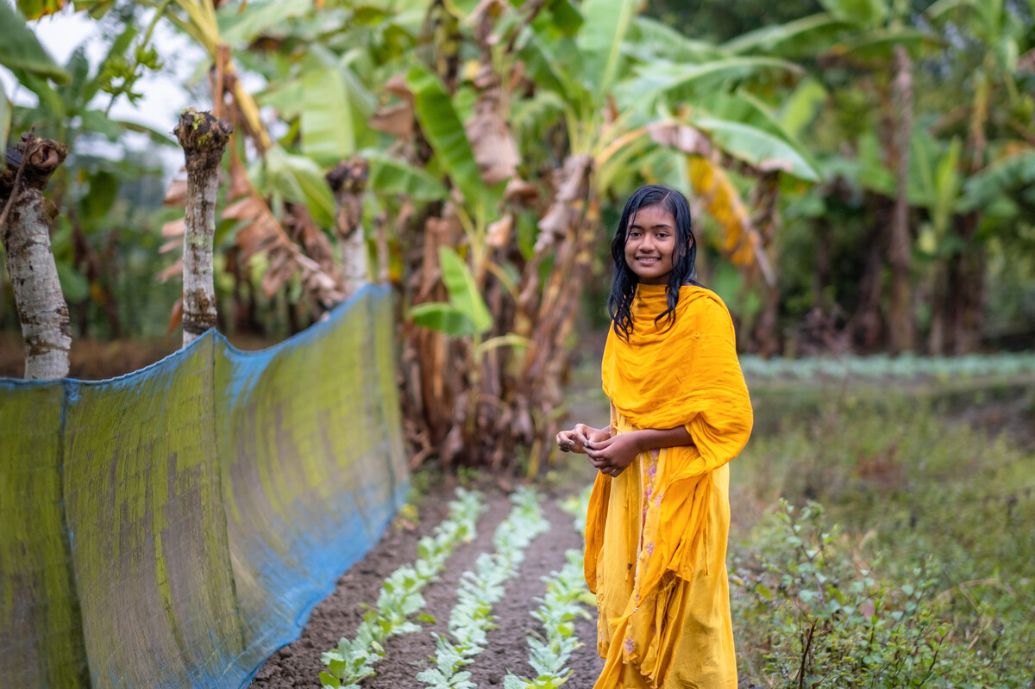
Stewardship
Exploring CST principles in CAFOD’s work
Notes:
Photo credit: Amit Rudro

Slide 2
Stewardship means we believe in
caring for
God’s gifts.

Slide 3
"God saw everything that he had made, and indeed, it was very good."
Genesis 1:31

Slide 4
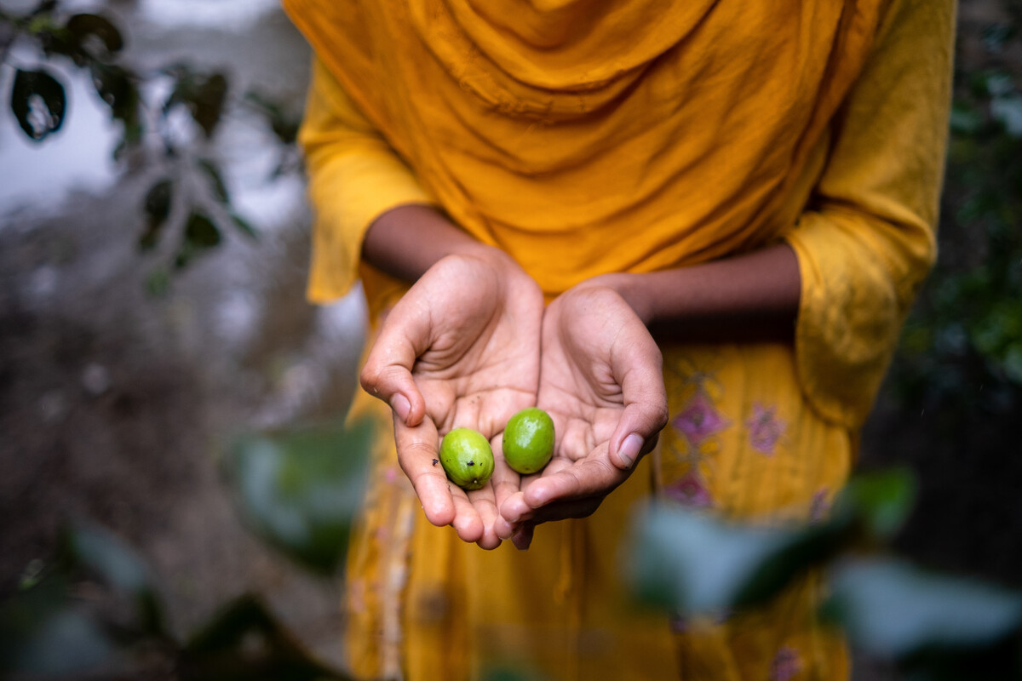
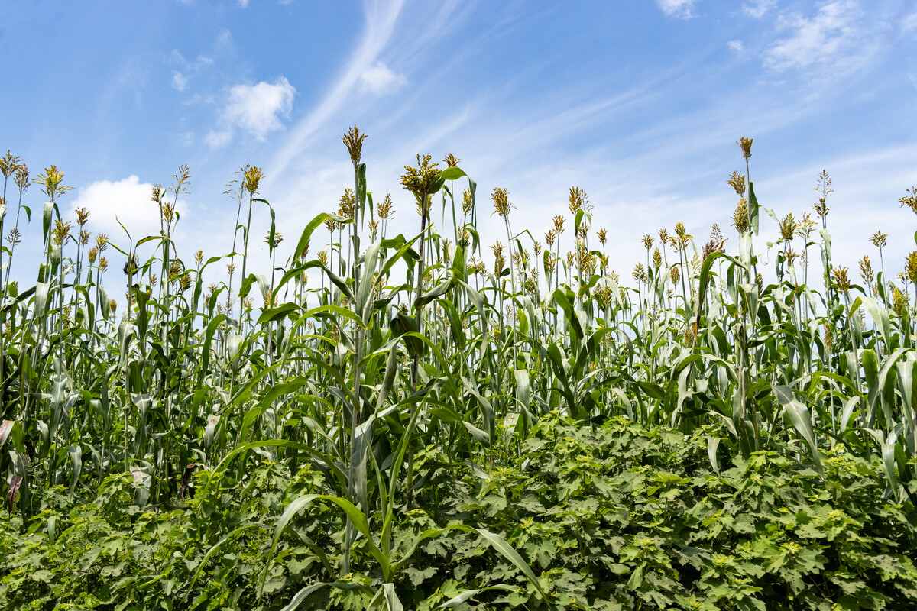
Stewardship
We are guardians of God's creation. We must do our best to take care of the planet and all the people who live on it.
Notes:
Photo credits: Amit Rudro and Achuoth Deng

Slide 5
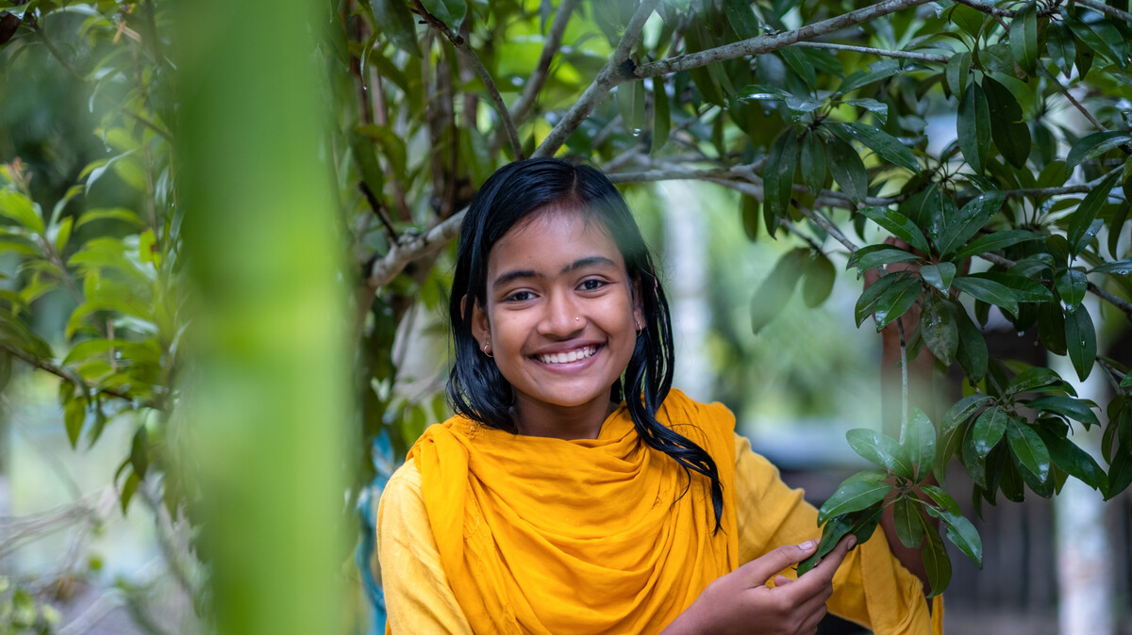
This is Dristy. She lives in Bangladesh.
Dristy loves being in her garden.
"My favourite thing is lychee fruit. I like bananas too. I am used to eating food from my garden. I love it because it is so fresh!"
Notes:
Photo credit: Amit Rudro

Slide 6
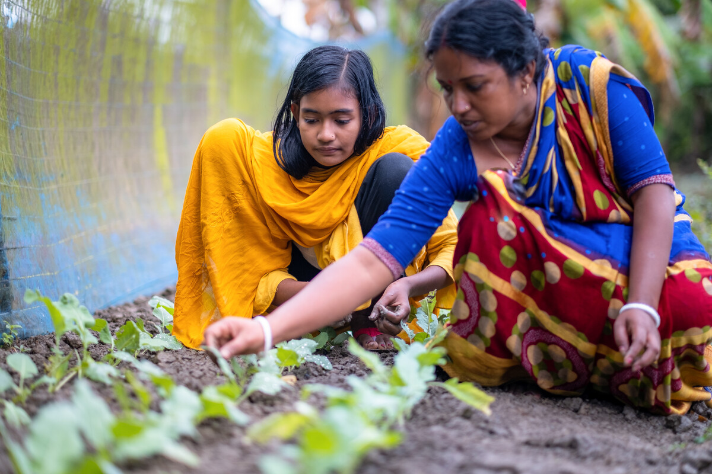
With CAFOD's help, Dristy's mum, Rupali, can now show her how to plant different crops to protect them from cyclones caused by climate change.
Dristy and Rupali show their friends and neighbours too.
Notes:
Photo credit: Amit Rudro

Slide 7
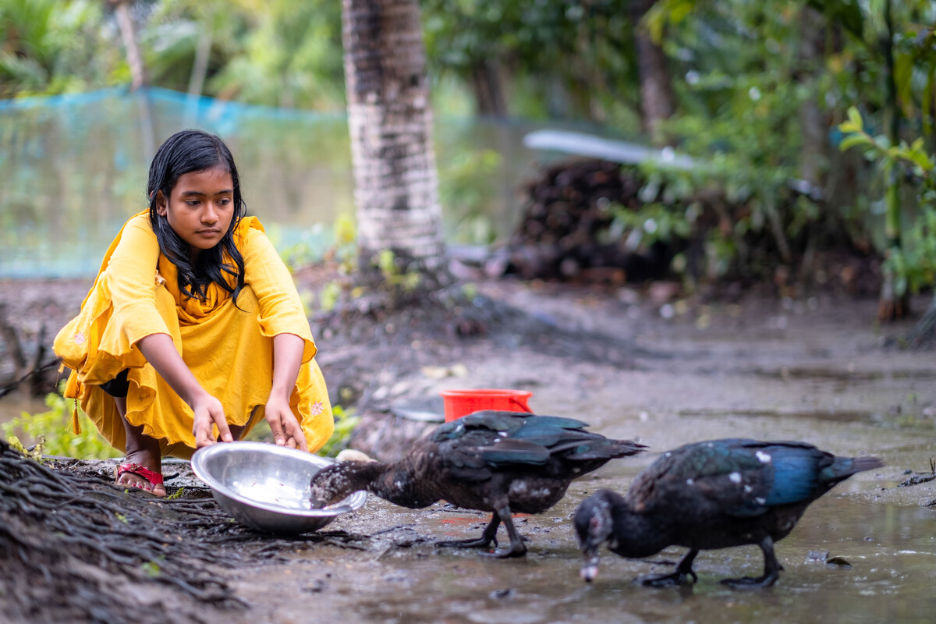
Dristy understands that all living things are connected.
We must use God’s gifts carefully, so everyone has what they need to live - now and in the future.
"This is the best way to protect our environment," says Dristy.
Notes:
Photo credit: Amrit Rudro

Slide 8
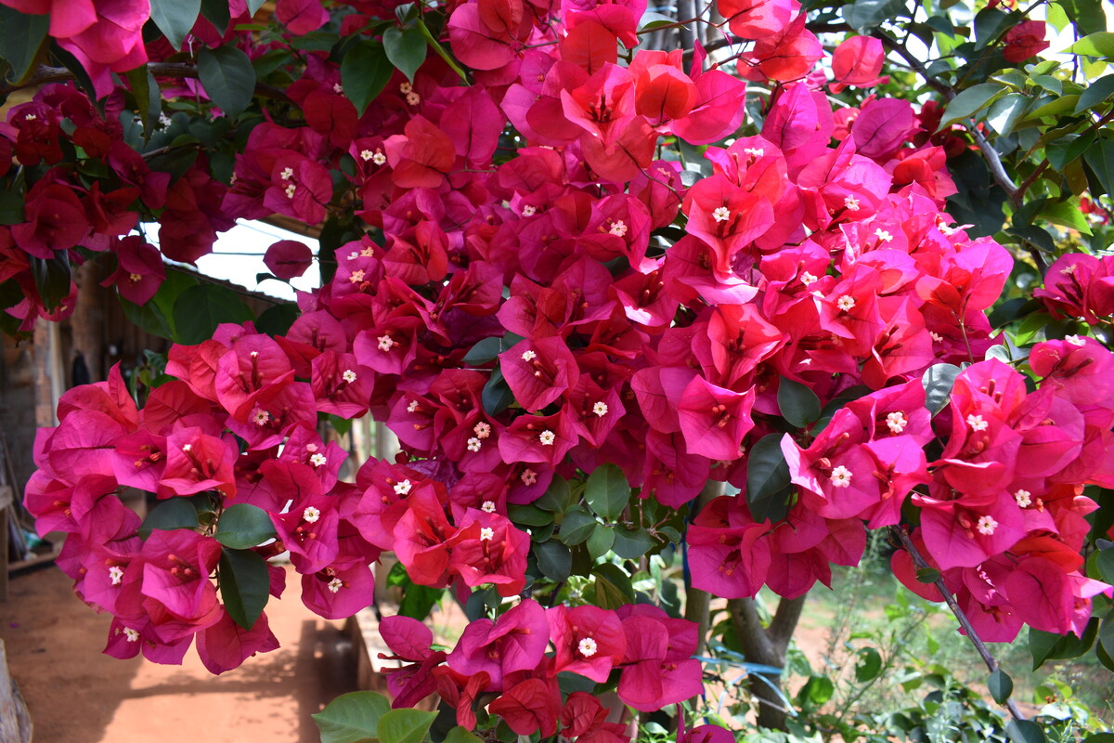
"The climate is a common good, belonging to all and meant for all."
Pope Francis,
Laudato Si’,23
Notes:
Photo credit: Kezia Lavan

Slide 9
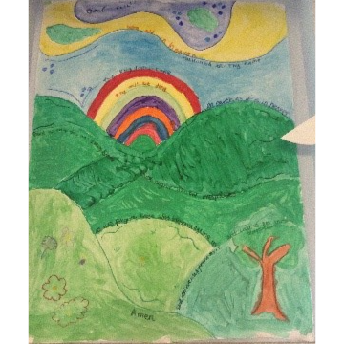
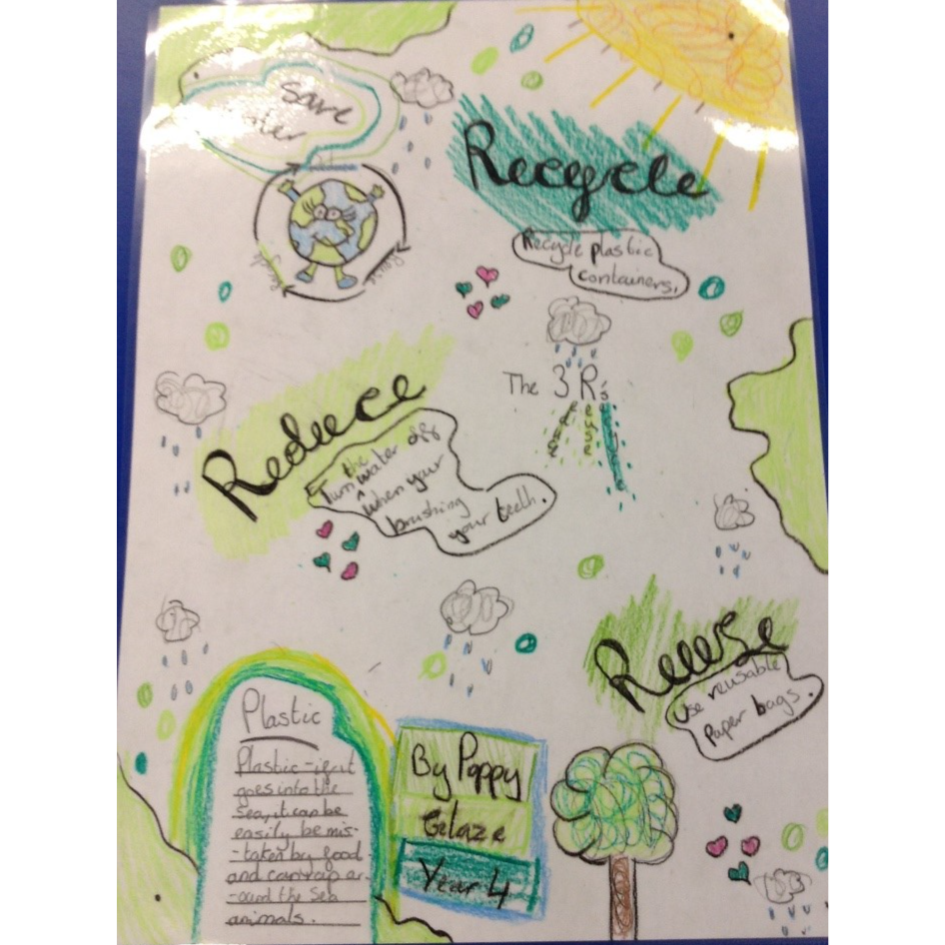
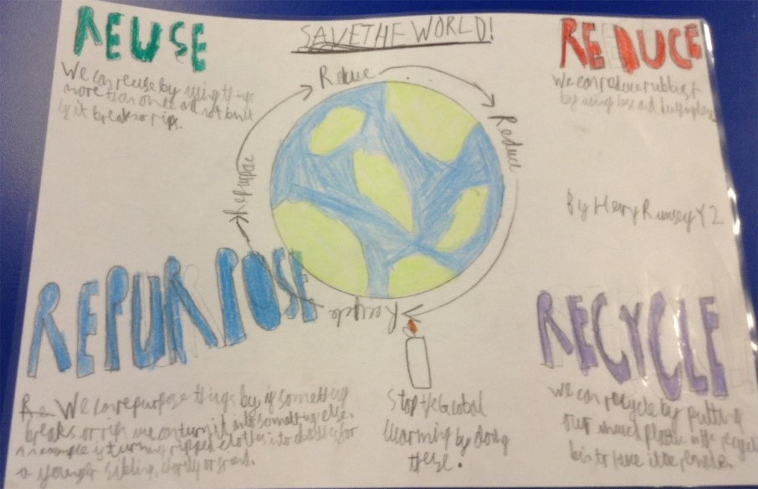
Caring for God's gifts
As part of their LiveSimply Award journey, children at St Patrick’s Primary School in Wigan made individual pledges about looking after the world.
Posters remind classmates to reduce, reuse, repurpose and recycle. Children also showed off their artistic talents in the 'Caring for God's World' art competition.
Notes:
Photo credits: St Patrick’s Primary School in Wigan

Slide 10
Let us pray
Loving God,
We believe that the world is for everyone.
We thank you for the gift of Creation.
Help us to take care of the planet and all people who live on it.
Lord in your mercy
Hear our prayer
Caring for God’s gifts
Stewardship
Notes:
Photo credit: Amit Rudro

Slide 11
Caring for God’s gifts
Sofia the sloth reminds us that Stewardship is caring for God's gifts, just like Dristy is doing.
How can we care for God's gifts?

