Slide 1
Become the LEADER we NEED
Notes:
Hello!! This slide deck was designed so that whoever is using it can “choose their own adventure”. There is probably more than you need so please review each slide and use what is helpful to cater to the audience you want to use it with. If anything is missing or unclear – please contact us at scholars@bezosfamilyfoundation.org. Many commonly asked questions are covered in the Frequently Asked Questions section of the website: https://www.bezosscholars.org/faq/. Thank you so much for your help in promoting this opportunity!
Potential talking points:
Join me for a short, five-minute presentation about an incredible leadership opportunity open to students that are juniors and a staff person from their school that they nominate as their educator to participate along side them.
This presentation will cover what the program is, why someone should apply and what they will get out of participating, who is eligible, how to apply, and what the application entails.

Slide 2
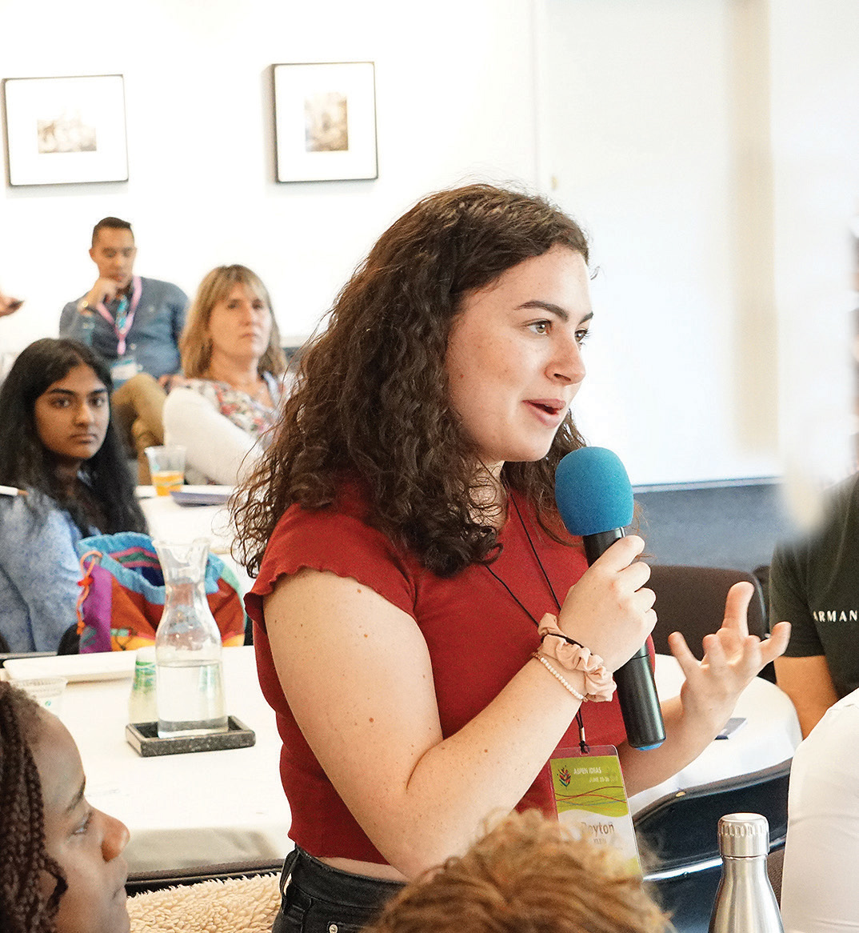
Program At-a-Glance
There’s no experience like the Bezos Scholars Program—a transformative, year-long, no-cost leadership development program.
Scholars receive leadership training from noted experts along with free college advising.
At the center of the program are community change projects—fresh approaches to solving urgent problems, conceived and launched by student-led teams with our support.
12 Scholars are chosen from public schools across the U.S. and 5 from the African Leadership Academy in Johannesburg, South Africa, along with an educator from each school.
Are You a Leader in Your Community?
Notes:
Potential talking points:
Program goal is to amplify youth voice and action.
Participating in the program does not cost anything for the student or educator - all costs associated with the program, and the trip, are covered.
Community Change projects have been developed by students that focus on relevant, tangible needs in their communities such as:
Mental health
Environmental justice
Food insecurity
Diversity, equity, and inclusion
Literacy
Access to STEM opportunities
Anything else you could dream up that is important to young people and impacting the people, places, animals, and things they care about.

Slide 3
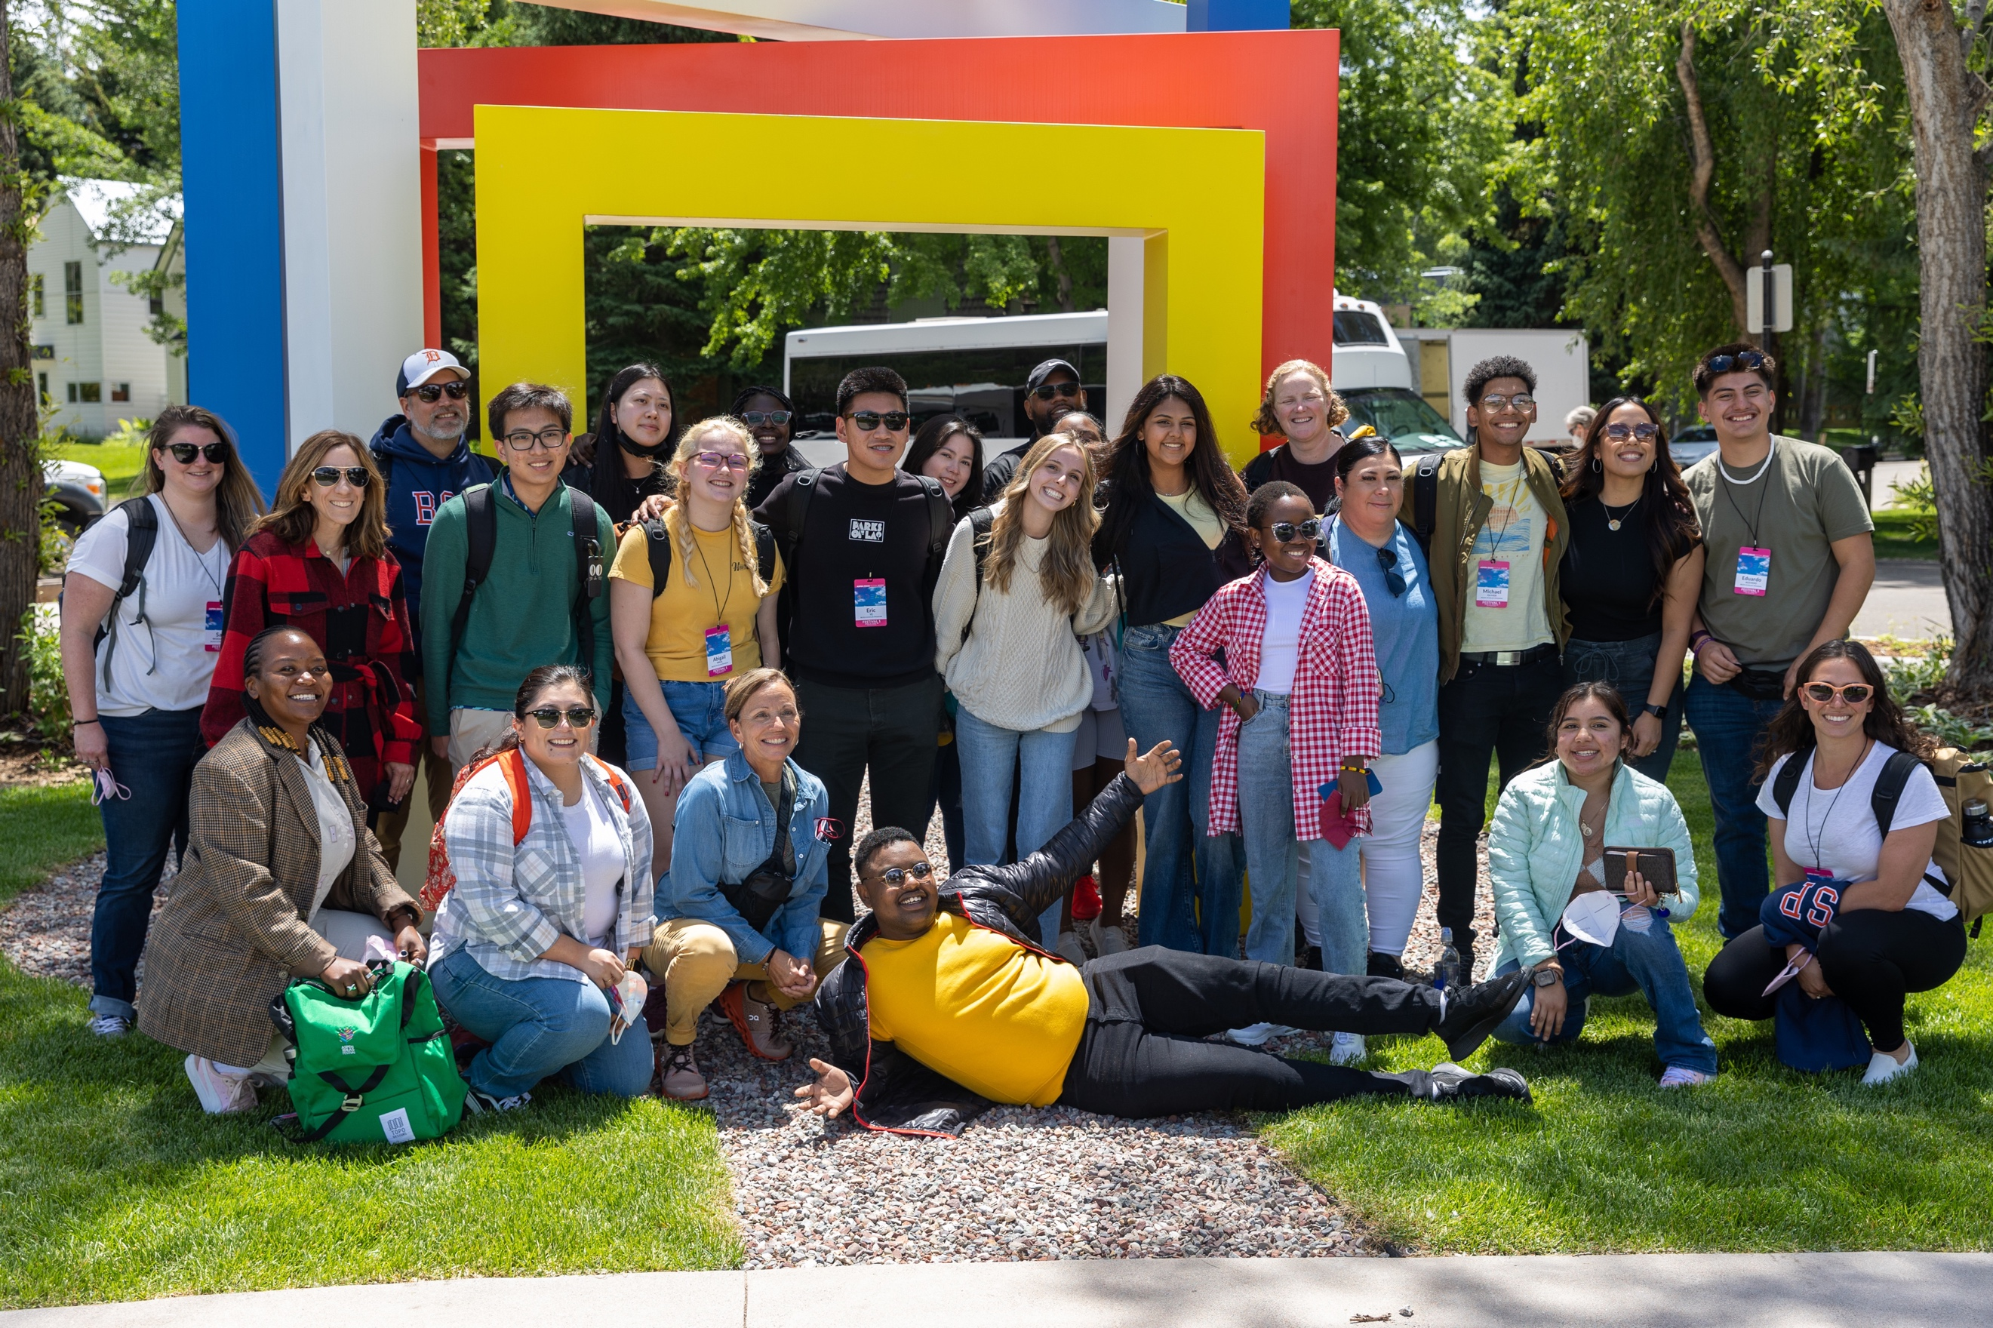
Why Apply?
Form lasting friendships across the U.S. and Africa.
Experience an all-expenses-paid trip to Aspen, Colorado to attend the Aspen Ideas Festival.
Engage in 45+ hours of virtual leadership skill-building sessions.
Participate in coaching with Bezos Scholar staff to support your leadership journey.
Receive FREE personalized College Advising for an entire year.
Earn $1,000 in financial support to launch a Community Change Project.
“The BSP experience is hands down one of the best programs I have been a part of. It helped me fine tune my organizational skills as a leader, educator, coach, and mentor.”
—Educator Scholar Alumni
Notes:
Optional talking points:
The staff person from the student's school that is nominated as their educator also goes on the trip with the student and participates along side them throughout the year long program.
There is absolutely no cost to participate in the program or go on the trip for the student or educator.
The trip to Aspen takes place at the end of June, for 7 days from June 25 – July 1. If it is safe to travel at that time, no exceptions to late arrival or early departure can be made.
Projects created by students are designed to be sustainable and carried on by new student leaders after they graduate from high school. That is why we invest in funding the project for up to three years.
Due to the uncertainty of COVID-19 and with safety being their utmost priority, the Scholars trip to Aspen may not be determined until closer to the departure date. If it is not safe to travel, they will still host a 2021 cohort and offer engaging virtual programming for Scholars during the week that we intended to be in Aspen.
College advising and online tutoring is completely free and catered to each students needs.
There are tons of unique, amazing opportunities catered for the alumni network with partners from the Bezos Family Foundation.

Slide 4
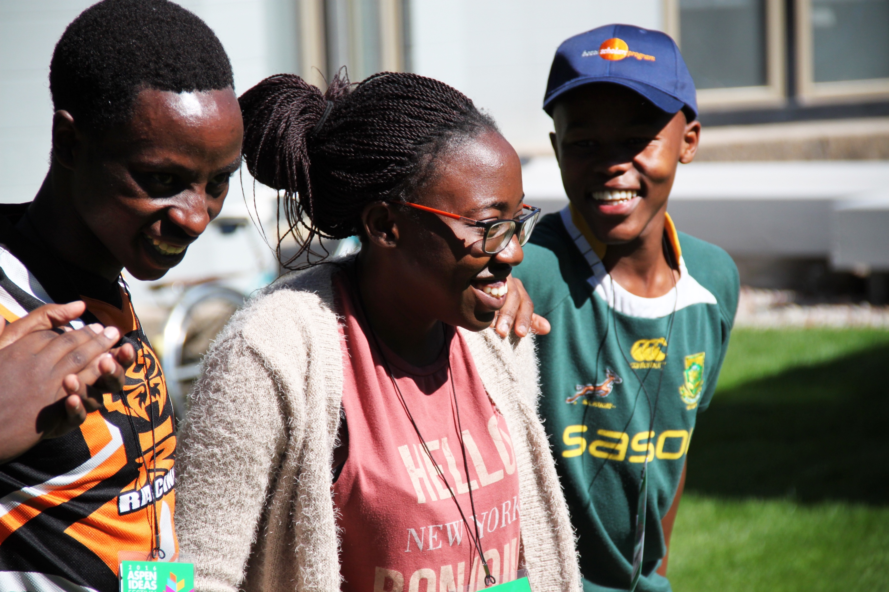
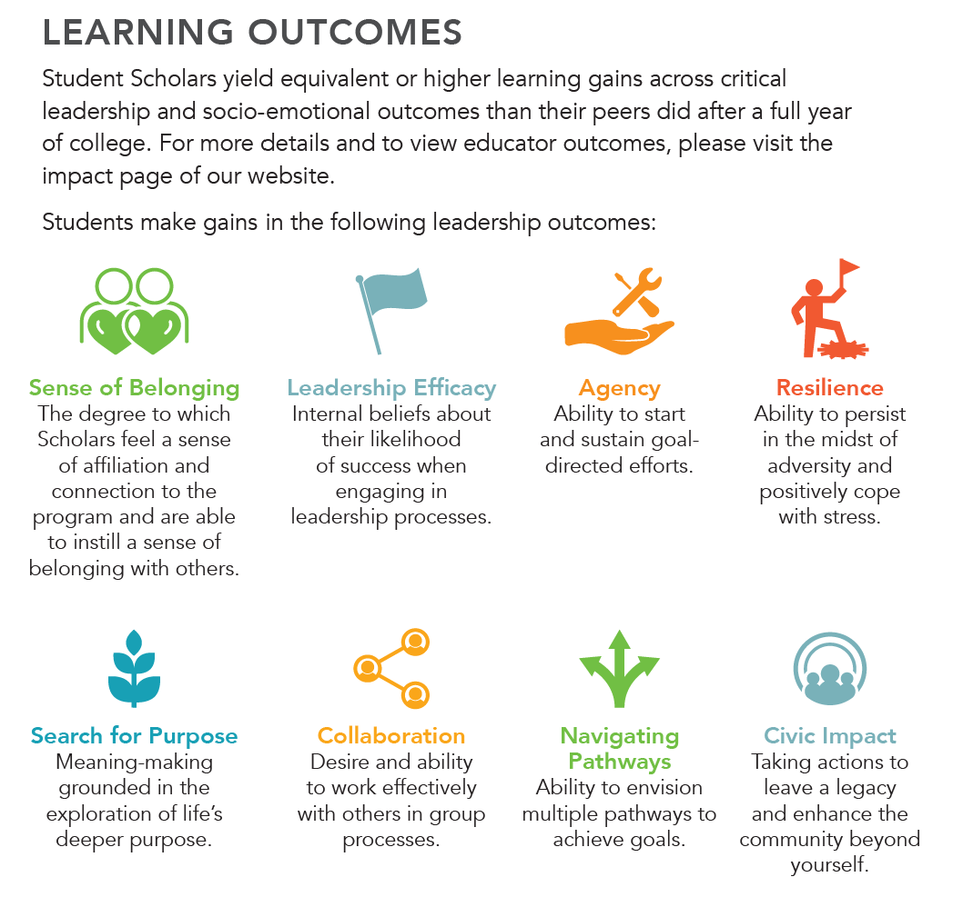
Turn your Passion into Action
Notes:
For Educator Scholars, a majority report that the year-long program becomes a memorable and meaningful experience that deepens and/or reignites their passion and commitment to their field. In their role as mentors, advocates, and allies to Student Scholars. Go to https://www.bezosscholars.org/explore/impact/ to see what learning outcomes we aim Educator Scholars to make meaningful gains in that are connected to the student learning outcomes.

Slide 5
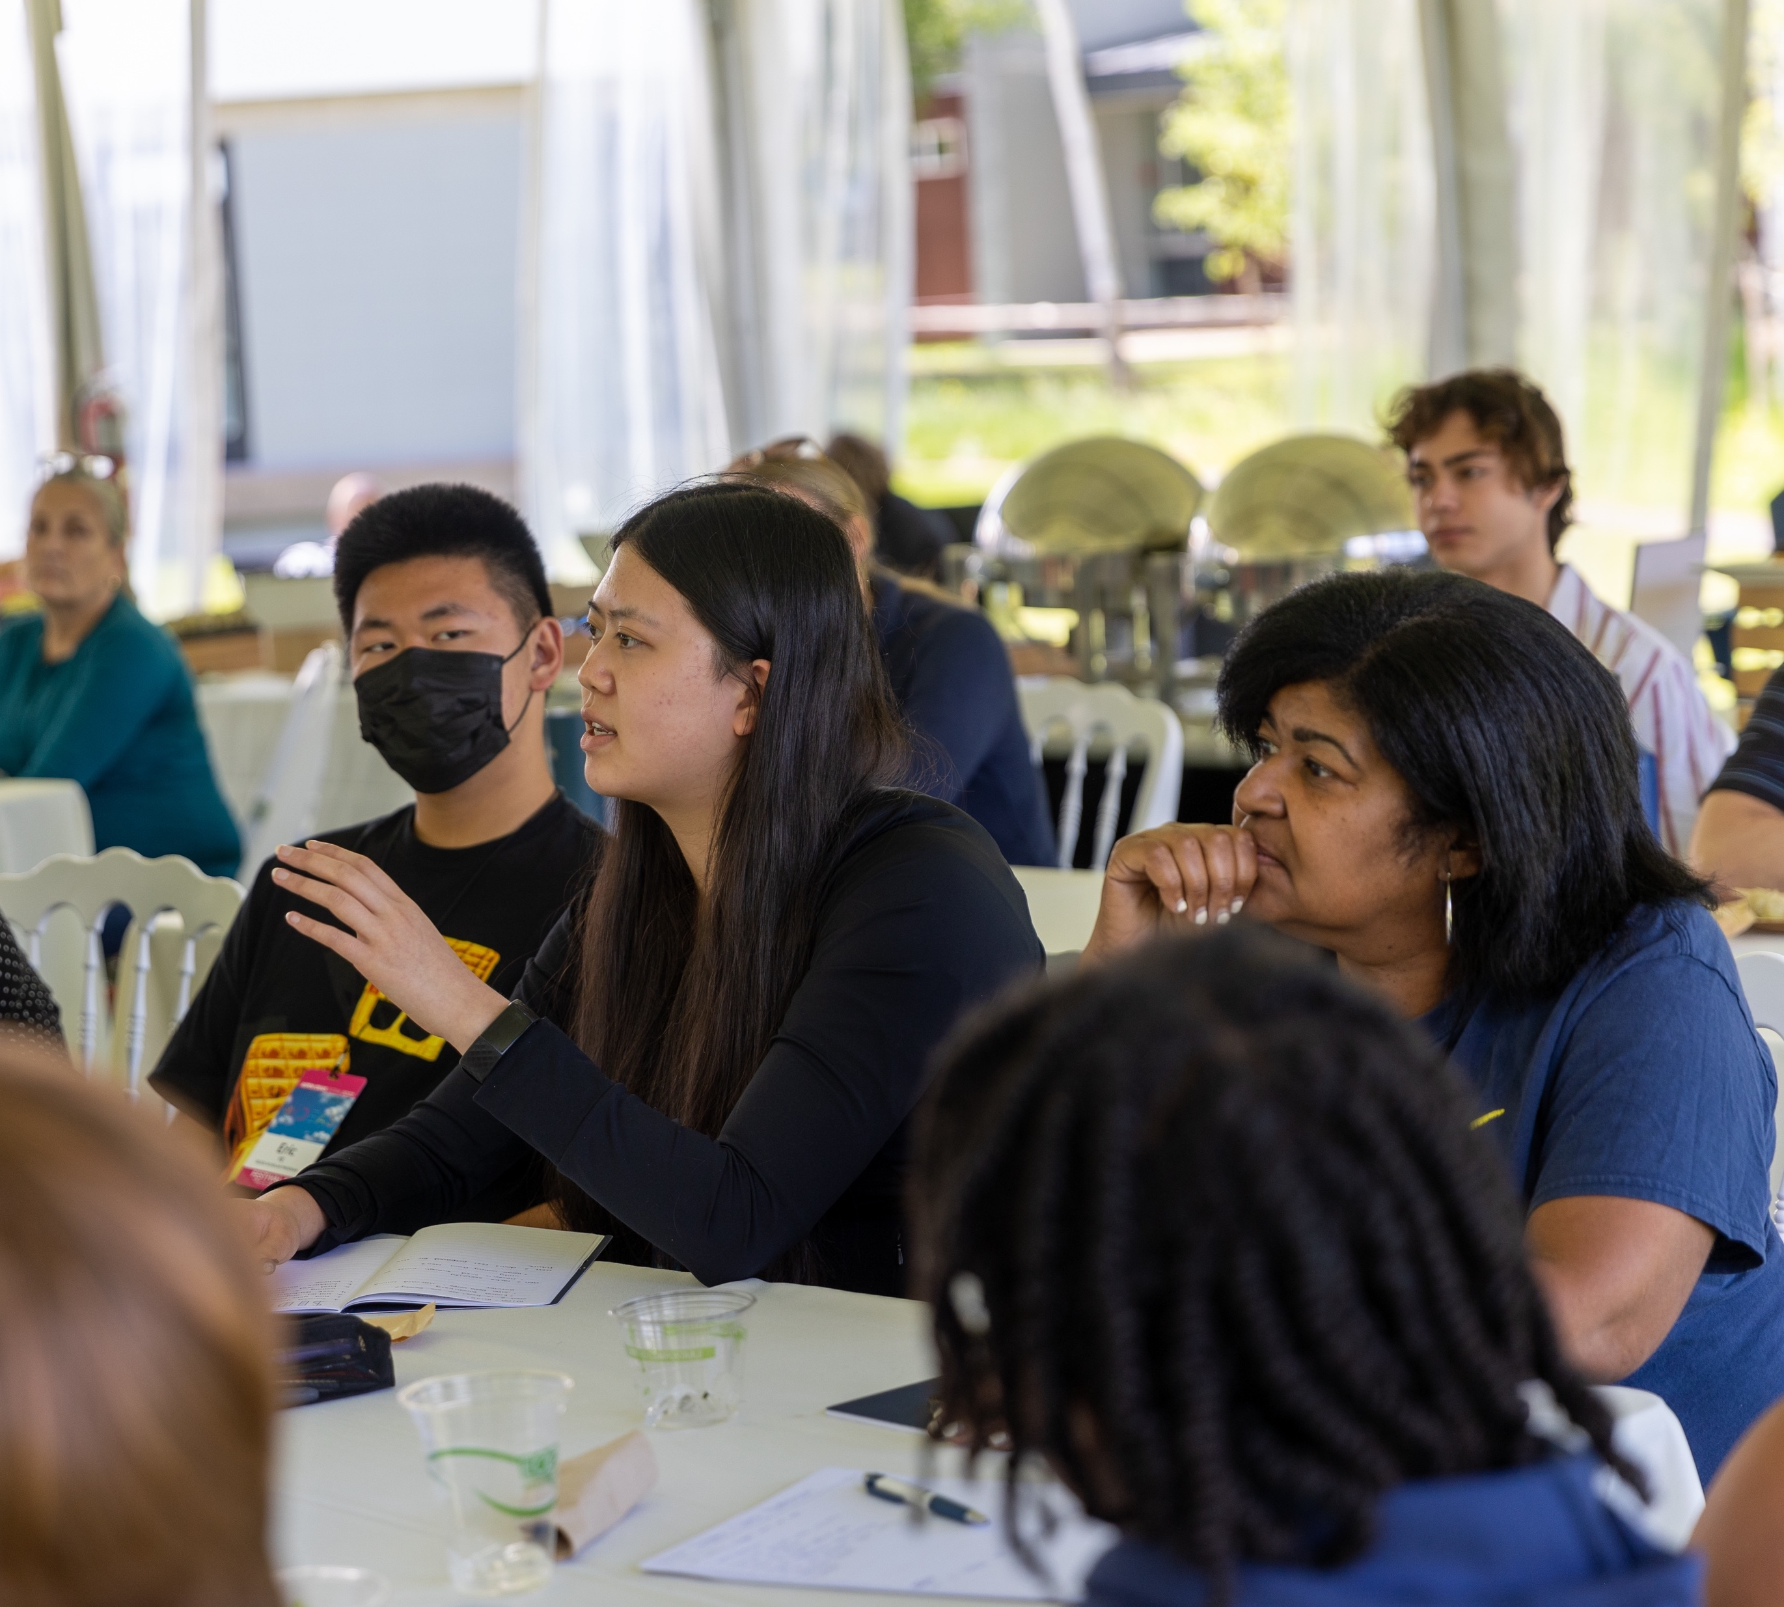
Who are Bezos Scholars?
Scholars are passionate and curious young people who are rising leaders in their schools and communities.
Scholars are as diverse as their interest’s. We aim to build a cohort of Scholars that represents the diversity of lived experiences reflected across the United States and Africa.
“I am so grateful to have embarked on this leadership journey. I developed new friendships while improving my problem- solving and team-building skills. It has been a transformational, humanizing, one-of-a-kind experience.”
—Student Scholar Alumni

Slide 6
Eligibility Criteria To be considered, U.S. students must:
Attend an eligible* public high school that currently has a 30% or greater overall free and reduced lunch rate.
Be a junior at the time they are applying to the program.
Be enrolled in or have taken during their high school career, one or more honors, Advanced Placement (AP), International Baccalaureate (IB), or college-level course.
Be a U.S. citizen, permanent resident, or have received DACA status.
Be available to fully participate in the year-long program and attend all dates for the Aspen Ideas Festival trip in Aspen, Colorado, June 22-28, 2024.
Nominate an educator, a willing and supportive adult from their school to serve as a mentor, who will fully participate in the program with them.
* To encourage equity of opportunity, students attending schools who’ve had a Scholar selected in 2022 or 2023 are not eligible to apply. For a full list of current ineligible schools, visit https://www.bezosscholars.org/apply
Notes:
Potential talking points:
Individual students do not need to qualify for free and reduced lunch to be eligible to apply.
A full list of current ineligible schools is listed on the website at www.bezosscholars.org/faq/#application. If you are promoting directly to a school, the list is below for you to double check:
Amundsen High School in Chicago, IL
ASU Preparatory Academy: South Phoenix High School in Phoenix, AZ
Benjamin Franklin High School in New Orleans, LA
C. E. Byrd High School in Shreveport, LA
Charlottesville High School in Charlottesville, VA
Colton High School in Colton, CA
Gahr High School in Cerritos, CA
Glen A. Wilson High School in Hacienda Heights, CA
Gonzales High School in Gonzales, CA
Granada Hills Charter High School in Granada Hills, CA
Harlingen School of Health Professions in Harlingen, TX
Harrisburg High School- SciTech Campus in Harrisburg, PA
Hawthorne Math & Science Academy in Hawthorne, CA
Ideate High Academy in San Diego, CA
James Hillhouse High School in New Haven, CT
Kokomo High School in Kokomo, IL
LaFayette High School in LaFayette, AL
Livingston Collegiate Academy in New Orleans, LA
Noble High School in North Berwick, ME
Piedmont Classical High School in Browns Summit, NC
Pomeroy High School in Pomeroy, WA
Taylor Allderdice High School in Pittsburgh, PA
West High School in Salt Lake City, UT
West Valley High School in Cottonwood, CA

Slide 7
Educator Nominee
Students are required to nominate a trusted adult from their school to fully participate in the year-long program. Educators travel to Aspen with their student and mentor student leaders as they launch a Community Change Project.
Who is eligible?
A current school staff member OR staff member of a community organization that partners with your school.
What makes a strong nominee?
Understand program expectations and have the capacity to take on additional commitments.
Have built trust and a good relationship with their student nominee.
Love their school and community and are invested in helping students take action to make change for the greater good.
Are strong student advocates, allies and mentors
Are invested in their own growth and recognize they know a lot—and still have a lot to learn.
Notes:
Go to www.bezosscholars.org/faq/#general to review commonly asked questions from potential educator nominee’s and their students.

Slide 8
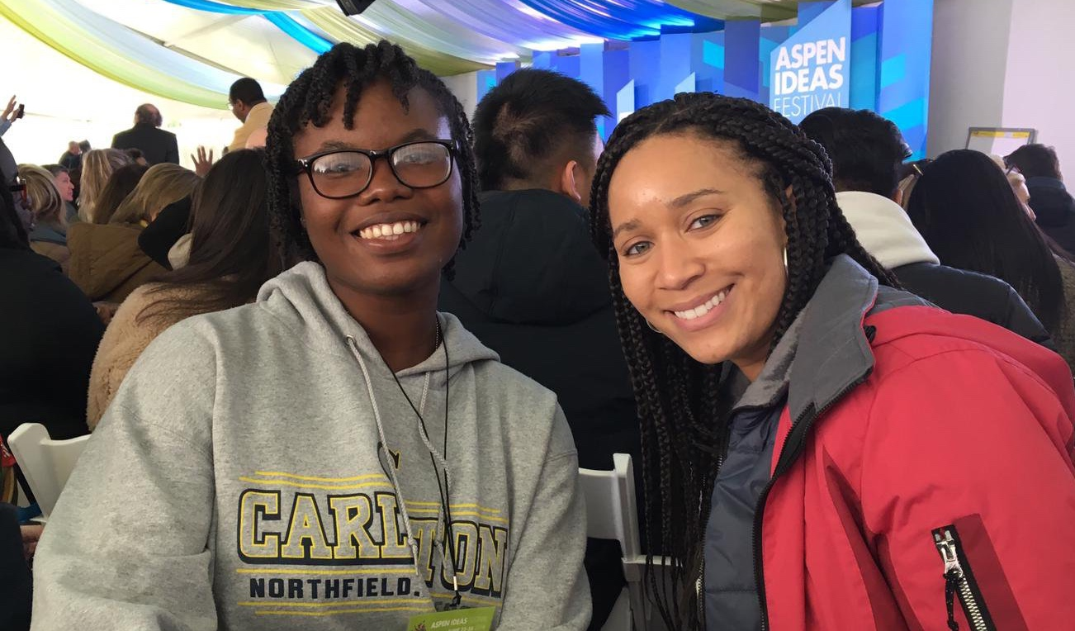
Student & Educator Commitment
From May of the student’s junior year to May of their senior year, Scholar commitment generally entails:
Participate in up to two, virtual 2.5-hour workshops per month on Saturdays along with monthly activities, team meetings and assignments.
Explore and engage with your cohort in Aspen, Colorado, for a full week at the end of June.
Engage diverse community stakeholders to gather insight and input on community issues and specific needs stemming from those issues to inform Community Change Project topic.
From your community, build a diverse and talented team of students and adult supporters, practicing shared leadership to successfully develop and launch a sustainable Community Change Project.
Students and Educator Scholars dedicate between
10-20 hours per month
on program-related activities throughout the year.

Slide 9
How to Apply
Application Requirements
Applications are available online at bezosscholars.org/apply
Applicants need to identify and nominate a trusted adult from their school to become their educator nominee.
Applicants are responsible in ensuring their educator nominee submits their recommendation form by the deadline.
Basic personal contact and demographic information.
General school information, current unweighted cumulative GPA and information on current enrollment in or completion of at least one advanced course.
Two extra-curricular activities
A one-minute video on why you want to become a Scholar.
Three short written essay responses.
Educator nominee form.
Applications are due January 25, 2024!

Slide 10
Founded in 2005, Bezos Scholars Program is operated and funded by the Bezos Family Foundation a private, independent foundation based in Seattle, WA.
Guided by the belief that all young people deserve the opportunity to reach their full potential and meaningfully contribute to society, the Foundation invests in the science of learning and the experiences that young people from birth through high school need to learn and thrive.
Learn more at bezosfamilyfoundation.org
Notes:
In case anyone is curious

