Slide 1


KLI Content Audit 3: Quarterly Report
Kotaklife.com
10/04/25

Slide 2
Table of Contents
S. No. | Topic | Slide No.
1 | Objective & Scope | 3
2 | Product Category Pages | 5
3 | Competitor Analysis | 7
4 | Savings Plan URLs Analysis | 25
5 | Retirement/Pension Plan URLs Analysis | 32
6 | ULIP URLs Analysis | 39
7 | Group Insurance URLs Analysis | 46
8 | Digitup Content Score | 53
9 | Statistical Case Studies | 55
10 | Key Takeaways | 65

Slide 3
Objective & Scope
Objective
Perform Content Audit for Kotaklife Product Category Urls. Understand Kotaklife Product Category URLs’ content gap with competitors.
Perform Content Audit for Kotaklife Product Urls (Retirement Plans, ULIP Plans, Group Plans, Savings Plans) along with understanding these URLs’ content gap with competitors.
Scope
Current study is done for Kotaklife.com product category pages. Also, the remaining product categories as mentioned above are also covered.

Slide 4
Current Content Audit - For Product Category Pages

Slide 5
KLI Product Category Pages
Product Category URL | No. of keywords | Total traffic | No. of branded keywords | No. of Non-branded keywords | Traffic from Branded keywords | No. of long-tail keywords | No. of keywords on Top 3 positions | No. of keywords on Top 10 positions
https://www.kotaklife.com/term-insurance | 359 | 4741 | 88 | 271 | 1987 | 128 | 13 | 33
https://www.kotaklife.com/ulip-plans | 89 | 1365 | 21 | 68 | 1146 | 31 | 3 | 16
https://www.kotaklife.com/retirement-and-pension-plans | 74 | 211 | 6 | 68 | 152 | 23 | 1 | 6
https://www.kotaklife.com/savings-plan | 55 | 151 | 42 | 13 | 100 | 7 | 5 | 12
https://www.kotaklife.com/business-solutions/group-term | 44 | 58 | 38 | 6 | 57 | 13 | 1 | 4
https://www.kotaklife.com/insurance-plans/insurance-plan-riders | 10 | 1 | 0 | 10 | 0 | 4 | 0 | 0
https://www.kotaklife.com/business-solutions/group-credit | 9 | 2 | 1 | 8 | 0 | 1 | 0 | 1
https://www.kotaklife.com/business-solutions/group-gratuity-leave-encashment | 6 | 5 | 1 | 5 | 0 | 0 | 0 | 1
https://www.kotaklife.com/business-solutions/group-superannuation | 2 | 0 | 0 | 2 | 0 | 0 | 0 | 0
* Based on March 2025 Semrush data

Slide 6
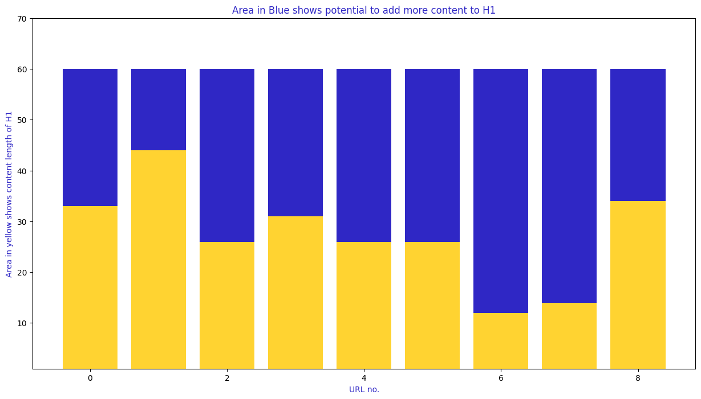
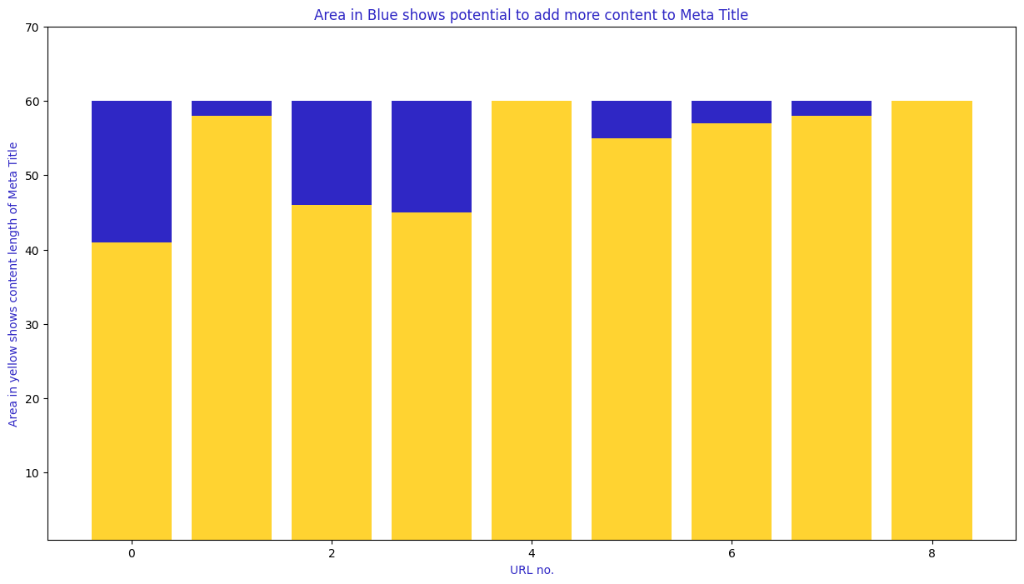
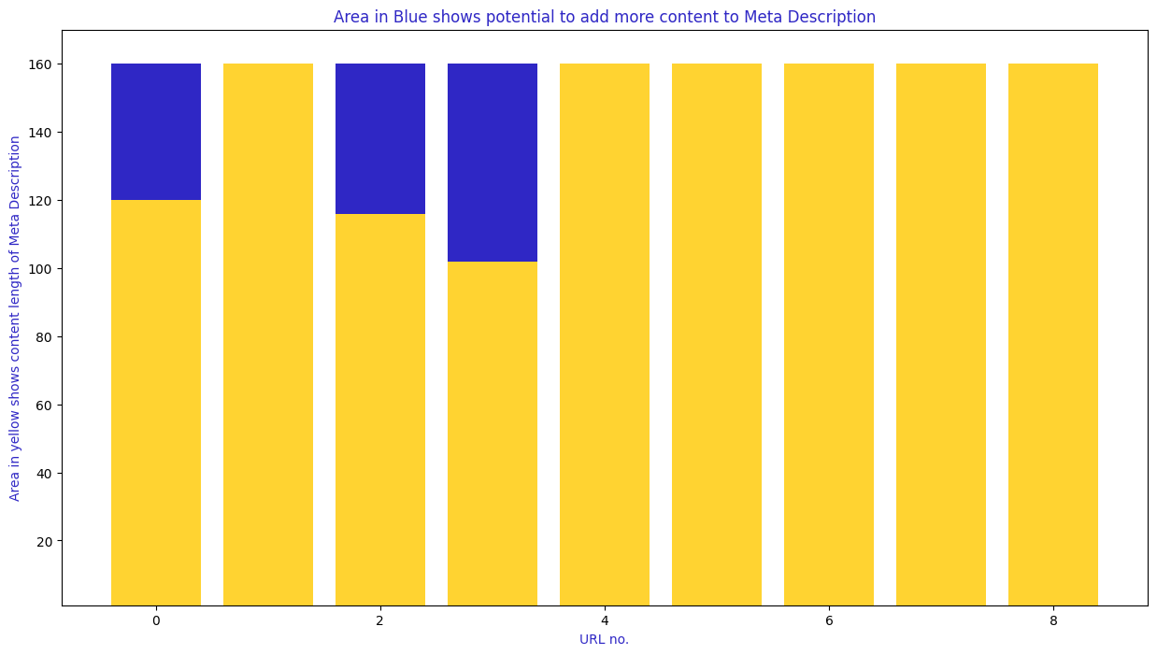
Content Capacity Utilization on Webpages
Recommended Characters Length on Metadata:
Meta Title – 60
Meta Description – 160
H1 - 60
Meta Data Location | Current % Capacity Utilization
Meta Title | 89%
Meta Description | 90%
H1 | 46%
KLI has average content capacity utilization of 75%. The remaining capacity can also be utilized to add further information and keywords as required.

Slide 7
Competitor Analysis - For Product Category Pages

Slide 8
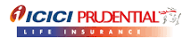
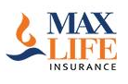
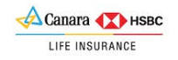
KLI Industry Peers (For Gap Analysis)
Shared Keywords
8.4k
 | No. of Product Category pages | No. of Keywords | Total Traffic from Ranking Keywords | No. of Branded Keywords
Kotak Life Insurance | 9 | 648 | 3442 | 197
ICICI Prudential Life Insurance | 10 | 3220 | 16067 | 1037
Max Life Insurance | 11 | 5229 | 24687 | 637
Canara HSBC Life Insurance | 12 | 645 | 1660 | 88
Missing Keywords
3.3k
Weak Keywords
3.2k
Strong Keywords
1.1k
* Based on March 2025 Semrush data

Slide 9
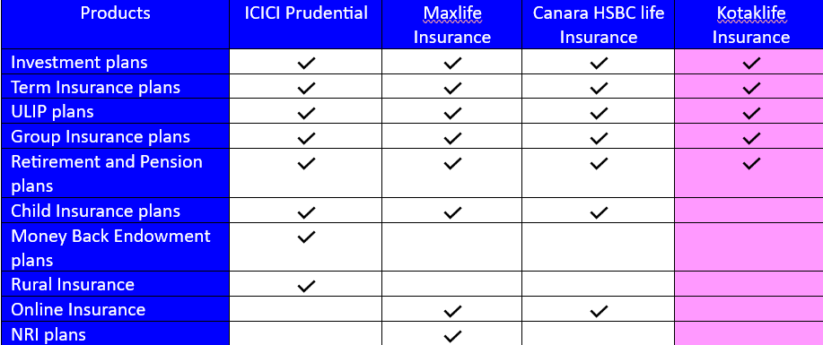
Existing Product Categories (KLI & Competitors)

Slide 10
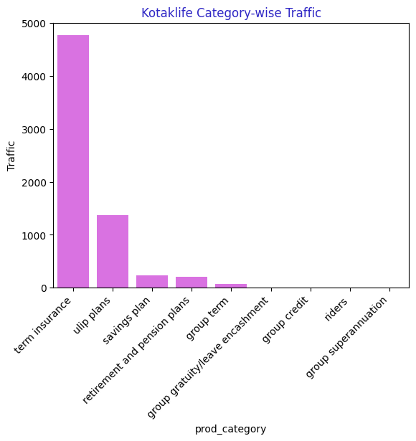
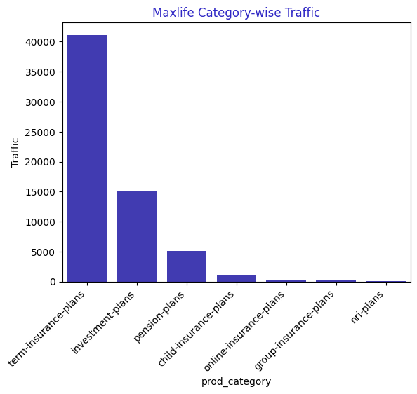
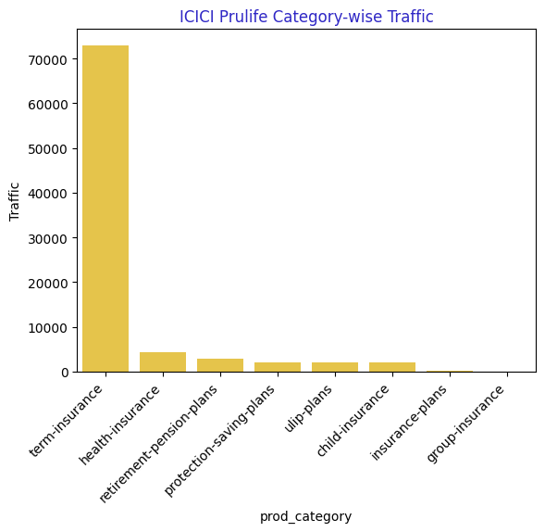
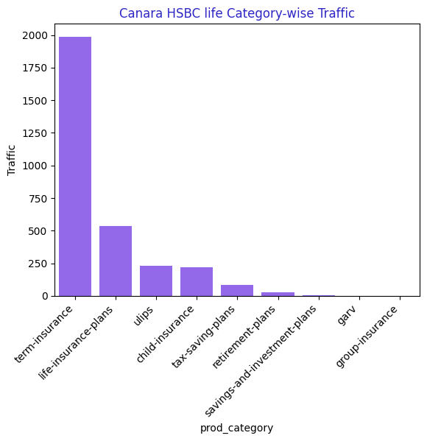
Major Traffic Contributors
Kotak Life Insurance
Max Life Insurance
Canara HSBC Life Insurance
ICICI Prudential
Term Insurance seems to be the focus of all websites for gathering traffic over their website.
* Based on March 2025 Semrush data

Slide 11
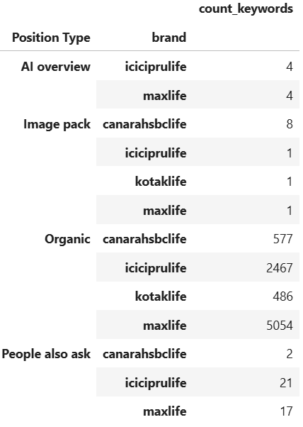
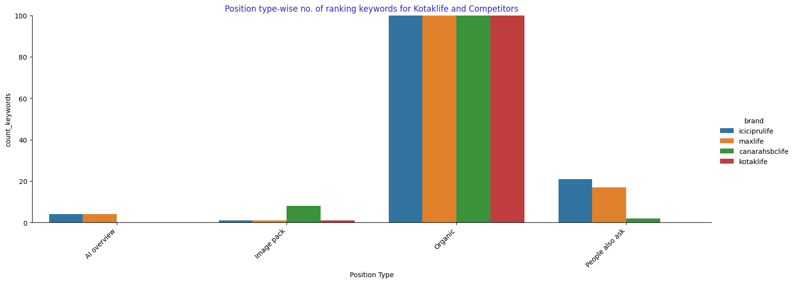
Position Type – wise Traffic
Google may rank a page organically, in AI Overview, in People Also Ask, in Image Pack etc. Most clearly all websites have organic traffic on their pages. Interesting thing to note here is that KLI is not ranking for AI Overview, on the other hand, ICICI Pru and Maxlife are.
* Based on March 2025 Semrush data

Slide 12
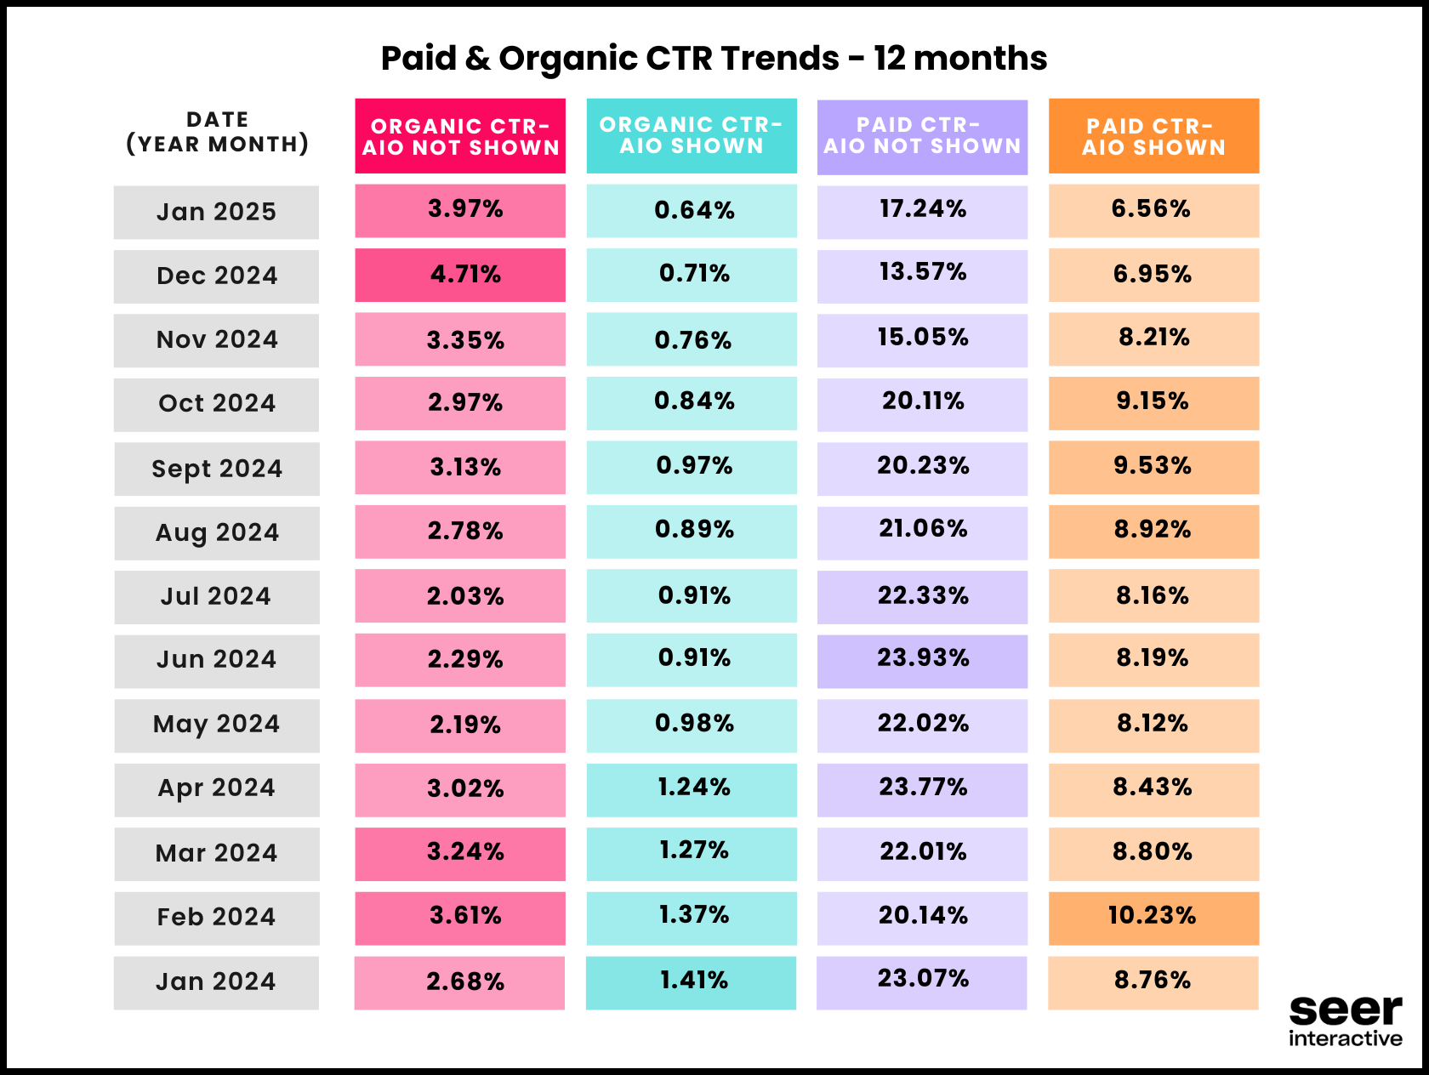
Why is AI Overview(AIO) Important??
As per a study done by Seer Interactive, they investigated CTR changes for queries where clients own the AIO vs. those where they do not. As clearly seen, CTR is very low where AIO search results are appearing for a search query.
Our Analysis also shows that for the keywords where AIO and Organic rankings both appear in search results, the AIO traffic is much more than the organic traffic. This shows User’s preference of AIO results over organic results.
Position Type | Kotaklife Traffic | ICICI Pru Traffic | Maxlife Traffic | CanaraHSBC Traffic
AI Overview | 3809 | 37211 | 23738 | 887
Organic | 880 | 15917 | 4718 | 346

Slide 13
Tips to rank for other position types (AI Overview, Featured Snippets, People Also Ask)
Identify keyword opportunities
Find queries where you rank in Top 10 organically but not other position types
Focus on question-based and comparative/list-based searches, preferably long-tail keywords
Use structured data markup
Optimize for AI Summarization
Answer queries succinctly in the first paragraph
Include summary section at the beginning or end of the article
Optimize for featured snippets
For Paragraph Snippets, place the definition/answer right after the heading
For List Snippets, use H2/H3 for subheadings
For Table Snippets, use an actual HTML table
For Video Snippets, ensure the title and description match common queries
Optimize for People also ask
Find popular questions
Use FAQ sections with H2 or H3 subheadings
Implement FAQ Schema

Slide 14
AIO Keyword Opportunities for KLI
KLI can focus on their top ranking ‘Informational Intent & Long-tail’ keywords to rank for AIO. Some examples are:
'best unit linked insurance plan’,
'unit linked insurance plan example’,
'a ulip plan is a combination of’,
'kotak mahindra term insurance plans’,
'10 lakh term insurance premium’,
'kotak life insurance claim settlement ratio’,
'kotak life claim settlement ratio’,
'kotak life insurance 10 year plan’,
'kotak life insurance plans list'

Slide 15
Tips to improvise ‘ULIP plans’ category page for keyword ‘unit linked insurance plan example (Search Volume 390)’ to rank in AI Overview
Google’s AI Overview prioritizes direct, structured, and well-explained responses.
H2: Unit Linked Insurance Plan Example Answer in the first paragraph: A Unit Linked Insurance Plan (ULIP) combines life insurance with investment. For example, if you invest ₹1,00,000 in a ULIP, a portion goes toward life insurance coverage, and the rest is invested in equity or debt funds based on your preference.
Bullet Format Example (AI Prefers Lists):
Person A buys a ULIP with ₹1,00,000 premium per year.
₹10,000 goes toward life insurance coverage.
₹90,000 is invested in market-linked funds.
Over time, returns vary based on market performance.
AI Overviews often pull from featured snippets. Improve your chances of getting a featured snippet, which can lead to inclusion in AI Overview.
Use an H2 or H3 heading: "A ULIP Plan is a Combination of Insurance and Investment“
Follow it with a short definition or list format
Add structured data (FAQ, HowTo, or Definition schema)
Example Snippet Format: H2: Example of a Unit Linked Insurance Plan (ULIP) Answer: "A ULIP allows policyholders to invest while securing life insurance. Here's an example:" Rahul buys a ULIP policy for ₹50,000 per year. ₹5,000 is allocated to life insurance coverage. ₹45,000 is invested in an equity-based ULIP fund.

Slide 16
Contd➔
AI Overviews favor content with real-world credibility. Enhance your content with: A short case study: "For example, if an investor chooses Kotak e-Invest ULIP, they can allocate funds in multiple equity and debt schemes. Over time, this creates a diversified investment while ensuring insurance protection."
Data-driven insights: "According to IRDAI, ULIPs provide tax benefits under Section 80C, making them a preferred investment for long-term financial planning.“
Google AI prioritizes natural, conversational queries. Optimize with:
Question-based content:
"What is an example of a ULIP plan?"
"Can you give a real-world ULIP example?"
Conversational style:
"Let’s say you invest ₹1 lakh in a ULIP. Here’s how it works…“
Internally link with contextual anchor text:
Explore more ULIP benefits here.
Check how different ULIP examples work.

Slide 17
Tips to improvise ‘ULIP plans’ category page for keyword ‘a ulip plan is a combination of(Search Volume 170)’ to rank in AI Overview
AI Overviews prioritize concise, well-structured, and authoritative content.
Include a direct answer in a clear, scannable format at the top of your content: A ULIP plan is a combination of insurance and investment that allows policyholders to grow their wealth while ensuring financial protection.
Ensure the first 2-3 sentences are concise, authoritative, and match user intent, which in this case is informational.
AI Overviews often pull from featured snippets. Improve your chances of getting a featured snippet, which can lead to inclusion in AI Overview.
Use an H2 or H3 heading: "A ULIP Plan is a Combination of Insurance and Investment“
Follow it with a short definition or list format
Add structured data (FAQ, HowTo, or Definition schema)
Example: H2: A ULIP Plan is a Combination of Insurance and Investment Answer: A ULIP (Unit Linked Insurance Plan) combines the benefits of insurance and investment. It offers life coverage while allowing policyholders to invest in equity, debt, or hybrid funds based on their risk appetite.
Include real-world data & statistics: AI Overviews prefer data-backed content.
Example: According to IRDAI, ULIPs provide tax benefits under Section 80C and 10(10D), making them a popular choice for wealth creation and financial security.
AI Overviews often answer questions. Include FAQs with direct answers.
Example: What is a ULIP plan a combination of? A ULIP plan is a combination of life insurance and market-linked investments, helping policyholders secure their future while growing their wealth.

Slide 18
Tips to rank for AIO or Featured Snippets ‘https://www.kotaklife.com/term-insurance’ vs ‘https://www.iciciprulife.com/term-insurance.html’
Feature | ICICI Score | Kotak Score | Suggested actions for KLI
Content Depth and Relevance | 9 | 7 | 1. Add detailed breakdowns of term insurance plans, covering scenarios, claim processes, and customer benefits. 2. Include a comparison table to show the differences between various plans. 3. Expand FAQs to address specific customer concerns, like "Which plan is best for young professionals?" or "How to claim under Kotak term insurance?" 4. Use case studies or real-life scenarios to make the content more relatable.
User Engagement Features | 8 | 7 | 1. Improve visibility of calculators by placing them above the fold and making them more interactive. 2. Implement personalized recommendation tools where users can enter their details and receive tailored plan suggestions. 3. Create engaging videos explaining term insurance benefits, claim processes, and case studies.
Search Engine Optimization (SEO) Factors | 8 | 6 | 1. Optimize title tags and meta descriptions to include high-volume keywords like "best term insurance in India" or "affordable term insurance plans." 2. Use structured data (Schema Markup) to help search engines understand key elements like premium amounts, benefits, and eligibility. 3. Create list-based or table-based content for better chances of appearing in Featured Snippets. 4. Add internal links to relevant blog posts and policy-related pages to improve SEO.
Page Load Speed and Mobile Optimization | 8 | 7 | 1. Optimize images and videos by compressing them for faster loading. 2. Minimize JavaScript and third-party scripts to enhance page speed. 3. Implement Accelerated Mobile Pages (AMP) for faster mobile performance. 4. Conduct regular performance audits using Google PageSpeed Insights.
Visual Design and Layout | 8 | 7 | 1. Improve section layout by using more visual elements like icons, graphics, and infographics. 2. Redesign CTA buttons to stand out and drive conversions (e.g., “Get a Quote” in a more prominent color). 3. Introduce a sticky navigation bar with quick links to important sections (e.g., Plans, Benefits, Claims). 4. Add customer testimonials and reviews to increase credibility.

Slide 19
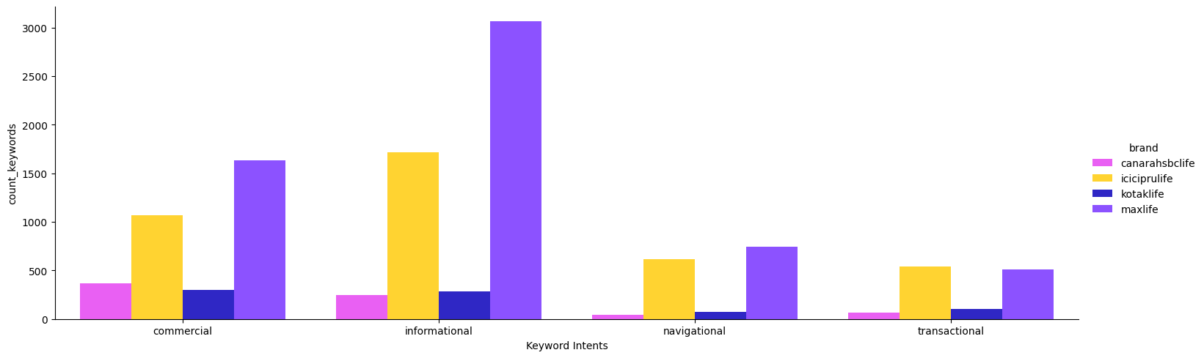
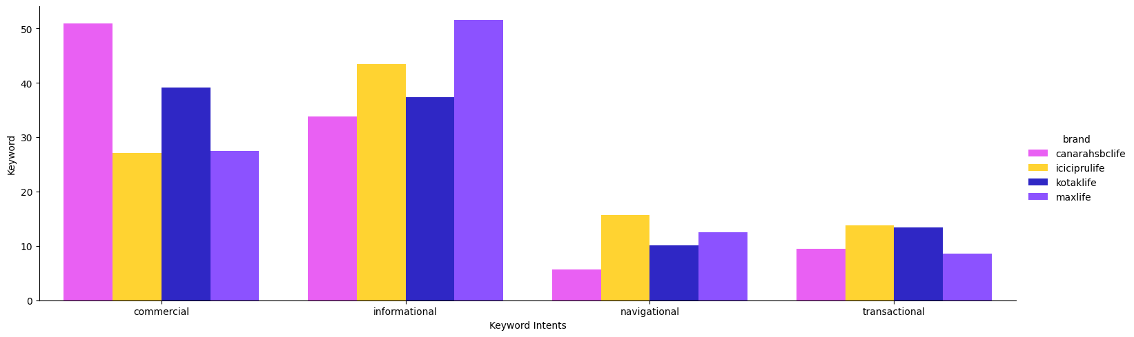
Keyword Intent Focus Comparison
Intent-wise no. of ranking keywords for Kotaklife and Competitors
Intent | Kotak life | ICICI Pru | Max life | Canara HSBC life
Commercial | 263 | 1009 | 1578 | 362
Transactional | 21 | 208 | 298 | 17
Navigational | 20 | 189 | 382 | 12
Informational | 183 | 1085 | 2817 | 196
Intent-wise percentage of ranking keywords for Kotaklife and Competitors
ICICI Pru and Maxlife focuses most on Informational intent keywords. Other than ranking organically, Informational intent keywords also helps to rank for other position types, such as, AI Overview, Featured Snippets etc.

Slide 20
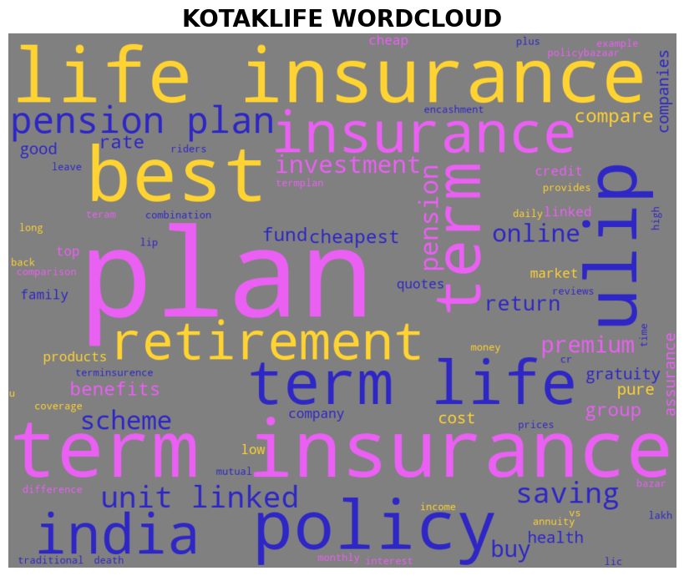
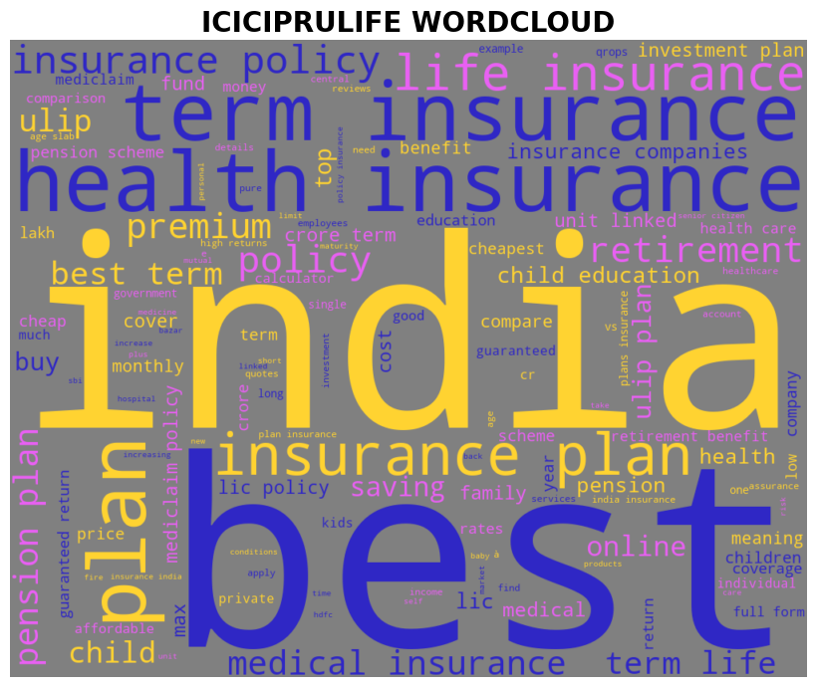
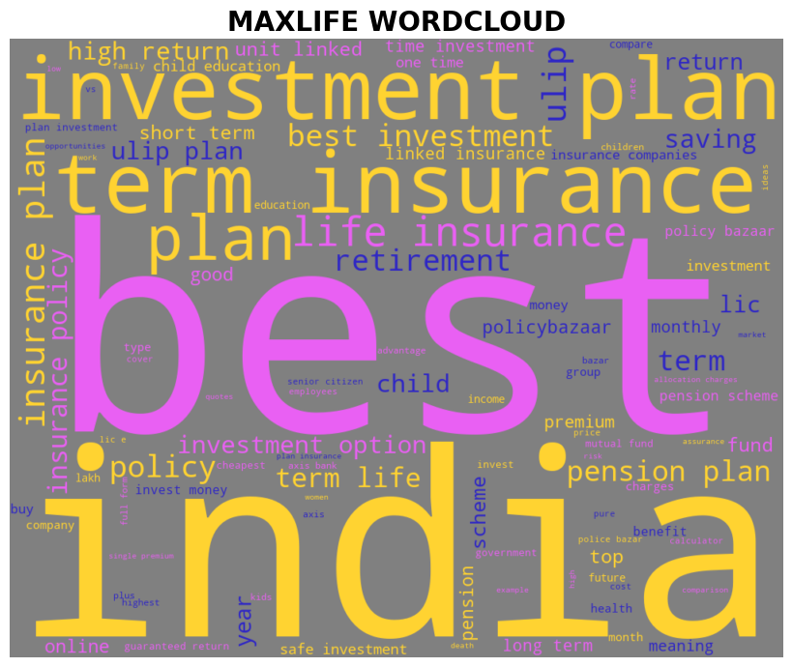
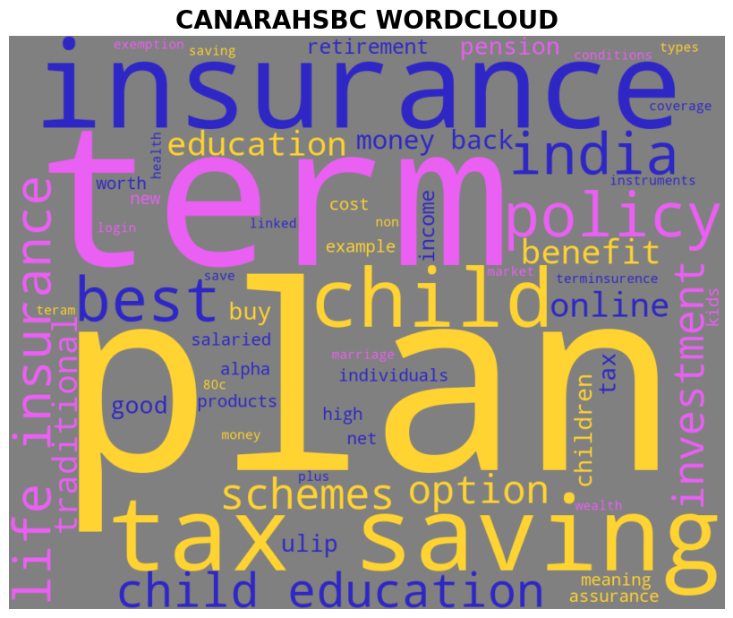
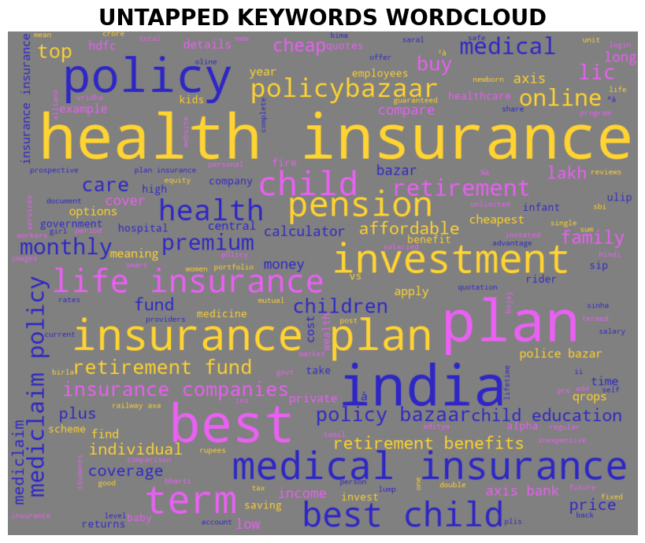
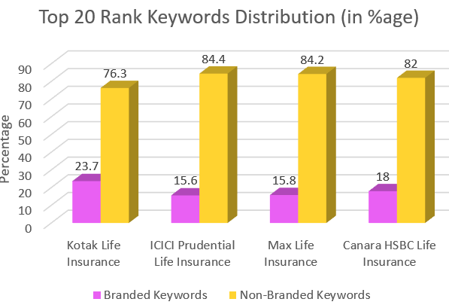
Top 20 Keywords Search Volumes/Difficulty Comparison
Search Volume – Average no. of times users have searched for a given keyword in past month.
Keyword Difficulty - Keyword Difficulty shows you how hard it would be for a website to rank organically in the Google top 10 for the analyzed keyword
Average Search Volume – 1984
Average Keyword Difficulty - 56
Average Search Volume – 1279
Average Keyword Difficulty – 52
Average Search Volume – 1159
Average Keyword Difficulty - 48
Average Search Volume – 1870
Average Keyword Difficulty - 43
No. of Top 20 Ranking Non-branded keywords
Kotaklife – 190
ICICI Prulife – 779
Maxlife – 832
Canara HSBCLife - 91
Shows the Keywords present in all competitors but missing from KLI. These keywords also have an average search volume of 1276 and average keyword difficulty of 50.
* Based on March 2025 month Semrush data (Non-branded keywords)

Slide 21
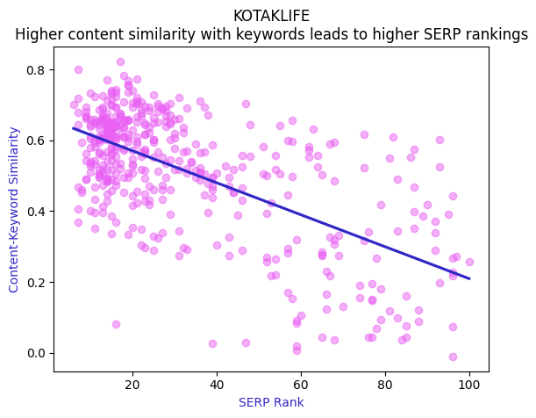
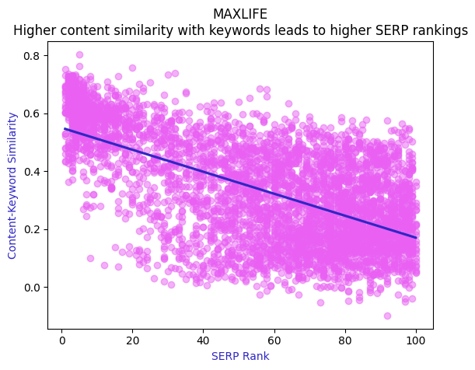
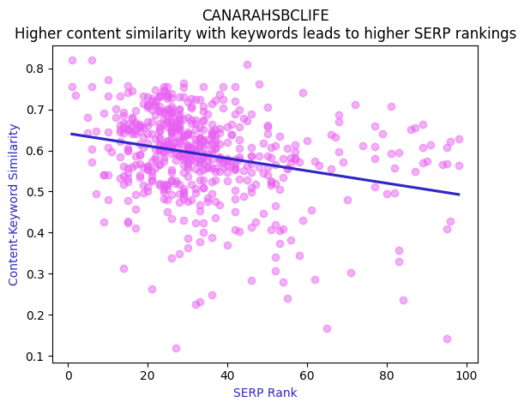
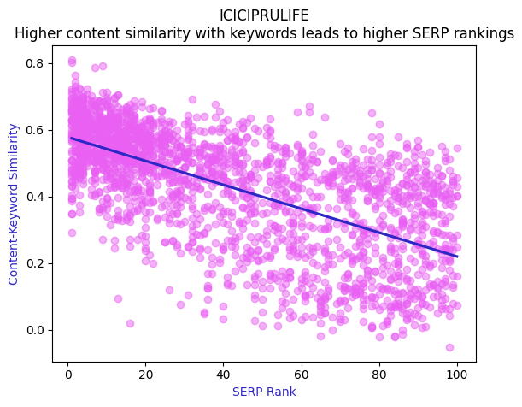
Finding right keyword is important!!
Kotak Life Insurance
Max Life Insurance
Canara HSBC Life Insurance
These graphs study the relation between a webpage’s SERP position and keywords-content relevance.
Higher content relevance to keywords leads to higher SERP positions.
ICICI Prudential Life Insurance

Slide 22
Shared keywords Analysis (Top 3 ICICI Pru keywords)
The aim of this analysis is to study similarity between Product URLs Content and their ranking keywords, for Top 3 SERP positions, for shared keywords of ICICI Pru and KLI.
Shared keywords are the keywords used by both websites and the intention is to study what is being done better by ICICI Pru than KLI, which makes it rank better in Search Engine Rankings for same set of keywords.
We will also see the distribution of these shared keywords in KLI URL rankings in the upcoming slide.

Slide 23
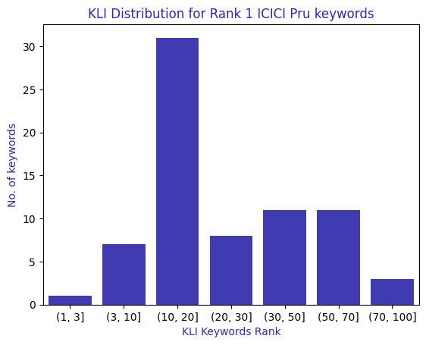
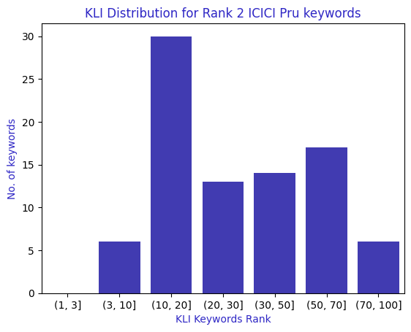
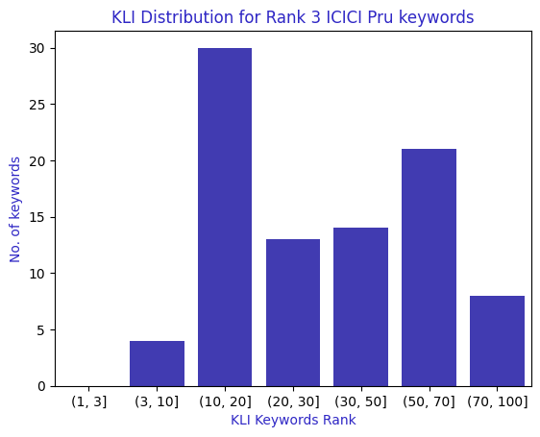
Similarity scoring between URLs content and its keywords is the judge of content relevance and proper keyword usage in the content.
Graph above shows CONSIDERABLY LOW similarity between KLI Product URLs content and shared keywords. Here ICICI Pru Top 3 rank Shared keywords* are compared with ICICI Pru and KLI URL content. There are 73 keywords at Rank 1, 91 keywords at Rank 2 and 90 keywords at Rank 3 for ICICI Pru Life Insurance Product URLs.
Above graphs shows KLI Product Category URLs rank distribution for the top 3 keywords group of ICICI Pru. We can clearly see that for top 3 keywords group of ICICI Pru, KLI Product URLs are rarely ranking at top 3. Most of the ranks are beyond 10.
* Shared keywords – shared between ICICI Pru and KLI
* Based on March 2025 month Semrush data

Slide 24
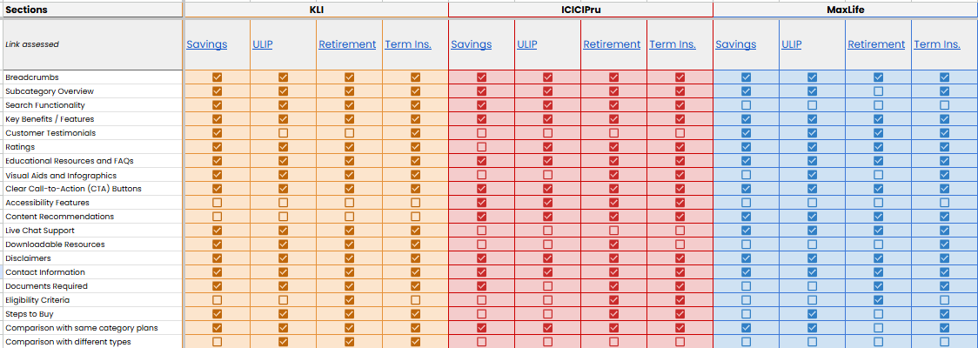
Category Page Content Structure Comparison
Below table compares structural elements on few Product pages of KLI, ICICI Pru and Maxlife. As clearly visible, KLI is missing some key elements, such as, Accessibility features and recommendations while being present on its competitors.

Slide 25
Savings Plans URLs Analysis

Slide 26
Savings Plans Branded vs Non-Branded Keywords
 | Total No. of URLs | Total No. of Savings Plan Keywords | No. of Branded Keywords | No. of Non-Branded Keywords | Non-branded in Top 3 | Non-branded in Top 10 | %age of keywords that are Branded | Traffic from Branded Keywords | Traffic from Non-Branded Keywords
Kotak Life Insurance | 6 | 242 | 214 | 28 | 2 | 4 | 88% | 2782 | 132
ICICI Prudential Life Insurance | 16 | 613 | 501 | 112 | 22 | 31 | 82% | 3060 | 1240
Max Life Insurance | 19 | 857 | 495 | 362 | 46 | 111 | 58% | 2556 | 2616
Canara HSBC Life Insurance | 6 | 80 | 61 | 19 | 0 | 2 | 76% | 0 | 5
Branded keywords help build and reinforce brand identity. When users search for your brand specifically, it shows they are familiar with it. Optimum number of branded keywords means:
Higher Click-Through Rates (CTR)
Improved Trust and Credibility
Competitive Advantage
Better Conversion Rates
Although, a proper balance between branded and non-branded is needed, as overreliance on Brand Traffic limits SEO scope.
KLI has high dependency on branded keywords for ranking and traffic.
* Based on March 2025 month Semrush data

Slide 27
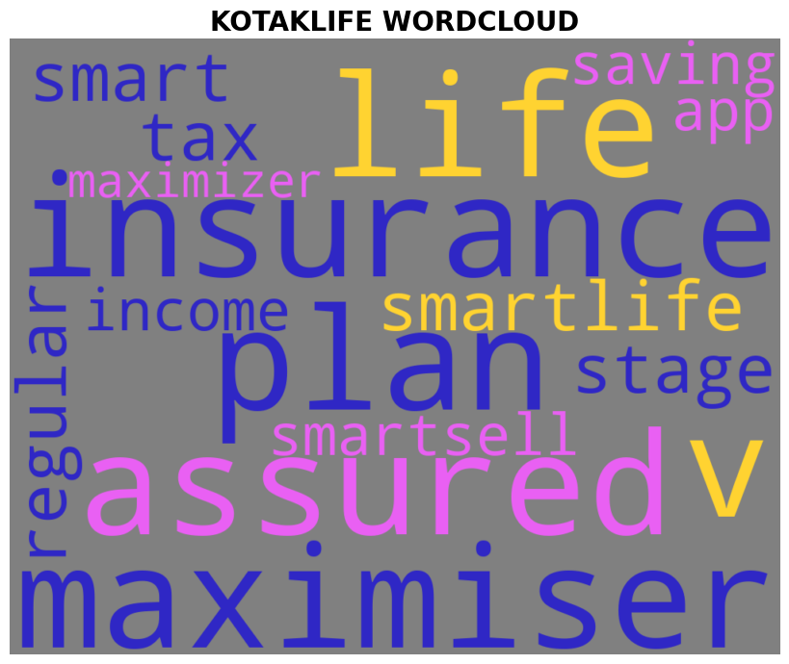
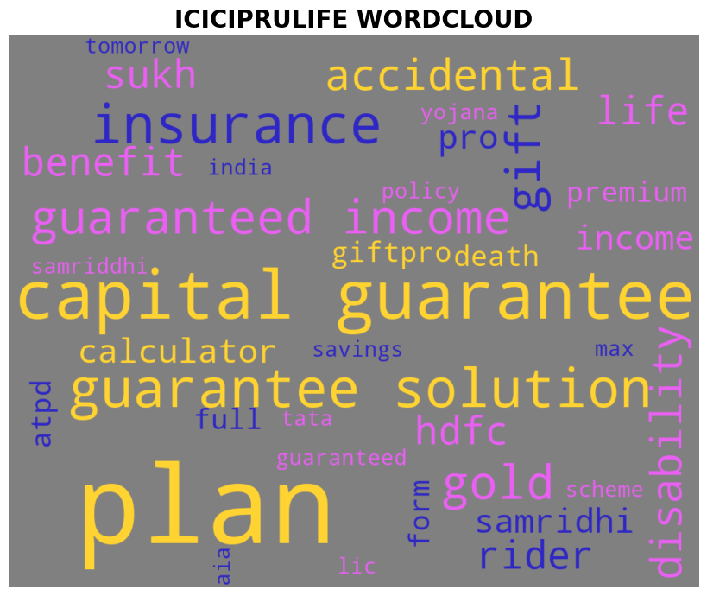
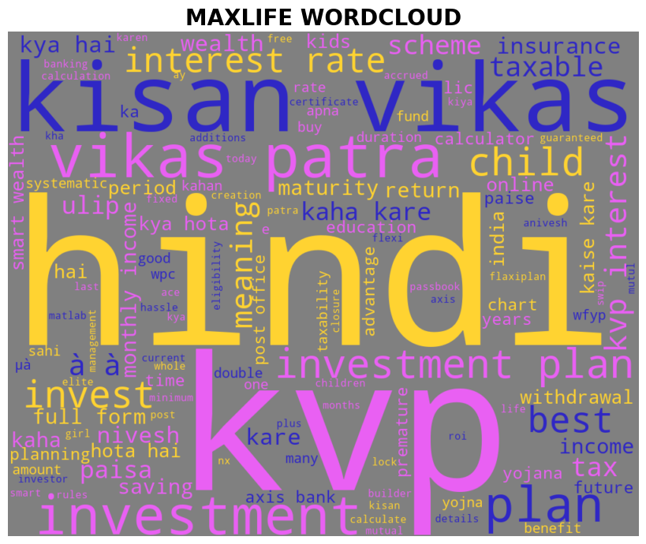
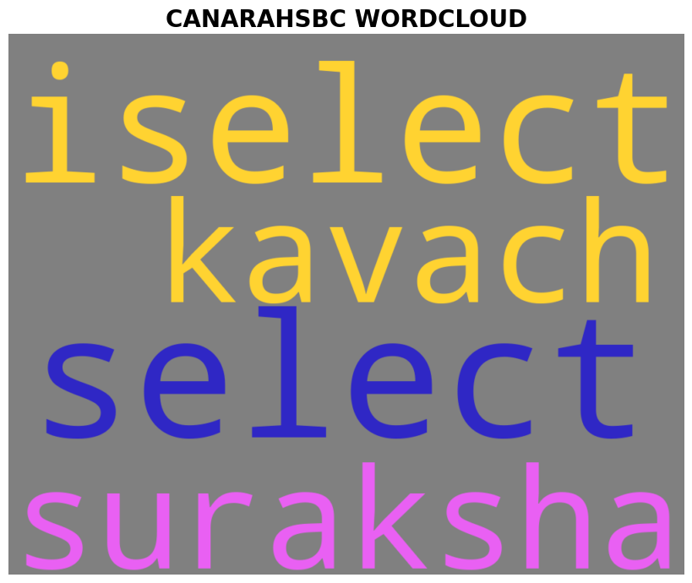
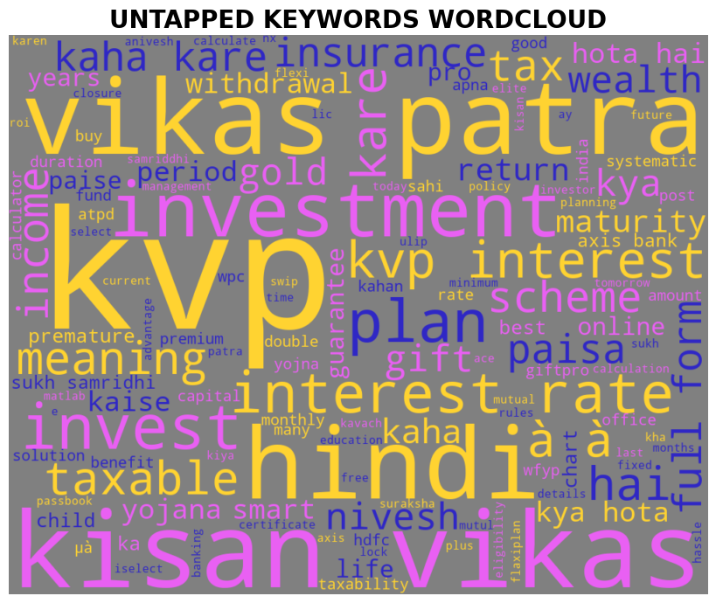
Top 20 Savings Plans Keywords Search Volumes/Difficulty Comparison
Average Search Volume – 573
Average Keyword Difficulty - 22
Average Search Volume – 333
Average Keyword Difficulty - 23
Average Search Volume – 787
Average Keyword Difficulty - 33
Average Search Volume – 647
Average Keyword Difficulty - 29
Search Volume – Average no. of times users have searched for a given keyword in past month.
Keyword Difficulty - Keyword Difficulty shows you how hard it would be for a website to rank organically in the Google top 10 for the analyzed keyword
Shows the Keywords present in all competitors but missing from KLI. These keywords also have an average search volume of 833 and average keyword difficulty of 32
* Based on March 2025 month Semrush data (Non-branded keywords)

Slide 28
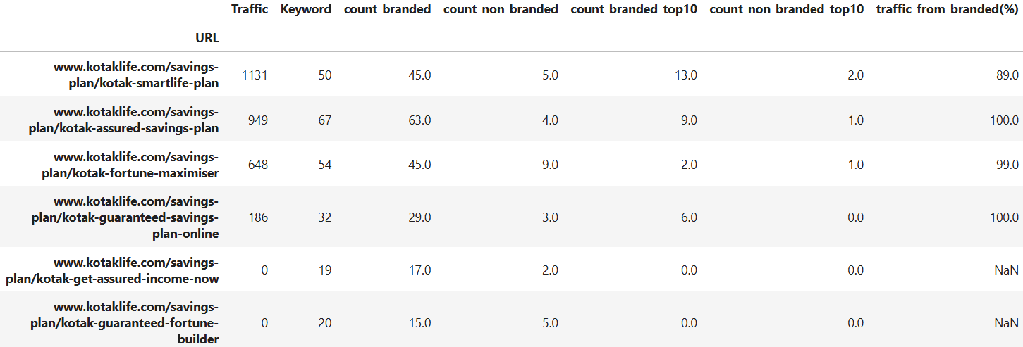
Savings Plans URLs for Kotak Life
The slide depicts the URL wise ranking performance of Savings Plan Product URLs.
We can see the bifurcation of Keywords for each URL into branded and non-branded keywords which is further filtered if the URL is ranking in top 10 SERP positions for those keywords.
Finally, we can also see the dependence of each URL on its Branded Keywords for bringing in Traffic.
Kotak Life shows very high dependency on its Branded Keywords for bringing in the traffic.
* Based on Dec month Semrush data

Slide 29
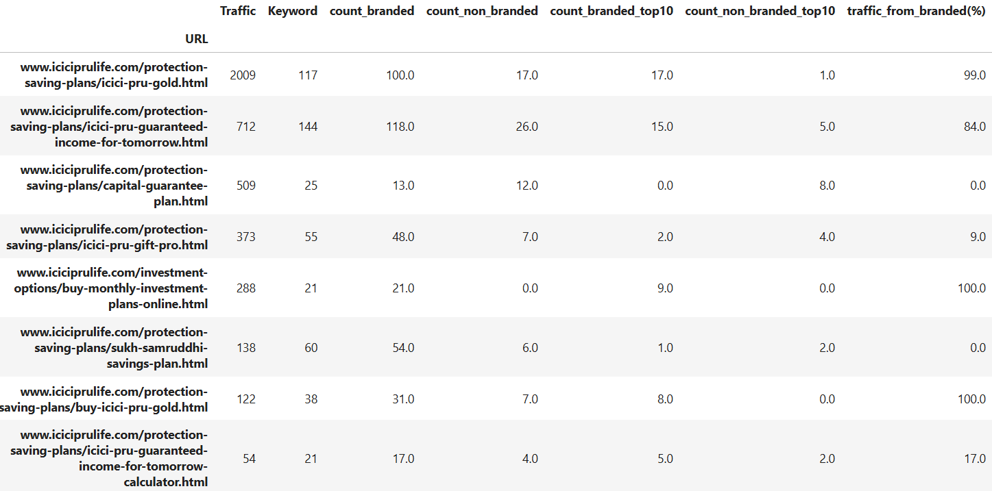
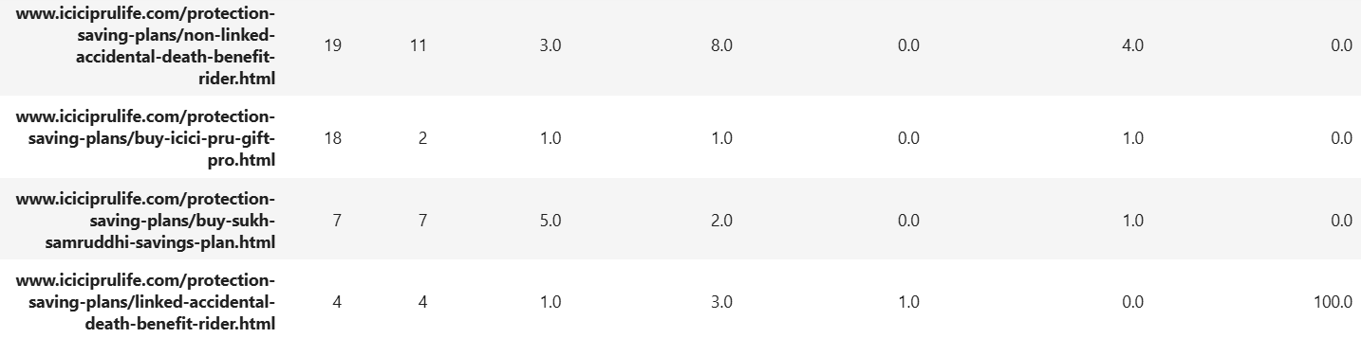
Savings Plans URLs for ICICIPruLife
The slide depicts the URL wise ranking performance of Savings Plan Product URLs.
We can see the bifurcation of Keywords for each URL into branded and non-branded keywords which is further filtered if the URL is ranking in top 10 SERP positions for those keywords.
Finally, we can also see the dependence of each URL on its Branded Keywords for bringing in Traffic.
ICICI’s dependency on its Branded Keywords is low compared to Kotak Life for Traffic.
* Based on March 2025 month Semrush data

Slide 30
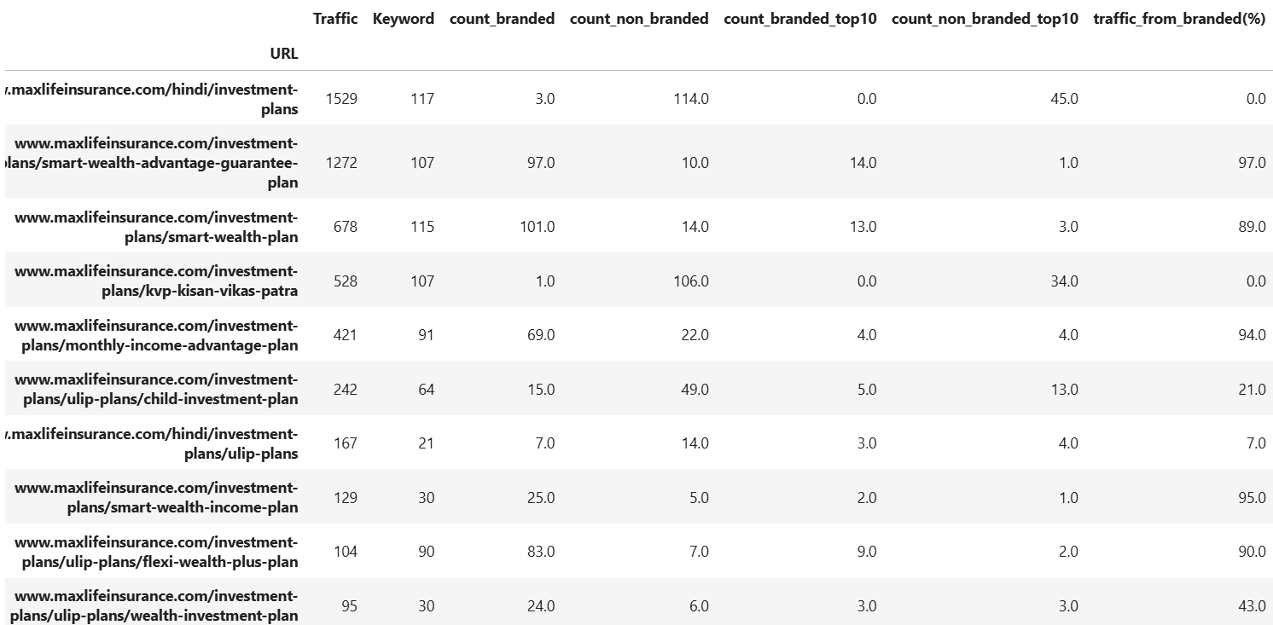
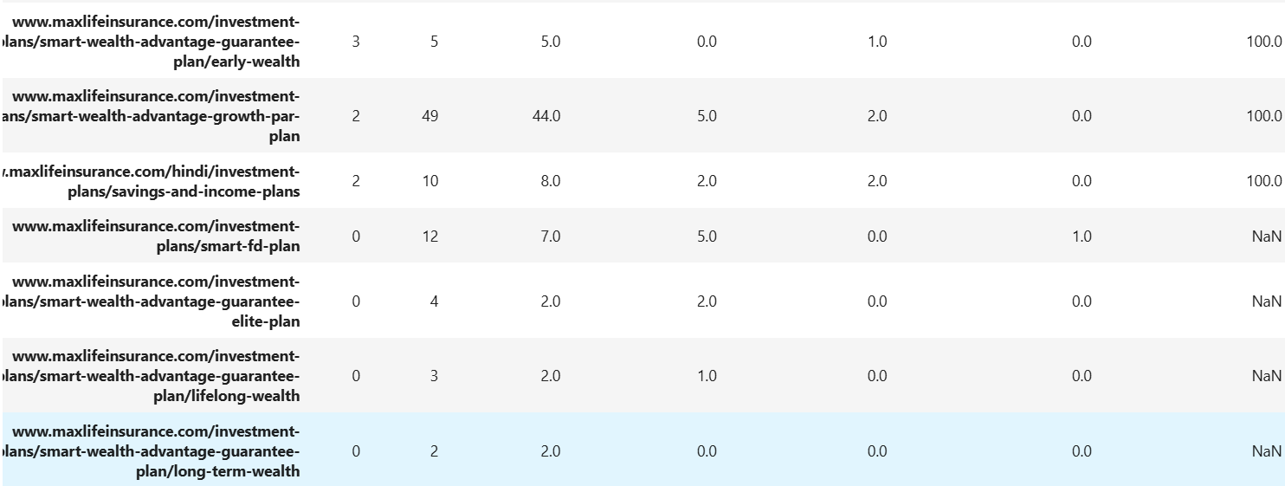
Savings Plans URLs for MaxlifeInsurance
The slide depicts the URL wise ranking performance of Savings Plan Product URLs.
We can see the bifurcation of Keywords for each URL into branded and non-branded keywords which is further filtered if the URL is ranking in top 10 SERP positions for those keywords.
Finally, we can also see the dependence of each URL on its Branded Keywords for bringing in Traffic.
MaxLife’s dependency on its Branded Keywords varies and it also shows a good amount of Branded Keywords’ Traffic.

Slide 31
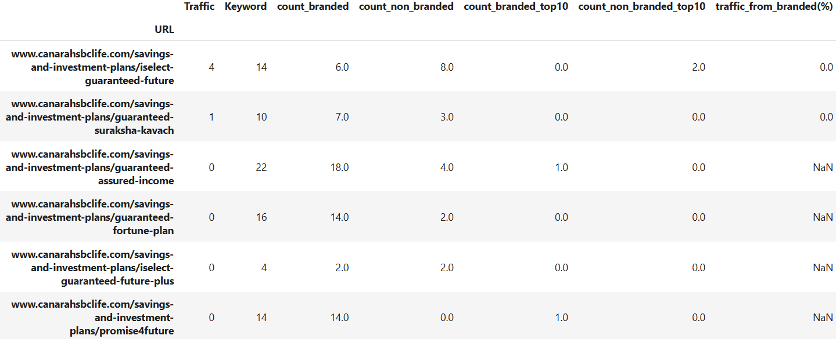
Savings Plans URLs for CanaraHSBCLife
The slide depicts the URL wise ranking performance of Savings Plan Product URLs.
We can see the bifurcation of Keywords for each URL into branded and non-branded keywords which is further filtered if the URL is ranking in top 10 SERP positions for those keywords.
Finally, we can also see the dependence of each URL on its Branded Keywords for bringing in Traffic.
CanaraHSBC Life’s Savings plan URLs see negligible traffic. Its high dependency on branded keywords might be the reason.

Slide 32
Retirement/Pension Plans URLs Analysis

Slide 33
Retirement/Pension Plans Branded vs Non-Branded Keywords
 | Total No. of URLs | Total No. of Retiremnt/ Pension Keywords | No. of Branded Keywords | No. of Non-Branded Keywords | Non-branded in Top 3 | Non-branded in Top 10 | %age of keywords that are Branded | Traffic from Branded Keywords | Traffic from Non-Branded Keywords
Kotak Life Insurance | 2 | 32 | 24 | 8 | 1 | 2 | 67% | 172 | 21
ICICI Prudential Life Insurance | 8 | 316 | 198 | 118 | 16 | 32 | 63% | 2343 | 963
Max Life Insurance | 2 | 53 | 28 | 25 | 0 | 1 | 53% | 53 | 31
Canara HSBC Life Insurance | 4 | 60 | 22 | 38 | 0 | 3 | 37% | 0 | 42
Branded keywords help build and reinforce brand identity. When users search for your brand specifically, it shows they are familiar with it. Optimum number of branded keywords means:
Higher Click-Through Rates (CTR)
Improved Trust and Credibility
Competitive Advantage
Better Conversion Rates
Although, a proper balance between branded and non-branded is needed, as overreliance on Brand Traffic limits SEO scope.
KLI has high dependency on branded keywords for ranking and traffic.
* Based on March 2025 month Semrush data

Slide 34
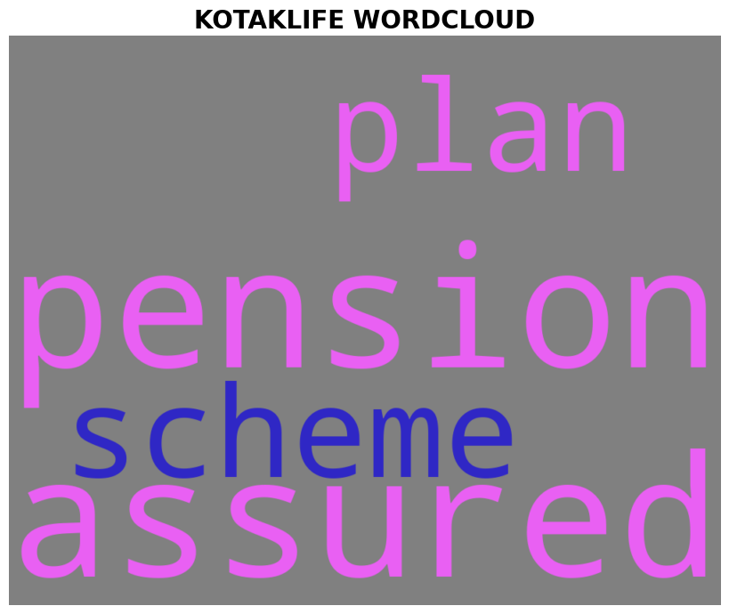
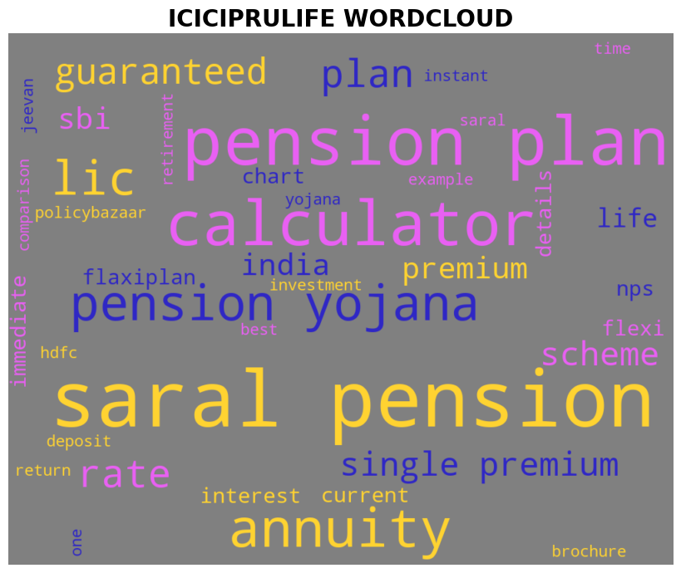
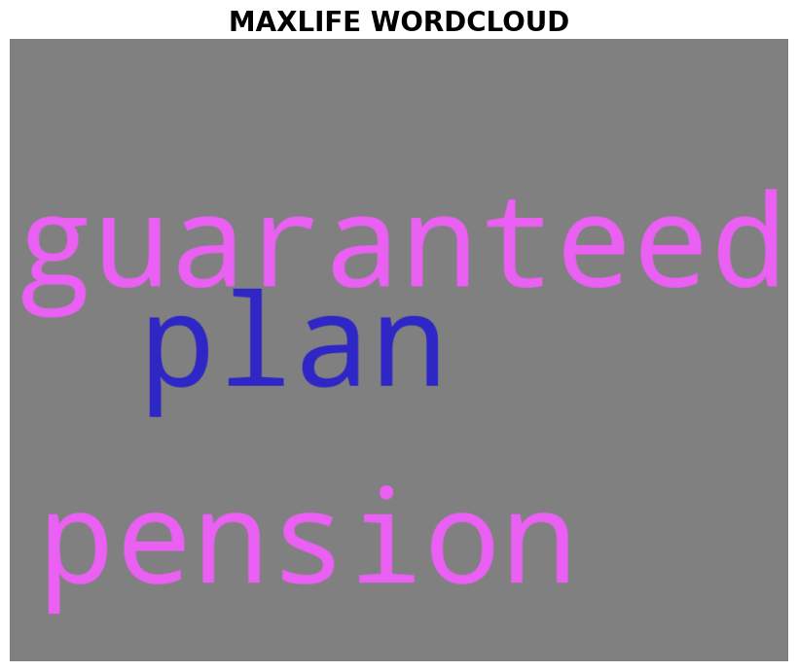
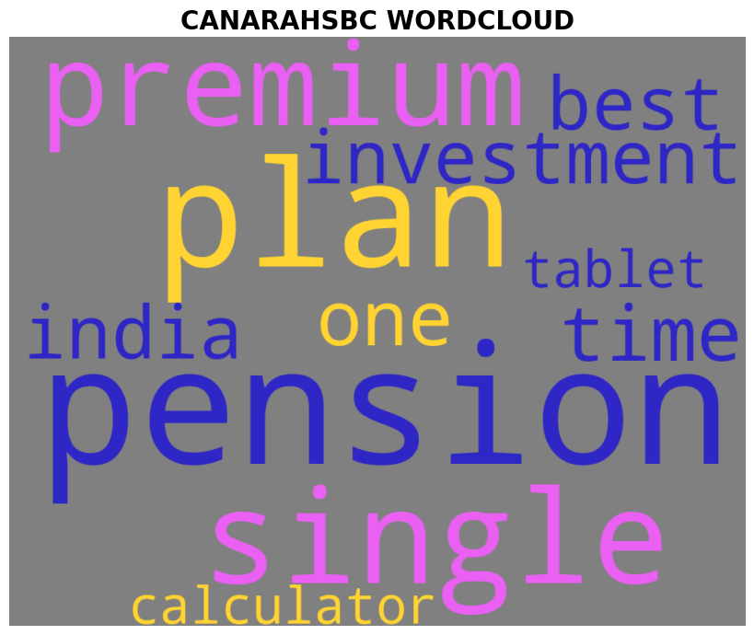
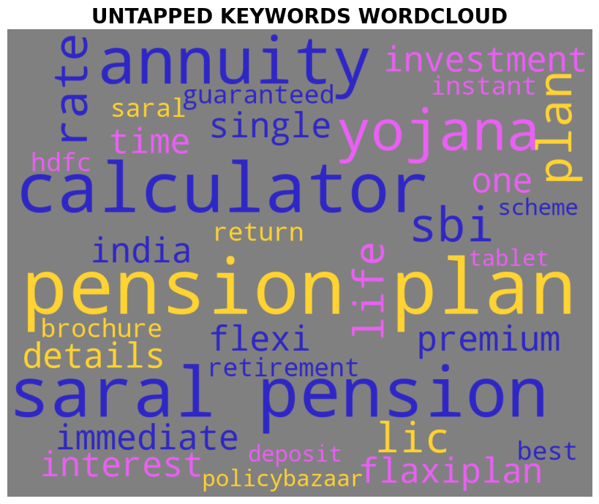
Top 20 Retirement/Pension Plans Keywords Search Volumes/Difficulty Comparison
Average Search Volume – 320
Average Keyword Difficulty - 25
Average Search Volume – 433
Average Keyword Difficulty - 29
Average Search Volume – 585
Average Keyword Difficulty - 27
Average Search Volume – 410
Average Keyword Difficulty - 28
Search Volume – Average no. of times users have searched for a given keyword in past month.
Keyword Difficulty - Keyword Difficulty shows you how hard it would be for a website to rank organically in the Google top 10 for the analyzed keyword
Shows the Keywords present in all competitors but missing from KLI. These keywords also have an average search volume of 841 and average keyword difficulty of 31
* Based on March 2025 month Semrush data (Non-branded keywords)

Slide 35
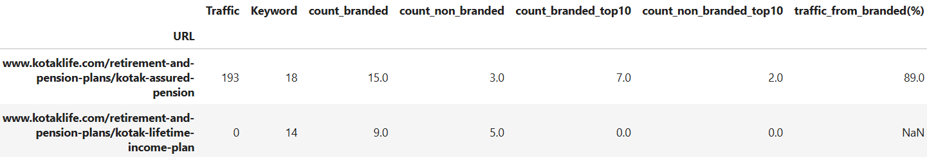
Retirement/Pension Plans URLs for Kotak Life
This slide depicts the URL wise ranking performance of Retirement/Pension Plans URLs.
We can see the bifurcation of Keywords for each URL into branded and non-branded keywords which is further filtered if the URL is ranking in top 10 SERP positions for those keywords.
Finally, we can also see the dependence of each URL on its Branded Keywords for bringing in Traffic.
Kotak Life shows very high dependency on its Branded Keywords for bringing in the the traffic.
* Based on March 2025 month Semrush data

Slide 36
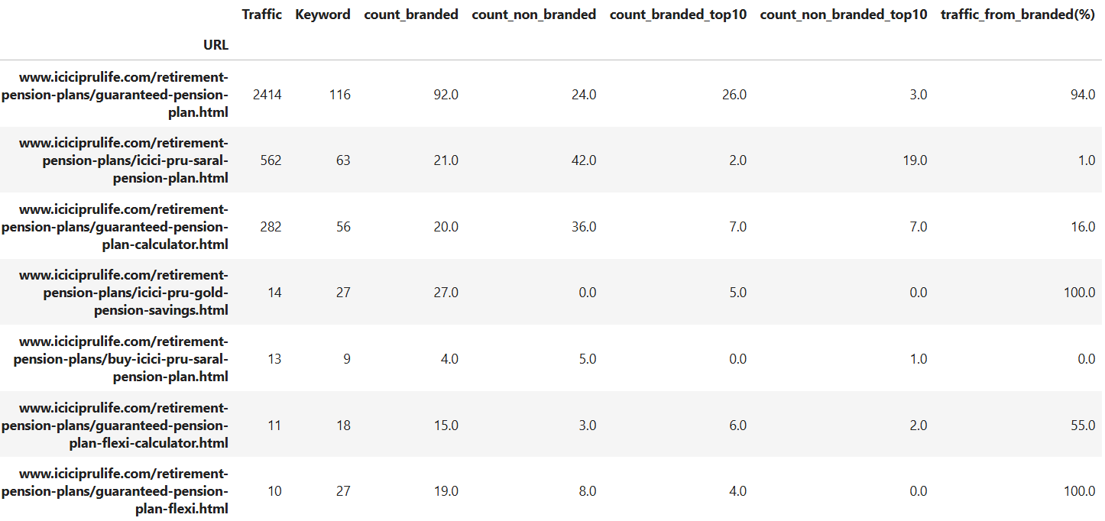
Retirement/Pension Plans URLs for ICICIPruLife
This slide depicts the URL wise ranking performance of Retirement/Pension Plans URLs.
We can see the bifurcation of Keywords for each URL into branded and non-branded keywords which is further filtered if the URL is ranking in top 10 SERP positions for those keywords.
Finally, we can also see the dependence of each URL on its Branded Keywords for bringing in Traffic.
Many ICICI PruLife Retirement/Pension URLs are able to bring in significant Traffic to the website. ICICI’s dependency on its Branded Keywords is low compared to Kotak Life for Traffic.
* Based on March 2025 month Semrush data

Slide 37
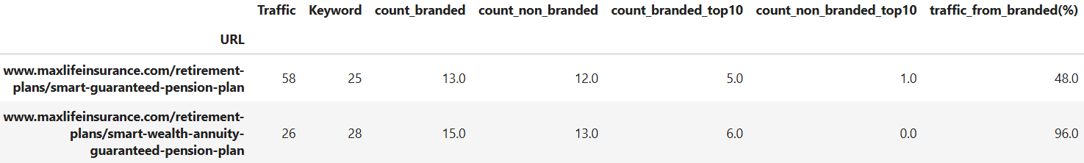
Retirement/Pension Plans URLs for MaxlifeInsurance
This slide depicts the URL wise ranking performance of Retirement/Pension Plans URLs.
We can see the bifurcation of Keywords for each URL into branded and non-branded keywords which is further filtered if the URL is ranking in top 10 SERP positions for those keywords.
Finally, we can also see the dependence of each URL on its Branded Keywords for bringing in Traffic.
Top MaxLife’s Retirement/Pension Plan URLs are able to bring in significant Traffic to the website. MaxLife’s dependency on its Branded Keywords varies and it shows a good balance of non Branded Keywords’ Traffic.

Slide 38
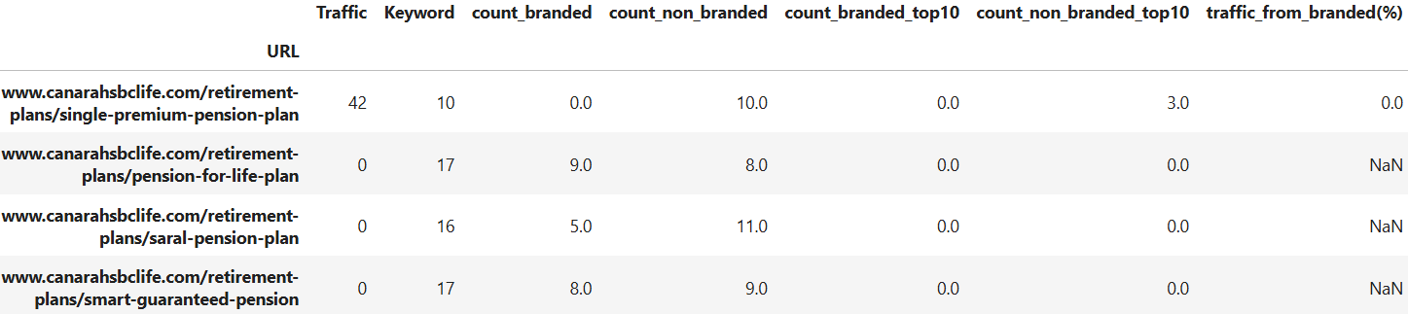
Retirement/Pension Plans URLs for CanaraHSBCLife
This slide depicts the URL wise ranking performance of Retirement/Pension Plans URLs.
We can see the bifurcation of Keywords for each URL into branded and non-branded keywords which is further filtered if the URL is ranking in top 10 SERP positions for those keywords.
Finally, we can also see the dependence of each URL on its Branded Keywords for bringing in Traffic.
CanaraHSBC Life’s Retirement/Pension Plan URLs are not able to bring in much traffic to the website.

Slide 39
ULIP Plans URLs Analysis

Slide 40
ULIP Plans Branded vs Non-Branded Keywords
 | Total No. of URLs | Total No. of ULIP Plan Keywords | No. of Branded Keywords | No. of Non-Branded Keywords | Non-branded in Top 3 | Non-branded in Top 10 | %age of keywords that are Branded | Traffic from Branded Keywords | Traffic from Non-Branded Keywords
Kotak Life Insurance | 7 | 66 | 60 | 6 | 0 | 0 | 91% | 2782 | 132
ICICI Prudential Life Insurance | 9 | 1047 | 945 | 102 | 5 | 25 | 90% | 7810 | 920
Max Life Insurance | 4 | 261 | 223 | 38 | 1 | 7 | 85% | 1892 | 26
Canara HSBC Life Insurance | 2 | 29 | 23 | 6 | 0 | 0 | 79% | 0 | 0
Branded keywords help build and reinforce brand identity. When users search for your brand specifically, it shows they are familiar with it. Optimum number of branded keywords means:
Higher Click-Through Rates (CTR)
Improved Trust and Credibility
Competitive Advantage
Better Conversion Rates
Although, a proper balance between branded and non-branded is needed, as overreliance on Brand Traffic limits SEO scope.
KLI has high dependency on branded keywords for ranking and traffic.
* Based on March 2025 month Semrush data

Slide 41




Top 20 ULIP Plans Keywords Search Volumes/Difficulty Comparison
No Non-branded Keywords in Top 20 positions for KLI
Average Search Volume – NA
Average Keyword Difficulty - NA
Average Search Volume – 597
Average Keyword Difficulty - 30
Average Search Volume – 169
Average Keyword Difficulty - 26
Average Search Volume – 110
Average Keyword Difficulty - 23
Search Volume – Average no. of times users have searched for a given keyword in past month.
Keyword Difficulty - Keyword Difficulty shows you how hard it would be for a website to rank organically in the Google top 10 for the analyzed keyword
Shows the Keywords present in all competitors but missing from KLI. These keywords also have an average search volume of 345 and average keyword difficulty of 29
* Based on March 2025 month Semrush data (Non-branded keywords)

Slide 42

ULIP Plans URLs for Kotak Life
This slide depicts the URL wise ranking performance of ULIP URLs.
We can see the bifurcation of Keywords for each URL into branded and non-branded keywords which is further filtered if the URL is ranking in top 10 SERP positions for those keywords.
Finally, we can also see the dependence of each URL on its Branded Keywords for bringing in Traffic.
Kotak Life shows dependency on its Branded Keywords for bringing in the the traffic.
* Based on Dec month Semrush data

Slide 43

ULIP Plans URLs for ICICIPruLife
This slide depicts the URL wise ranking performance of ULIP URLs.
We can see the bifurcation of Keywords for each URL into branded and non-branded keywords which is further filtered if the URL is ranking in top 10 SERP positions for those keywords.
Finally, we can also see the dependence of each URL on its Branded Keywords for bringing in Traffic.
Many ICICI PruLife ULIP URLs are able to bring in significant Traffic to the website. ICICI’s dependency on its Branded Keywords is low compared to Kotak Life for Traffic with proper mix of branded and non-branded keywords.
* Based on March 2025 month Semrush data

Slide 44

ULIP Plans URLs for MaxlifeInsurance
This slide depicts the URL wise ranking performance of ULIP URLs.
We can see the bifurcation of Keywords for each URL into branded and non-branded keywords which is further filtered if the URL is ranking in top 10 SERP positions for those keywords.
Finally, we can also see the dependence of each URL on its Branded Keywords for bringing in Traffic.
Maxlife too shows lot of dependency on branded keywords.

Slide 45

ULIP Plans URLs for CanaraHSBCLife
This slide depicts the URL wise ranking performance of ULIP URLs.
We can see the bifurcation of Keywords for each URL into branded and non-branded keywords which is further filtered if the URL is ranking in top 10 SERP positions for those keywords.
Finally, we can also see the dependence of each URL on its Branded Keywords for bringing in Traffic.
CanaraHSBC Life’s ULIP URLs doesn’t perform well and gets no traffic to the website.

Slide 46
Group Insurance URLs Analysis

Slide 47
Group Branded vs Non-Branded Keywords
 | Total No. of URLs | Total No. of Group Keywords | No. of Branded Keywords | No. of Non-Branded Keywords | Non-branded in Top 3 | Non-branded in Top 10 | %age of keywords that are Branded | Traffic from Branded Keywords | Traffic from Non-Branded Keywords
Kotak Life Insurance | 20 | 72 | 48 | 24 | 2 | 2 | 67% | 499 | 17
ICICI Prudential Life Insurance | 1 | 70 | 35 | 35 | 0 | 14 | 50% | 2 | 127
Max Life Insurance | 9 | 168 | 39 | 129 | 2 | 14 | 23% | 5 | 282
Canara HSBC Life Insurance | 8 | 86 | 44 | 42 | 3 | 3 | 51% | 27 | 70
Branded keywords help build and reinforce brand identity. When users search for your brand specifically, it shows they are familiar with it. Optimum number of branded keywords means:
Higher Click-Through Rates (CTR)
Improved Trust and Credibility
Competitive Advantage
Better Conversion Rates
Although, a proper balance between branded and non-branded is needed, as overreliance on Brand Traffic limits SEO scope.
KLI has high dependency on branded keywords for ranking and traffic.
* Based on March 2025 month Semrush data

Slide 48





Top 20 Group Keywords Search Volumes/Difficulty Comparison
Average Search Volume – 216
Average Keyword Difficulty - 21
Average Search Volume – 422
Average Keyword Difficulty - 30
Average Search Volume – 899
Average Keyword Difficulty - 27
Average Search Volume – 213
Average Keyword Difficulty - 25
Search Volume – Average no. of times users have searched for a given keyword in past month.
Keyword Difficulty - Keyword Difficulty shows you how hard it would be for a website to rank organically in the Google top 10 for the analyzed keyword
Shows the Keywords present in all competitors but missing from KLI. These keywords also have an average search volume of 1163 and average keyword difficulty of 32.
* Based on Dec month Semrush data (Non-branded keywords)

Slide 49


Group Insurance URLs for Kotak Life
This slide depicts the URL wise ranking performance of Group Insurance URLs.
We can see the bifurcation of Keywords for each URL into branded and non-branded keywords which is further filtered if the URL is ranking in top 10 SERP positions for those keywords.
Finally, we can also see the dependence of each URL on its Branded Keywords for bringing in Traffic.
Kotak depends heavily on branded keywords
* Based on March 2025 month Semrush data

Slide 50

Group Insurance URLs for ICICIPruLife
This slide depicts the URL wise ranking performance of Group Insurance URLs.
We can see the bifurcation of Keywords for each URL into branded and non-branded keywords which is further filtered if the URL is ranking in top 10 SERP positions for those keywords.
Finally, we can also see the dependence of each URL on its Branded Keywords for bringing in Traffic.
ICICI Pru has just 1 URL for group insurance with 50% branded keywords, though it has only 2% of it traffic from branded keywords.
* Based on March 2025 month Semrush data

Slide 51

Group Insurance URLs for MaxlifeInsurance
This slide depicts the URL wise ranking performance of Group Insurance URLs.
We can see the bifurcation of Keywords for each URL into branded and non-branded keywords which is further filtered if the URL is ranking in top 10 SERP positions for those keywords.
Finally, we can also see the dependence of each URL on its Branded Keywords for bringing in Traffic.
Maxlife shows a mix of branded and non-branded keywords on its pages with minimal traffic from branded keywords.

Slide 52

Group Insurance URLs for CanaraHSBCLife
This slide depicts the URL wise ranking performance of Group Insurance URLs.
We can see the bifurcation of Keywords for each URL into branded and non-branded keywords which is further filtered if the URL is ranking in top 10 SERP positions for those keywords.
Finally, we can also see the dependence of each URL on its Branded Keywords for bringing in Traffic.
CanaraHSBC Life’s URLs have mix of branded and non-branded keywords.

Slide 53
Digitup Content Score

Slide 54



Digitup Content Score: KotakLife vs competitors
Digitup has a scoring system (ranging from 0 to 10) to evaluate the webpages. The scoring system takes into consideration:
Content Relevance
Content Readability
Internal Linking of Website pages
URL performance metrics
Page Size
Core Web Vitals (LCP, INP, CLS etc.)
Backlink Strategy
Google performance data (traffic, bounce rate, etc.)
High Score: 6 – 10
Medium Score: 4 – 6
Low Score: 0 – 4
MaxLife has best Content Score.
The top 4 factors which influence the score for Kotak (in contrast to MaxLife as it shows best results):
Less Backlinks
Low Grammer Score
Less Referring Domains
High CLS (Cumulative Layout Shift)
KLI has maximum proportion of low scoring pages (scoring 0-4) and none in high scoring range.

Slide 55
Statistical Case Studies

Slide 56
Let’s understand what ICICI Pru and Maxlife are doing better (in terms of Keyword Placement ) - A STATISTICAL PERSPECTIVE

Slide 57
What all Statistical Analysis is done? Analysis aims to understand what is being done by ICICI Pru and MaxLife in terms of keyword embedding in their content, which makes them leaders in many criteria as seen in previous slide.
A keyword can be embedded in a content in 2 ways:
Exact keyword
Context of keyword
There can be multiple locations where a keyword can be used in its original form or using context of the keyword. These locations can be as follows:
URL
H1
Meta Title
Meta description
Main Content
A keyword can be inserted at 1 or multiple locations.
We intend to study the impact of following on URL position on Google Search Engine Results for all the keywords and exclusively for non-branded keywords too:
Whether to use keywords in exact form or using the context of keyword?
How many locations should the keyword be embedded in whether in its original form or the contextual form?
What locations embedding give best results?
* Note
To understand the contextual usage we perform similarity scoring of keyword with text, which tells to what extent keyword is being understood in the text.

Slide 58
Study 1 - Exact match keyword Inclusion effect on keyword position
The analysis shows that usage of exact keywords leads to better position and traffic.
For Non-Branded keywords
 | No. of Exact matching keywords | No. of keywords without exact match | Statistical Test result (Position) | Statistical Test result (Traffic)
KotakLife | 25 | 462 | Sig diff, exact keyword presence has better positions | No sig diff, though exact keyword present has better traffic
ICICI PruLife | 51 | 2442 | Sig diff, exact keyword presence has better positions | No sig diff, though exact keyword present has better traffic
MaxLife | 49 | 5027 | Sig diff, exact keyword presence has better positions | Sig diff, exact keyword present has better traffic
CanaraHSBCLife | 39 | 548 | Sig diff, exact keyword presence has better positions | No sig diff, though exact keyword present has more traffic

Slide 59
Study 2 - Text-Keyword similarity effect on keyword position (Sim threshold 0.6)
The analysis shows that better contextual inclusion of a keyword leads to better position and traffic.
For Non-Branded keywords
 | No. of low sim keywords | No. of high sim keywords | Statistical Test result (Position) | Statistical Test result (Traffic)
KotakLife | 295 | 192 | Sig diff, high similarity keywords has better positions | No sig diff, though better keyword similarity, better is the traffic
ICICI PruLife | 2141 | 352 | Sig diff, better keyword similarity, better is the position | No sig diff, though better keyword similarity, better is the traffic
MaxLife | 4654 | 422 | Sig diff, better keyword similarity, better is the position | Sig diff, better keyword similarity, better is the traffic
CanaraHSBCLife | 291 | 296 | Sig diff, better keyword similarity, better is the position | Sig diff, better keyword similarity, better is the traffic

Slide 60
Study 3 - No. of locations for keyword matches matters – (url, h1, meta title, meta description, combined content)
The analysis shows that if keyword embedding is done at 3 or 4 locations (no. of locations being 5, namely url, h1, meta title, meta description and main content) , it might lead to better position and traffic.
For Non-Branded keywords
 | 0 loc | 1 loc | 2 loc | 3 loc | 4 loc | 5 loc | Statistical Test result (Position) | Statistical Test result (Traffic)
KotakLife | 462 | 16 | 1 | 6 | 2 | 0 | No diff | No diff
ICICI PruLife | 2442 | 24 | 8 | 7 | 8 | 4 | Sig diff, keywords embedding at 3, 4 locations gives better positions. | Sig diff, keywords embedding at 3 locations gives better traffic.
MaxLife | 5027 | 22 | 14 | 4 | 5 | 4 | Sig diff, 4, 3 locations gives better positions. | Sig diff, 2 locations gives better traffic.
CanaraHSBCLife | 548 | 13 | 10 | 9 | 6 | 1 | Sig diff, 4 locations gives better positions. | Sig diff with 4 locations gives better traffic.

Slide 61
Study 4 - Analyse similarity value buckets – (B1 0-0.2, B2 0.2-0.5, B3 0.5-0.7, B4 0.7-1)
The analysis shows that more the similarity between webpage content and keyword, better is the position and traffic.
For Non-Branded keywords
 | B1 | B2 | B3 | B4 | Statistical Test result (Position) | Statistical Test result (Traffic)
KotakLife | 39 | 144 | 269 | 33 | sig diff, bucket 4 has better positions | sig diff, bucket 4 has better traffic
ICICI PruLife | 360 | 1215 | 883 | 24 | sig diff, bucket 4 has better positions | sig diff, bucket 4 has better traffic
MaxLife | 1679 | 2381 | 929 | 56 | sig diff, bucket 4 has better positions | sig diff, bucket 4 has better traffic
CanaraHSBCLife | 3 | 103 | 417 | 64 | sig diff, bucket 4 has better positions | sig diff, bucket 4 has better traffic

Slide 62
Study 5 - Analyse best performing location – Exact Matching
The analysis states that exact keyword inclusion at h1 and meta desc leads to better position and traffic.
For Non-Branded keywords
 | none | url | H1 | mt | md | mc | Statistical Test result (Position) | Statistical Test result (Traffic)
KotakLife | 462 | 1 | 8 | 15 | 8 | 12 | No sig diff | Sig diff, exact inclusion at meta title and main content gives better traffic
ICICI PruLife | 2442 | 4 | 18 | 29 | 29 | 33 | No sig diff, though meta desc gives better positions | Sig diff, exact inclusion at meta title, desc and main content gives better traffic
MaxLife | 5027 | 5 | 10 | 28 | 32 | 27 | Sig diff, h1 inclusion gives better positions | Sig diff, meta desc gives better traffic
CanaraHSBCLife | 548 | 1 | 11 | 29 | 28 | 20 | Sig diff, h1 gives better positions | Sig diff, h1 gives better traffic

Slide 63
Study 6 - Analyse best performing location – using sim scores
The analysis states that including keyword context at meta description and main content performs best.
For Non-Branded keywords
 | url | H1 | mt | md | mc | Statistical Test result (Position) | Statistical Test result (Traffic)
KotakLife | 167 | 273 | 158 | 118 | 197 | No diff | Sig diff, h1 inclusion gives better traffic
ICICI PruLife | 130 | 806 | 398 | 373 | 306 | Sig diff, main content and url inclusion gives better positions. | Sig diff, url gives better traffic
MaxLife | 448 | 771 | 314 | 481 | 309 | Sig diff, url, h1 and meta desc gives better traffic. | No Sig diff, though h1 gives better positions
CanaraHSBCLife | 287 | 323 | 266 | 233 | 185 | Sig diff, meta desc and main content inclusion gives better traffic. | No Sig diff

Slide 64
Study 7 - Analyse whether keyword presence in first 20 words affects position/traffic
The analysis states that including target keyword in first 20 words of content leads to better traffic and position.
 | Keywords present in first 20 words | Keywords not present in first 20 words | Statistical Test result (Position) | Statistical Test result (Traffic)
KotakLife | 15 | 472 | Sig diff, keywords in first 20 words gets better positions | Sig diff, keywords in first 20 words gets more traffic
ICICI PruLife | 11 | 2482 | Sig diff, keywords in first 20 words gets better positions | Sig diff, keywords in first 20 words gets more traffic
MaxLife | 40 | 5036 | Sig diff, keywords in first 20 words gets better positions | Sig diff, keywords in first 20 words gets more traffic
CanaraHSBCLife | 20 | 567 | Sig diff, keywords in first 20 words gets better positions | Sig diff, keywords in first 20 words gets more traffic
For Non-Branded keywords

Slide 65
Key Takeaways
KLI has only 23 keywords rankings on top 3 positions of its Product Category URLs as compared to 47 in last quarter, i.e. reduced by almost 50%.
KLI has average content capacity utilization of 75% on its Product Category pages, which looks good. Though H1 having only 46% capacity utilization, can have more content which may include relevant keywords.
KLI is not ranking for any keyword in AI Overview, though its competitors are. Some suggestions are provided for KLI’s consideration which might help to rank for AIO.
KLI should add more Informational intent keywords on its Category pages. Other than ranking organically, Informational intent keywords also helps to rank for other position types, such as, AI Overview, Featured Snippets etc.
KLI has to improve the content on its category pages with better keyword inclusion, which can be clearly seen in lower keyword-content similarity scores.
KLI can add some recommendations (articles, blogs or other related pages) on its Product Category pages, which will improve internal linking of the website.
KLI relies too heavily on Branded keywords as compared to its competitors, non-branded keywords which are crucial for expanding brand reach, attracting new customers, and driving organic traffic by targeting users who are still researching and exploring options.
KLI has lowest Digitup Content Score as compared to its competitors, owing to less backlinks/referring domains, low grammer scores and high CLS.

Slide 66

Thank You!

