Slide 1
The New Era of Private Markets Benchmarks
22 July 2026
FOR INSTITUTIONAL, WHOLESALE, QUALIFIED AND PROFESSIONAL INVESTOR/CLIENT USE ONLY. NOT FOR FURTHER DISTRIBUTION.

Slide 2
Private Markets Update
Cameron Joyce, CFA, CAIA
Head of Private Markets Research
FOR INSTITUTIONAL, WHOLESALE, QUALIFIED AND PROFESSIONAL INVESTOR/CLIENT USE ONLY. NOT FOR FURTHER DISTRIBUTION.

Slide 3
Private market returns lagging since interest rate hikes
Private equity highest performer over last 10 years; natural resources leading short-term annualized returns
3-year returns | 5-year returns | 10-year returns
21.3% S&P 500 TR | 18.3% Natural resources | 14.0% Private equity
19.4% MSCI World Index | 14.2% Private equity | 12.8% S&P 500 TR
19.0% MSCI Europe TR | 12.8% S&P 500 TR | 11.6% Venture capital
17.0% MSCI Emerging Markets TR | 11.5% Venture capital | 10.3% MSCI World Index
16.1% US 60/40 | 11.0% MSCI Europe TR | 9.5% Infrastructure
12.1% Russell 2000 TR | 10.9% Infrastructure | 9.4% US 60/40
10.1% S&P Global Infrastructure | 10.6% Private credit | 9.2% MSCI Europe TR
9.8% Natural resources | 10.5% MSCI World Index | 8.9% MSCI Emerging Markets TR
8.8% ICE BofA US High Yield Index | 8.6% US 60/40 | 8.7% Private credit
8.5% Private credit | 6.8% S&P Global Infrastructure | 8.1% Russell 2000 TR
8.4% Infrastructure | 6.6% Real estate | 7.2% Real estate
7.8% Private equity | 4.7% Russell 2000 TR | 6.7% Natural resources
6.1% ICE BofA US Corporate Index | 4.7% MSCI Emerging Markets TR | 6.7% ICE BofA US High Yield Index
3.8% Venture capital | 4.5% ICE BofA US High Yield Index | 5.3% S&P Global Infrastructure
3.5% S&P Global REIT | 0.9% S&P Global REIT | 3.3% ICE BofA US Corporate Index
0.1% Real estate | 0.8% ICE BofA US Corporate Index | 0.6% S&P Global REIT
Note: Returns are annualized geometric averages. Public indices are total return and gross of fees. Private market indices are net of fees
Source: Preqin, S&P CapIQ, Federal Reserve, Aladdin, MSCI, Bloomberg, ICE, LSEG. Data as of May 2026
For use at FundForum 2026 only
FOR INSTITUTIONAL, WHOLESALE, QUALIFIED AND PROFESSIONAL INVESTOR/CLIENT USE ONLY. NOT FOR FURTHER DISTRIBUTION.

Slide 4
Fund distributions across private markets remain under pressure
Private equity and real estate saw further tightening, while DPI in other classes appears to have stabilized
Source: Preqin Private Markets Research. Data as of May 2026
FOR INSTITUTIONAL, WHOLESALE, QUALIFIED AND PROFESSIONAL INVESTOR/CLIENT USE ONLY. NOT FOR FURTHER DISTRIBUTION.

Slide 5
Private markets have typically seen higher risk-adjusted returns
Unlisted infrastructure shows largest difference from equivalent public market benchmark across asset classes
Preqin indices
Unsmoothed indices
Public market benchmarks
Note: All returns cover the period between Q3 2006 and Q2 2025. Preqin private market indices are net of fees and unsmoothed indices are based on AR (1) filter. Public market indices are gross of fees and are total returns. MSCI ACWI IMI TR and the Bloomberg Global Aggregate Bond represent the global 60/40 portfolio
Source: Preqin Private Markets Research, MSCI, Bloomberg, S&P CapIQ. Data as of January 2026
For use at FundForum 2026 only
FOR INSTITUTIONAL, WHOLESALE, QUALIFIED AND PROFESSIONAL INVESTOR/CLIENT USE ONLY. NOT FOR FURTHER DISTRIBUTION.

Slide 6
Historical market dislocations often followed by strong vintages
Vintages launched during turbulence saw strong performance, highlighting impact of timing in allocations
Fully/mostly realized
Majority realized
Majority unrealized
Note: Shiller CAPE ratio assesses overall value of equities within the market, cyclically adjusted on 10-year rolling basis. Shaded areas indicate vintages that experienced outperformance during periods of market dislocation
Source: Preqin, Robert Shiller. Data as of May 2026
FOR INSTITUTIONAL, WHOLESALE, QUALIFIED AND PROFESSIONAL INVESTOR/CLIENT USE ONLY. NOT FOR FURTHER DISTRIBUTION.

Slide 7
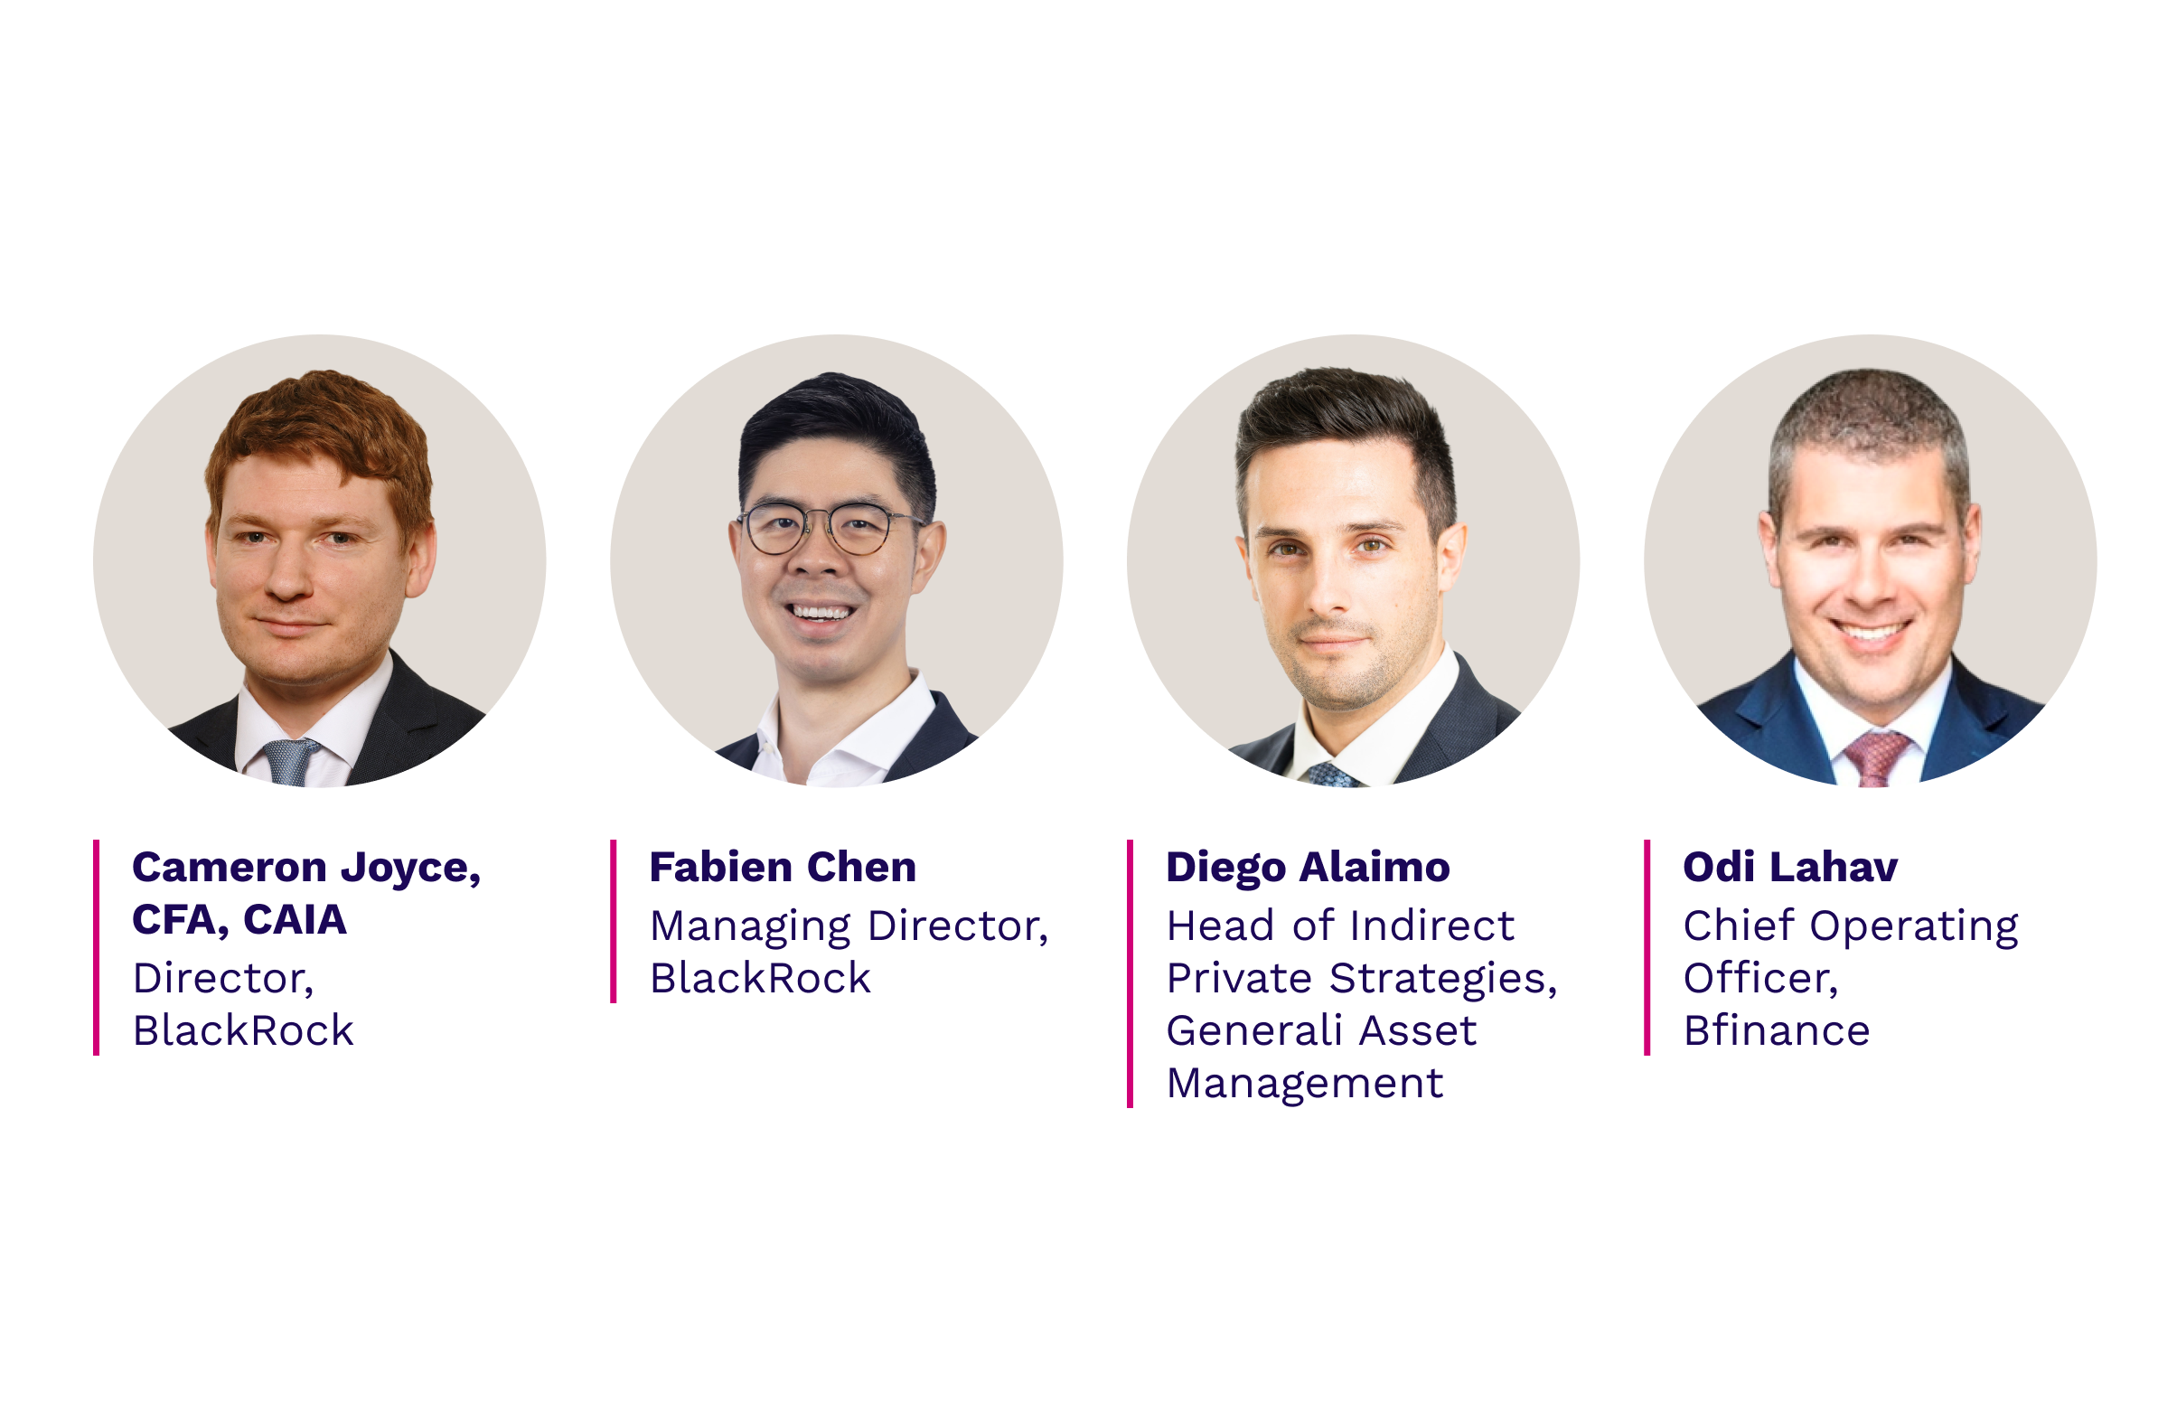
Join the discussion with our expert panel
FOR INSTITUTIONAL, WHOLESALE, QUALIFIED AND PROFESSIONAL INVESTOR/CLIENT USE ONLY. NOT FOR FURTHER DISTRIBUTION.

Slide 8
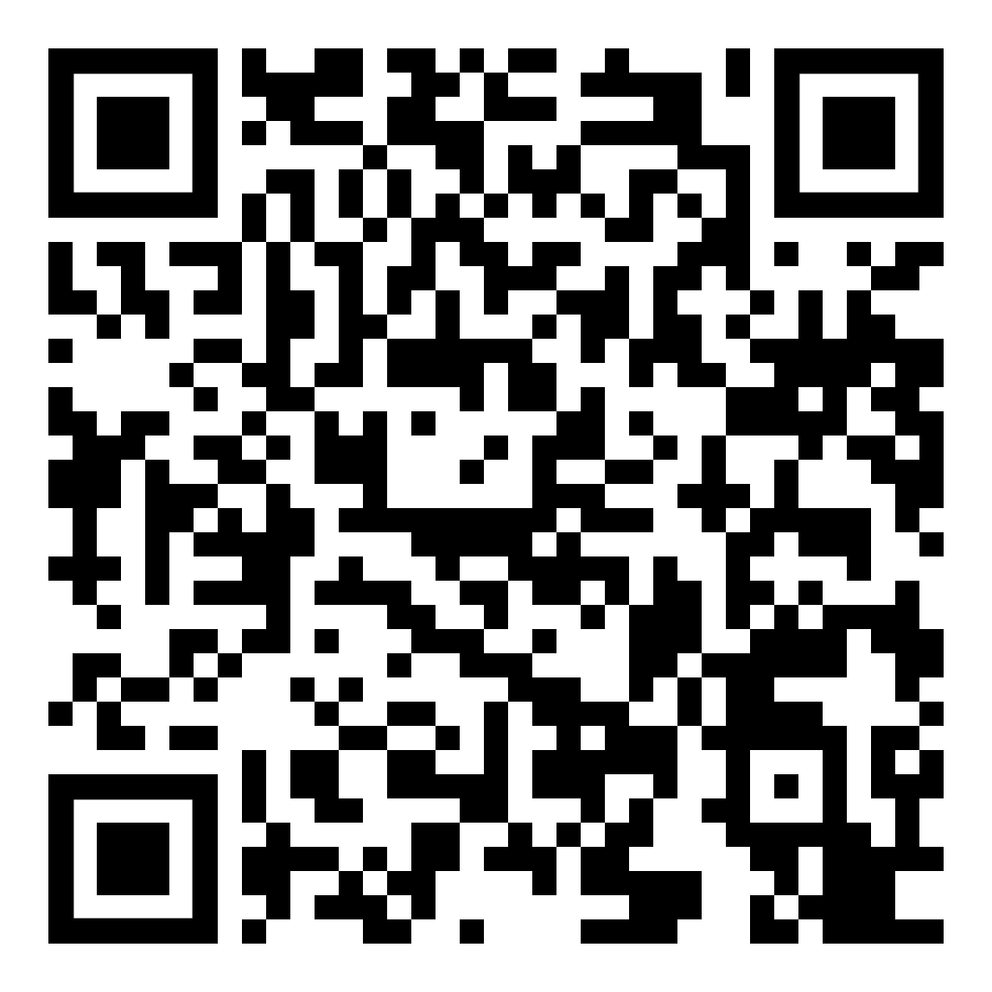
Complimentary resources
Scan the QR code
FOR INSTITUTIONAL, WHOLESALE, QUALIFIED AND PROFESSIONAL INVESTOR/CLIENT USE ONLY. NOT FOR FURTHER DISTRIBUTION.

Slide 9
This material is provided for informational purposes only and is not intended to be relied upon as a forecast, research or investment advice, and is not a recommendation, offer or solicitation to buy or sell any securities or to adopt any investment strategy. The opinions expressed are subject to change at any time without notice. The information and opinions contained in this material are derived from proprietary and nonproprietary sources deemed by BlackRock to be reliable, are not necessarily all-inclusive and are not guaranteed as to accuracy. This material should not be construed as a representation or guarantee that use of Aladdin technology or Preqin information will satisfy your legal or regulatory, or tax or accounting, obligations. BlackRock, as provider of the technology, does not assume any responsibility or liability for your compliance with applicable regulations or laws, or tax or accounting obligations For additional information on any of the descriptions contained herein, please contact your Aladdin or Preqin Relationship Management representative. BlackRock may modify or discontinue any functionality or service component described herein at any time without prior advance notice to you.
None of the information in this material is made available for use as a benchmark as defined in the Regulation 2016/1011 of the European Parliament and of the Council, including such Regulation retained in UK law (the “Benchmarks Regulation”). None of BlackRock, Preqin or its affiliates are providing any such information as a benchmark administrator under the Benchmarks Regulation. Recipients of this material are not permitted to use content in any way that would constitute “use of a benchmark” under the Benchmarks Regulation.
©2026 BlackRock, Inc. or its affiliates. All rights reserved. BLACKROCK, ALADDIN, eFRONT and PREQIN are trademarks of BlackRock, Inc. or its affiliates. All other marks are the property of their respective owners.
FOR INSTITUTIONAL, WHOLESALE, QUALIFIED AND PROFESSIONAL INVESTOR/CLIENT USE ONLY. NOT FOR FURTHER DISTRIBUTION.

