Slide 1
Mondelez International Business Partner Account Guide for external manufacturers
This document has instructions for 3rd parties.
Last Update June 24 2025.

Slide 2
contents
Accessing MDLZ Applications
How to Reset / Recover your Password
Sharepoint Access

Slide 3
accessing MDLZ applications

Slide 4
Step 1 of 3: MDLZ initiates the BP account Request
Instructions for accessing MDLZ Applications
A MDLZ Business Partner Account is required for external parties to access MDLZ Applications. For EM's, this would include different Sharepoint Access for Specifications, Quality documentation, KPI data collection sites, and MDLZ Auditing systems (Enablon).
The Mondelez manager for your BP account will raise a request for account creation. Once the request is approved, you will receive the new account information through an email.
It takes 24 hours after account creation to synchronize the changes and hence, you should try to login only after this period.
Notes:
Notes for Oscar: 24 hour wait time is causing confusion for users who might think it is active immediately.
Possible Solutions?
- IT shouldn’t send the email unless its active.
- Email instructions should be very clear that they don’t log in right away.

Slide 5
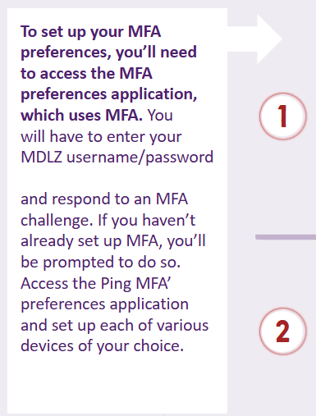
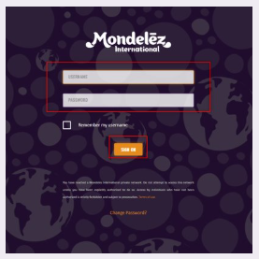
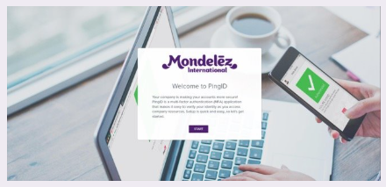
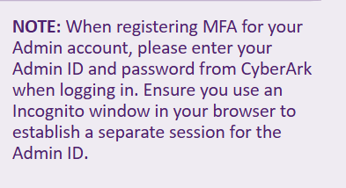
Step 2 of 4: Set up ping Multi-Factor Authentication (MFA)
Instructions for accessing MDLZ Applications
There is no opt-out for Ping MFA - If you need to access any MFA enabled Mondelez applications (eg Enablon), you need to mandatorily setup Ping MFA. Once your Ping MFA is setup, every time when you access MFA enabled applications, you will need to authenticate using your selected or preferred option. Different options are outlined on the following slides.
https://mfa.ping.aws.mdlz.com
Cont’d…

Slide 6
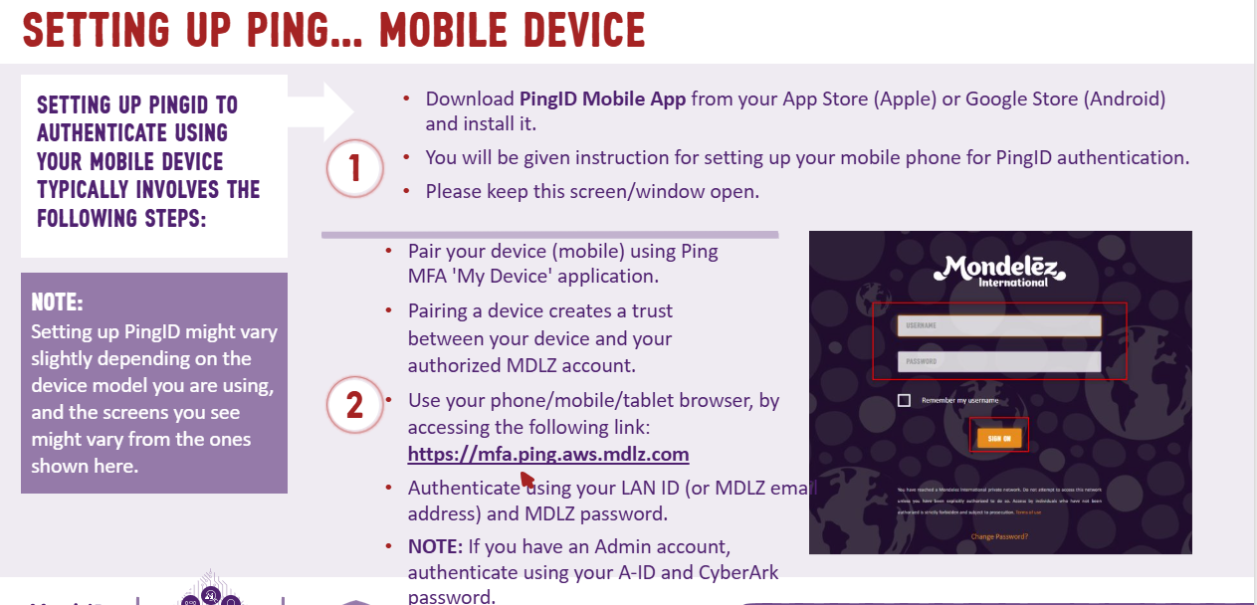
Cont’d…

Slide 7
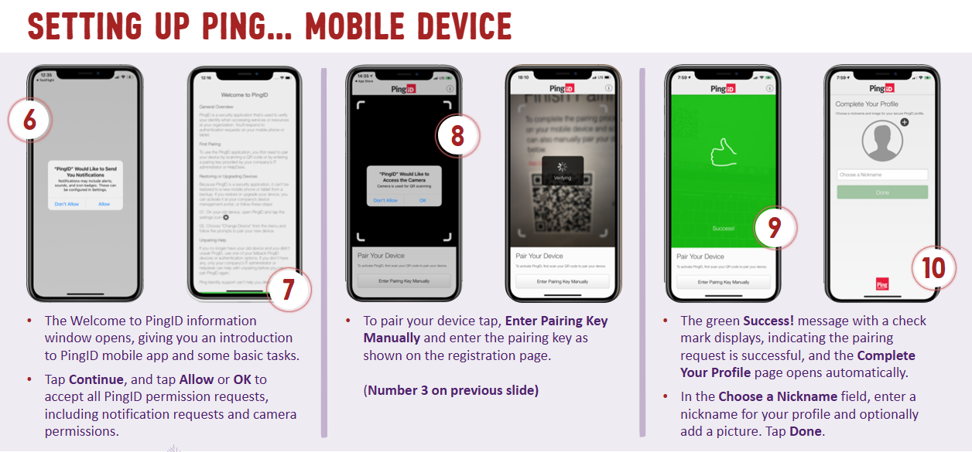
Cont’d…

Slide 8
Cont’d…

Slide 9
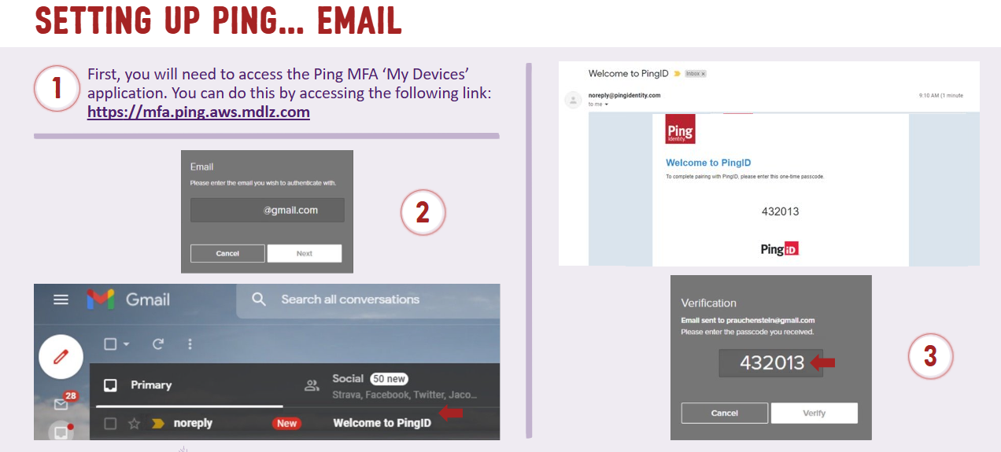
Cont’d…

Slide 11
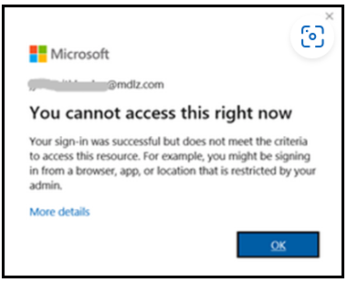
Step 3 of 4: Set up MS Multi-factor Authentication (MS MFA)
Instructions for accessing MDLZ Applications
Microsoft MFA is needed for accessing O365 services (Outlook, Teams, SharePoint, One Drive for Business etc)
Business Partner (BP) users need to set up Microsoft MFA using the email address provided in your welcome email with the subject line RE: New Joiner Request for Business Partner. E.g. deepak-g.hcl.com@mdlzpartner.com.
Once you finish setting-up your Microsoft MFA, and you access any MS MFA enabled application, you need to enter your Mondelez email and password along with this, it will ask you to verify your identity by authenticating via chosen method like -
If you have installed Microsoft Authenticator app as part of MS MFA setup, then tap on "Approve" in your mobile app.
If you have setup to authenticate via SMS code, then enter the code and sign into application.
If you have setup to authenticate via receiving a call back, then authenticate and sign into application.
Note: If you try accessing an MS MFA-enabled application when your registration
enrolment is complete, but you haven't configured/setup MFA in your device,
then you will be prompted with 'More information required', you MUST click Next
to configure MS MFA. If you try to access MS MFA enabled applications without
following the steps above, you will see a prompt displaying 'You cannot access this
right now' and need to register for MFA (see image to the right).
Go to next step
:

Slide 13
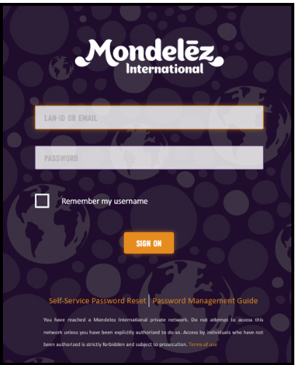
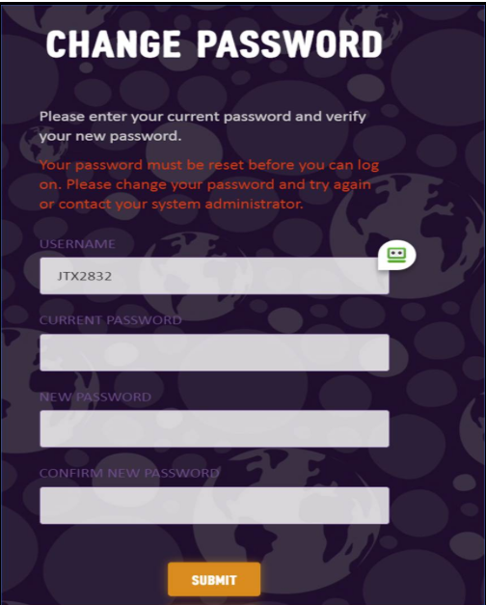
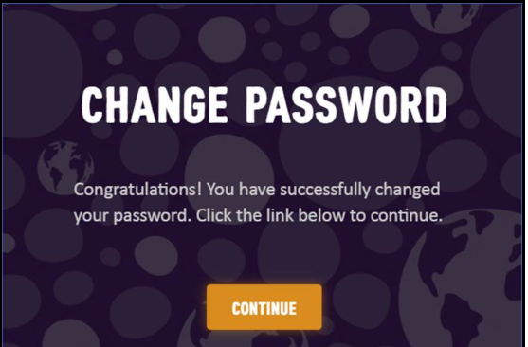
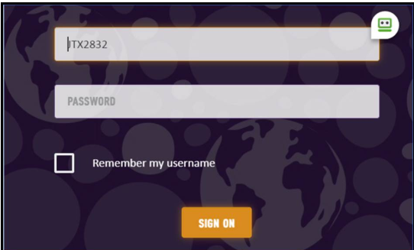
Step 4 of 4: register in Password center to self-reset/recover your mdlz password
Instructions for accessing MDLZ Applications
By registering with Mondelēz Password Centre, you will be able to reset or recover your password on your own. This will avoid the need for you to reach out to your MDLZ sponsor/manager. A one-time registration with Password Center using Security Questions is required to use this service.
Log on to Password Center https://mypassword.mdlz.com/ and use your BP email ID and password received in your joiner email
Once log-in is complete, you will be prompted to change your temporary password. Click Continue. Type in your LAN ID and current password followed by a new password. Click Submit.
A success message will display confirming successful password reset. Click Continue.
The system will redirect back to initial login page, and you will have to enter your email and newly set password again.
Go to next step
:
Notes:
Notes
- Sometimes Questions show up that were never set up
The password Centre has options to reset password on the main screen; This shouldn’t be an option if they haven’t registered.
Suggestion: Remove registration requirement to use password centre

Slide 14
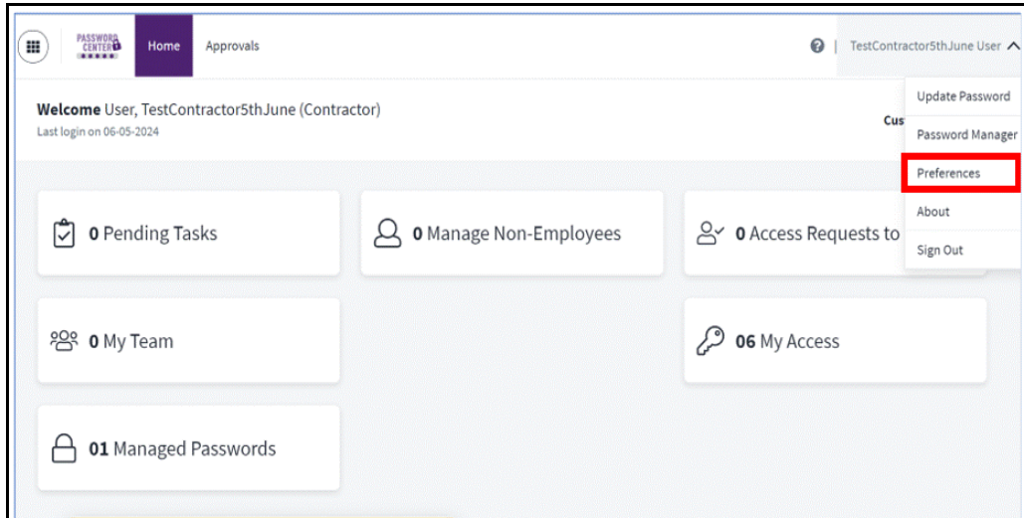
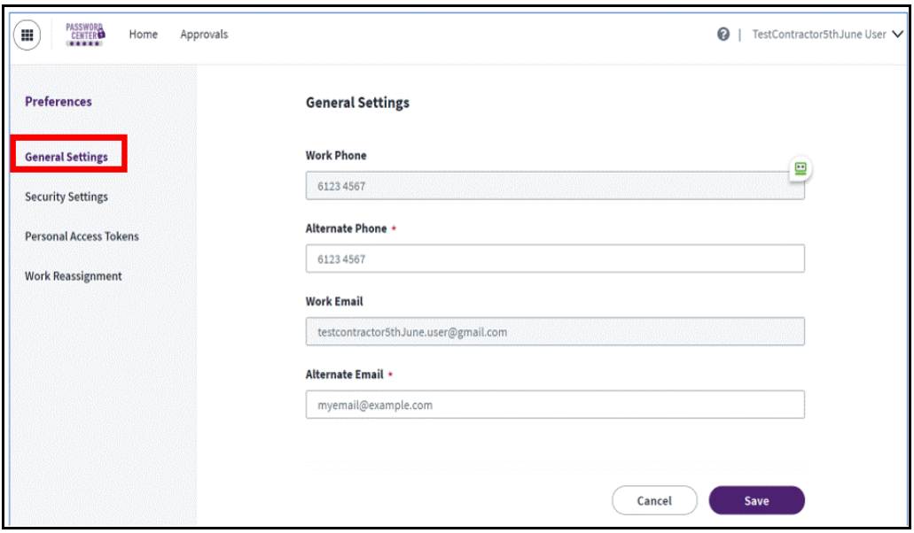
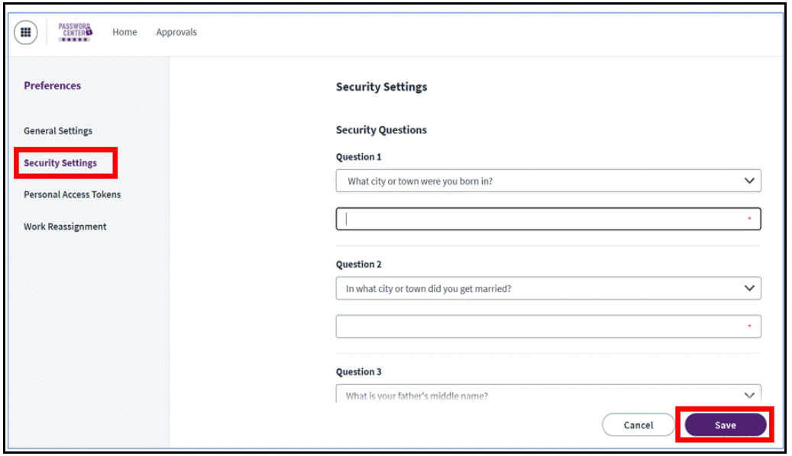
Instructions for accessing MDLZ Applications
(…Cont’d) Step 3 of 3: register in Password center to self-reset/recover your mdlz password
5. Once logged into the Password Center, the following screen will display. This dashboard will allow you to manage your Password Center account. Click the drop-down located in the upper right corner and select Preferences:
6. Select General Settings - This will allow you to setup an Alternate Phone number and Alternate Email which can be used as authentication method in case you forgot your password. Click Save.
7. Select Security Settings to setup your security question and answers which is another method used for authentication in the event you forgot your password. Complete the 5-security question and answers then click Save.

Slide 15
If you’ve made it this far, your bp account Is now set up!

Slide 16
How to Reset / Recover your Password

Slide 17
PASSWORD RESET
Passwords expire every 180 days. Email reminders are sent to users for resetting a password from 7 days prior to expiry.
1. MDLZ BP account Manager (or any MDLZ colleague) must go into Access Center (SailPoint IdentityIQ - Home (mdlz.com)) to do a Delegated Password Reset.
Notes:
Need to send email only when ready or give instructions on the timing needed

Slide 18
Sharepoint access
Notes:
A good reference is Shannon Gould (NA HFS)

Slide 19
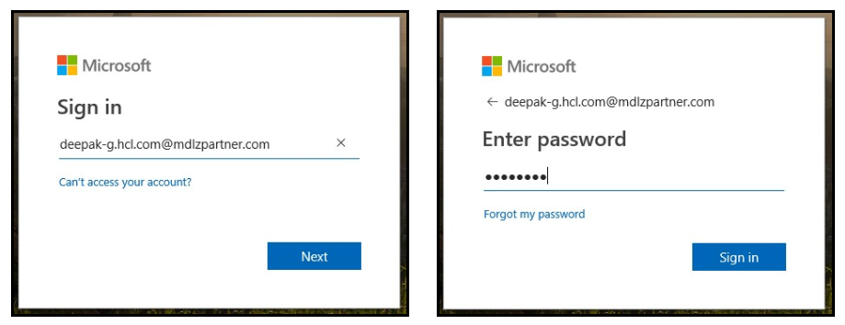
Signing into a sharepoint as a BP
You cannot sign in using your partner email address. You need to enter your partner email address in a specific format to be able to sign into a site.
For example, for a user with email address 'deepak-g@hcl.com', sign in as 'deepak-g.hcl.com@mdlzpartner.com' (i.e. replace the @ symbol with a dot '.' and suffix with @mdlzpartner.com). This is designed to ensure there are no duplicate usernames across partners.
Before reporting an issue related to a business partners site, ensure that you have an active Business Partner ID (BP ID).
Team Sites, Partner Sites and Mondelez Intranet Sites are Microsoft cloud-based SharePoint sites and are accessible on internet. Therefore, you must ensure that your network is up and running before reporting any issues related to site inaccessibility.
Your company's firewall, SSO or MFA settings may interrupt the accessibility of SharePoint sites and should be discussed with your IT team.
If you have multiple Microsoft cloud IDs, you must ensure you're signing in with correct Business Partner ID (preferably using Microsoft Edge or Google Chrome). You should be able to see the login details by clicking the profile picture in the upper right corner of the SharePoint site.
If you do require an issue to be escalated after investigating all potential issues above, reach out to dlknamssharepointsupport@mdlz.com so you can do a Teams screeshare session to troubleshoot, or prashant.dhasal@mdlz.com
Notes:
Ilaria Example

