Slide 1
AML Supervision to move to FCA
Ask me anything
Amy Bell
Founder and Director

Slide 2
AML Supervision changes
Government have announced supervision will move from legal regulators to FCA
No timetable given
Consultation open until Christmas Eve!
  Drafting of the guidance
  Just AML or all economic crime
SRA vs FCA
  No one knows……
  Expect controls

Slide 3
How did we get here?
Option 1 – More OPBAS Powers
Option 2 – Consolidation of PBS
Option 3 – Move to FCA
Option 4 – Single supervisor – like AUSTRAC

Slide 4
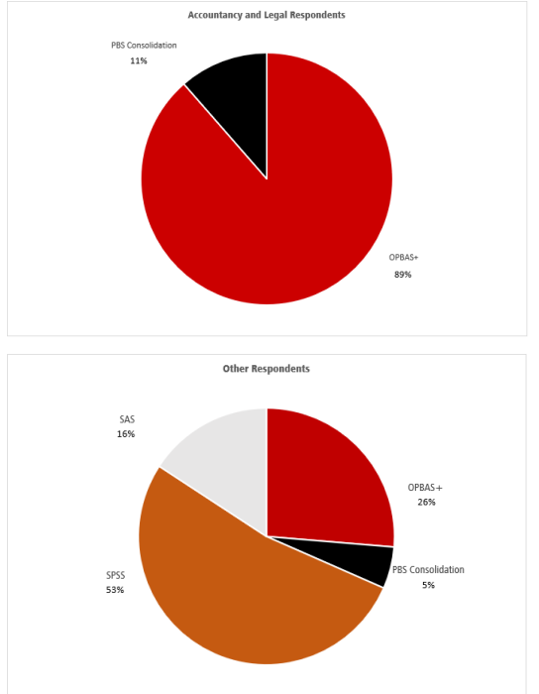

Slide 5
Consultation
Key Proposals
The FCA register all in-scope firms, conduct appropriate gatekeeping checks, and have powers to accept, deny, suspend, or cancel registrations.
The FCA “police the perimeter”, by working to identify unregistered activity and bring these businesses under supervision. Could be listed in a public register

Slide 6
Consultation
Apply a consistent and coherent risk-based approach for each of the sectors, maintaining up-to-date risk profiles and conducting targeted supervisory activity such as on-site and desk-based reviews.
Require relevant information from firms, conduct inspections and exchange information with domestic and international authorities.
Powers to allow the FCA to issue directions to firms or to require a firm to appoint a skilled person to conduct a review.
Provide up-to-date information to firms on AML/CTF risks and effective compliance with the MLRs. This could include responsibility for published guidance.

Slide 7
Consultation
Carry out intelligence-sharing with law enforcement, other supervisors, and support whistleblowing
Power to impose civil penalties, suspensions, prohibitions and public censures, and to initiate criminal proceedings for breaches of the MLRs, in line with existing FCA and HMRC powers.
Use of its powers should be appealable to the courts, ensuring judicial oversight

Slide 8
Consultation
Fees charged to supervised firms on a cost-recovery basis. HM Treasury is providing Economic Crime Levy funding for implementation.
Avoid creating significant new burdens on firms; and that supervisors share information with each other to ease firms’ involvement with their regulators.
Continue to be operationally independent of HM Treasury and political control. It will remain accountable to HM Treasury and Parliament.

Slide 9
Consultation Questions
Agree to FCA maintaining a register?
“fit and proper” tests to legal, accountancy, and trust & company service providers? Competence!
Extra powers to “police the perimeter”?
Double jeopardy?
Who will draft and approve the guidance?
Information sharing and privilege?
Sharing from NCA to FCA
Who should pay?

Slide 10

Control Framework
Policy
Procedure
Control

Slide 11

Questions?

Slide 12
The End!
These course notes, slides and other materials that are provided for use on the course have been prepared solely for the benefit of delegates. They are designed to be part of the presentation and not to stand on their own. The materials will provide an outline of the provisions of various matters including legislation and case law. They will not be exhaustive and in particular will contain many points of law that will have been reduced to broad statements for the purposes of brevity and to aid explanation and understanding. It is important that delegates refer to original sources or one of the standard works on the relevant subject area for further guidance. In particular, in no circumstances should be materials be used be used for giving advice to clients.

