Slide 1


Slide 2


Slide 3

[Insert School Name]
[Insert School Name]
£0,000.00

Slide 4

TEACHER:
Insert pictures here of your
Red Nose Day fundraising in action!

Slide 5


Slide 6
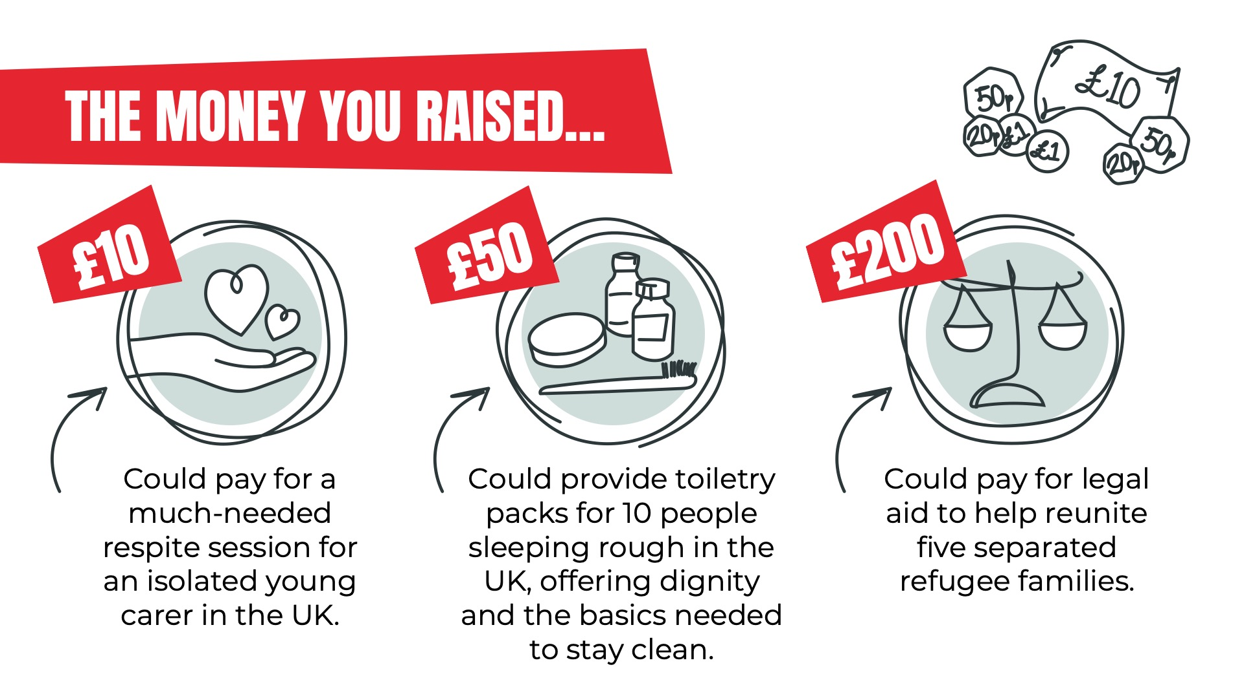

Slide 7



Slide 8


