Slide 1


Slide 2


Slide 3
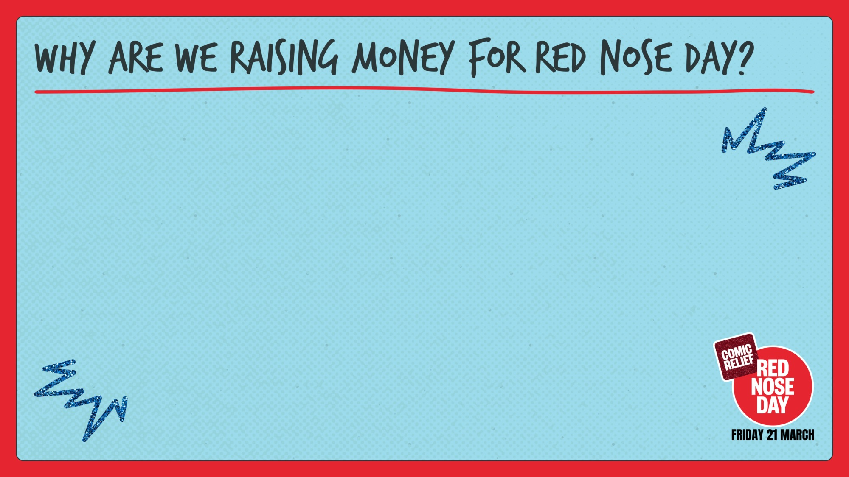
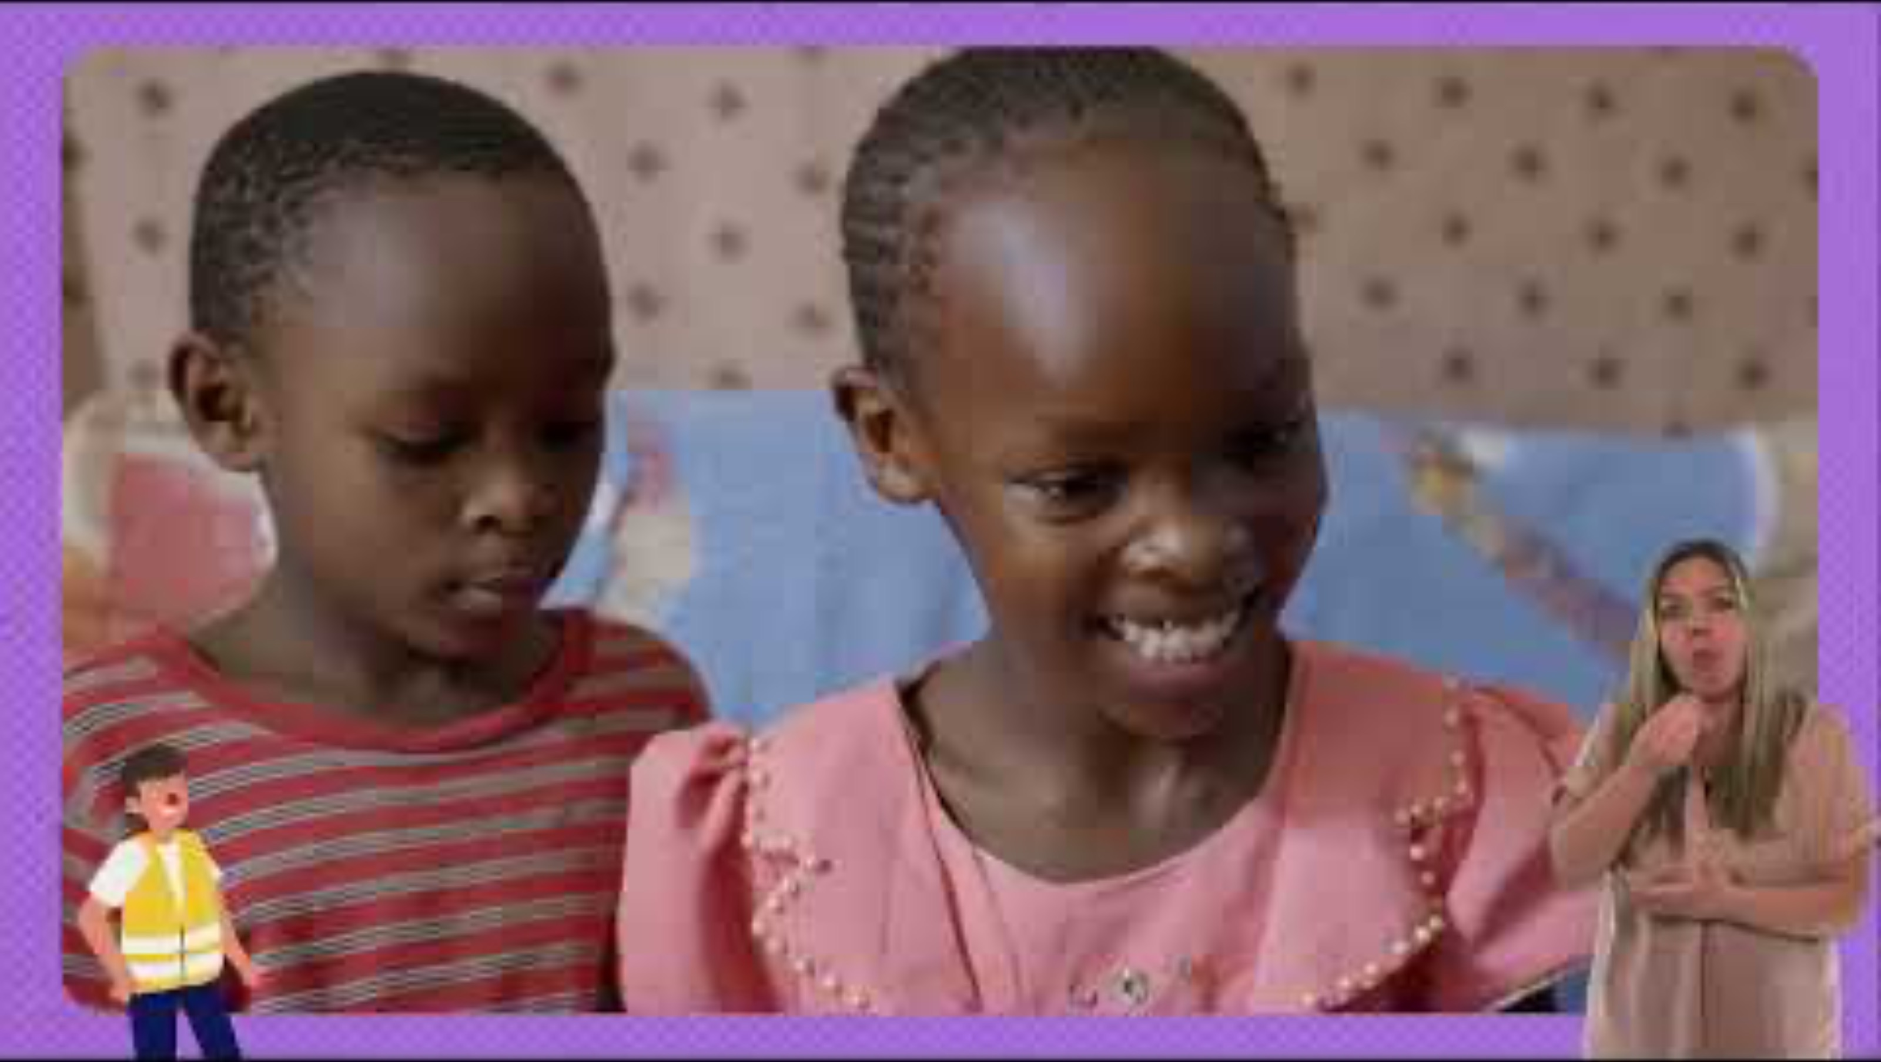

Slide 4
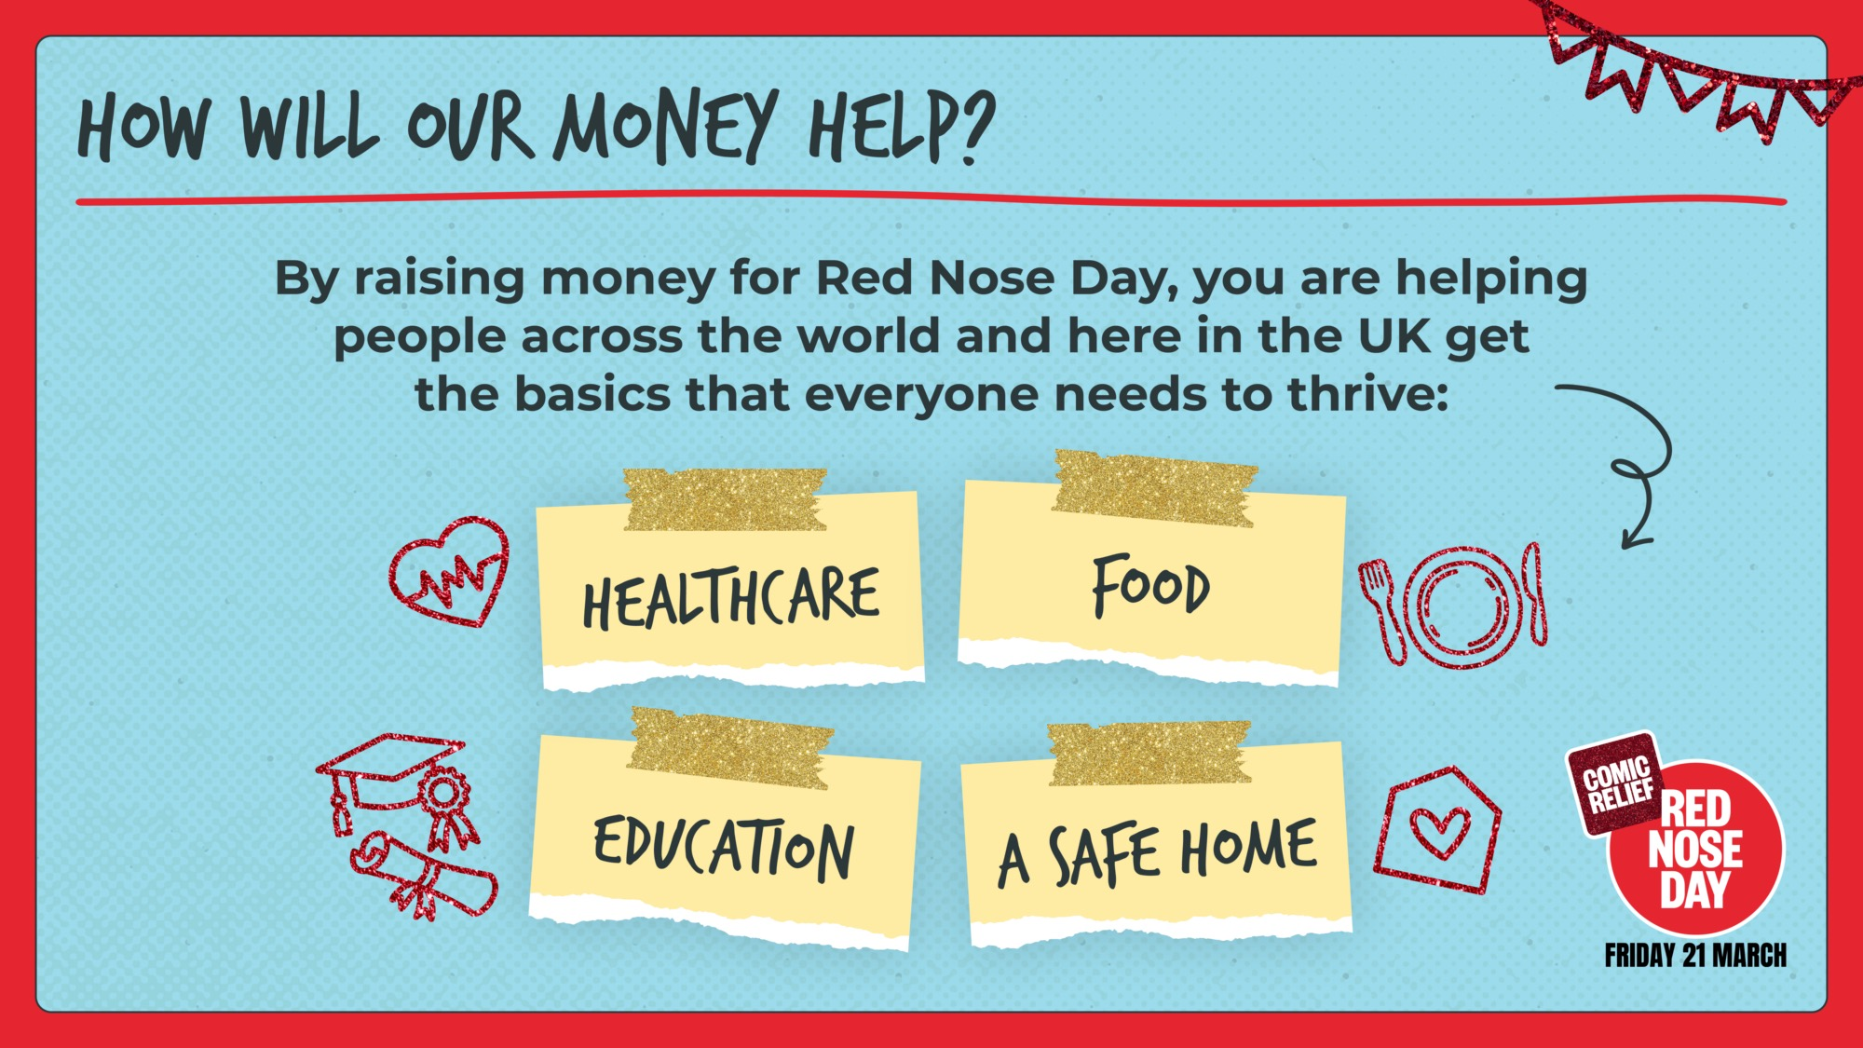

Slide 5
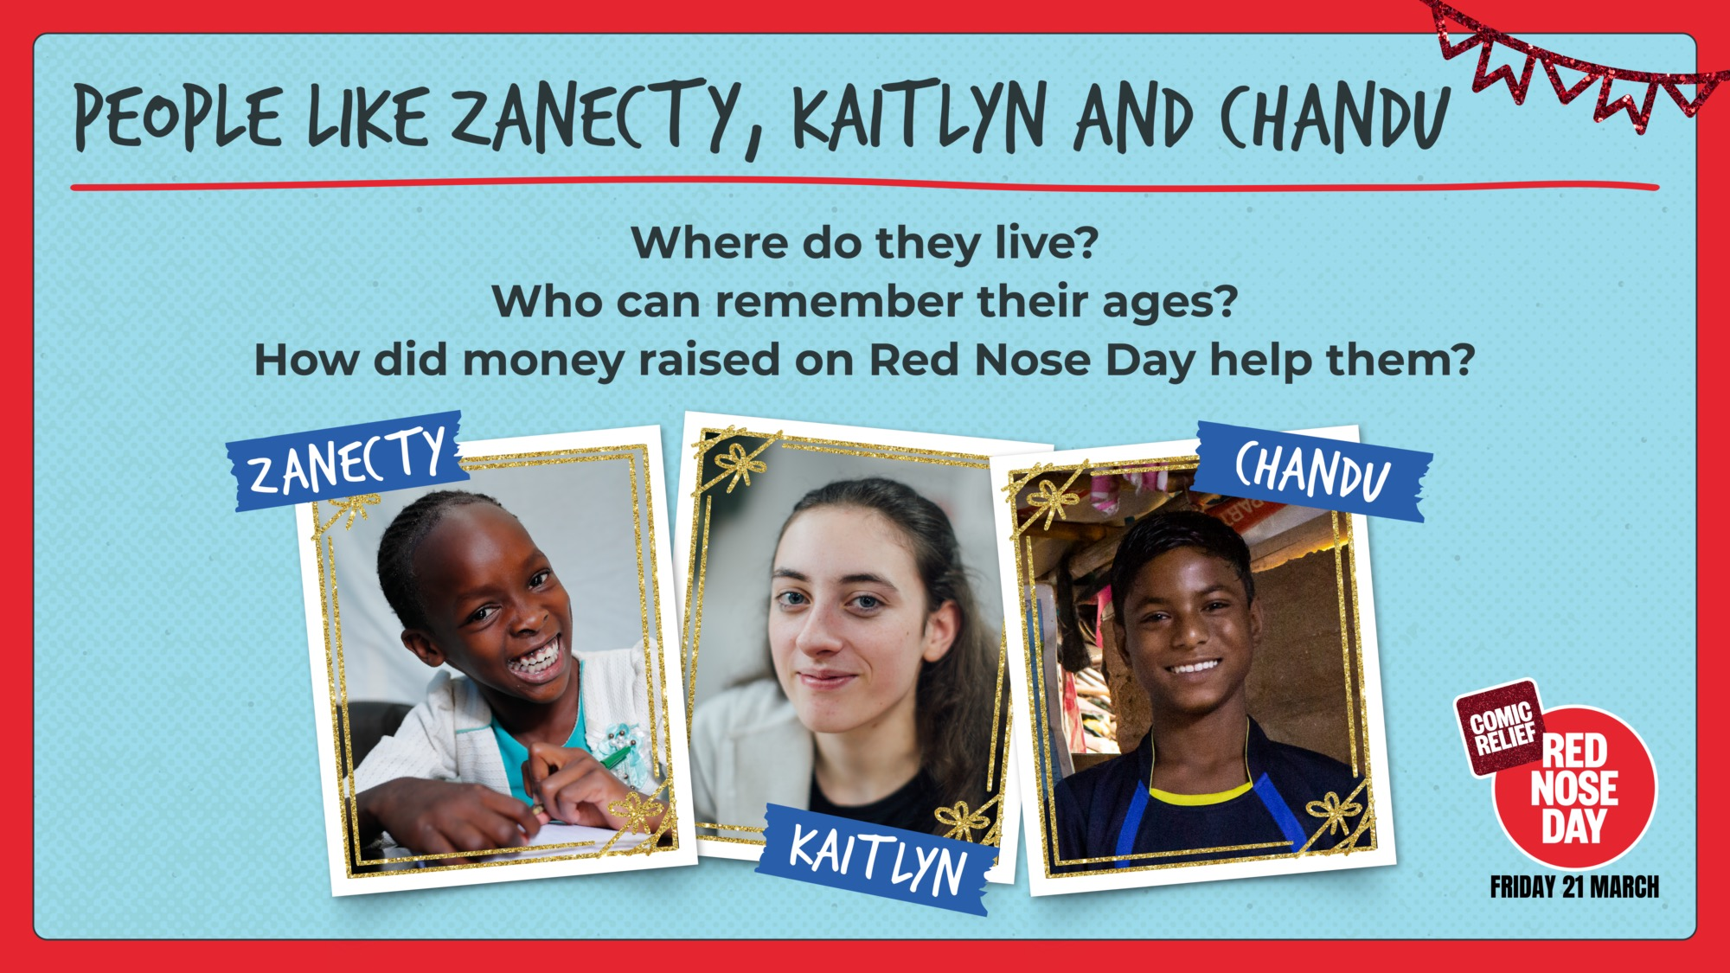

Slide 6


Slide 7
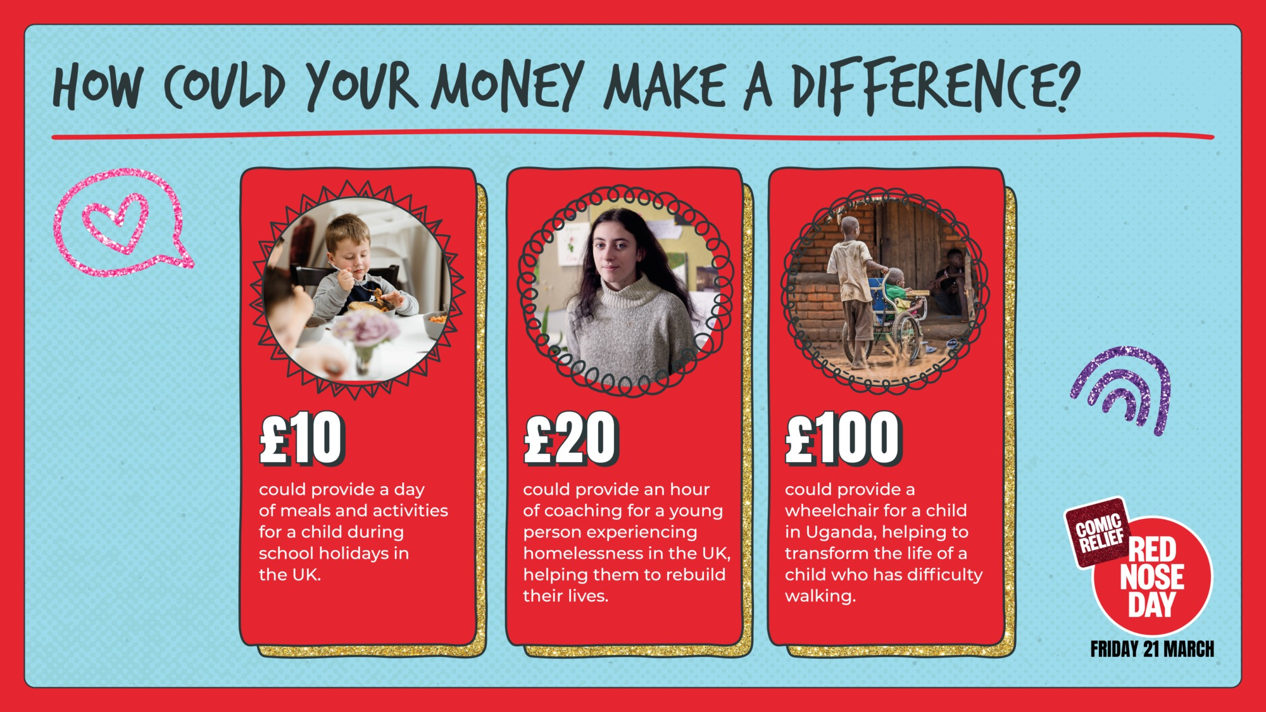

Slide 8
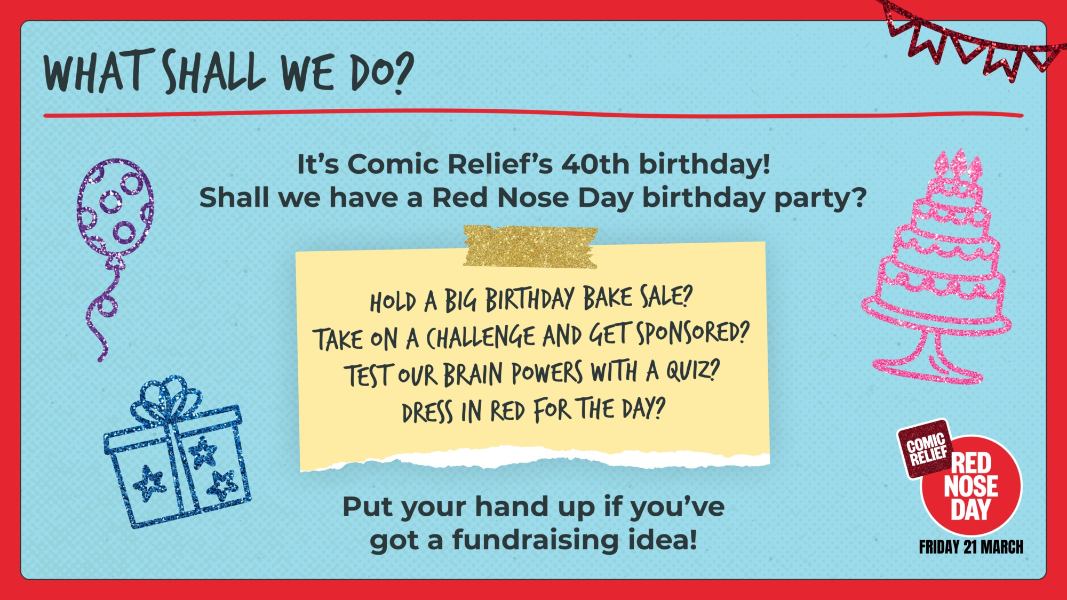

Slide 9

TEACHER:
This slide has been left blank for you to customise with your school’s fundraising plans.
Please edit or delete, as required.

Slide 10

TEACHER:
If your pupils have already completed Red Nose Day activities (e.g. making Newsround reports or writing and telling jokes), allow time for them to share what they have done here.
Please edit or delete, as required.

Slide 11


