Slide 1


Slide 2


Slide 3
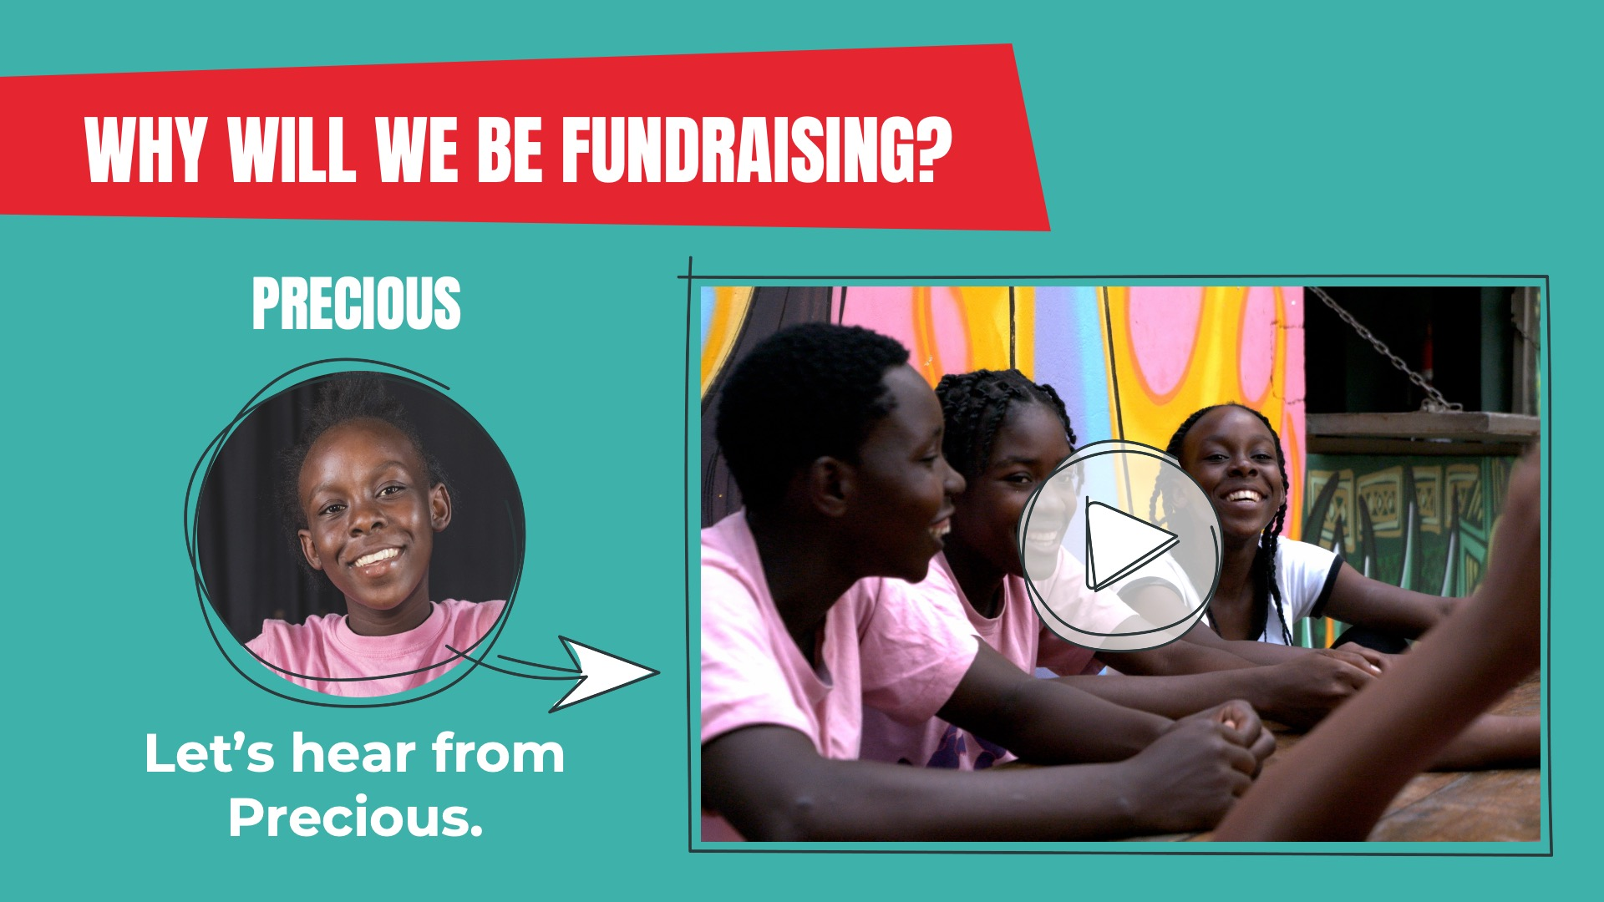

Slide 4
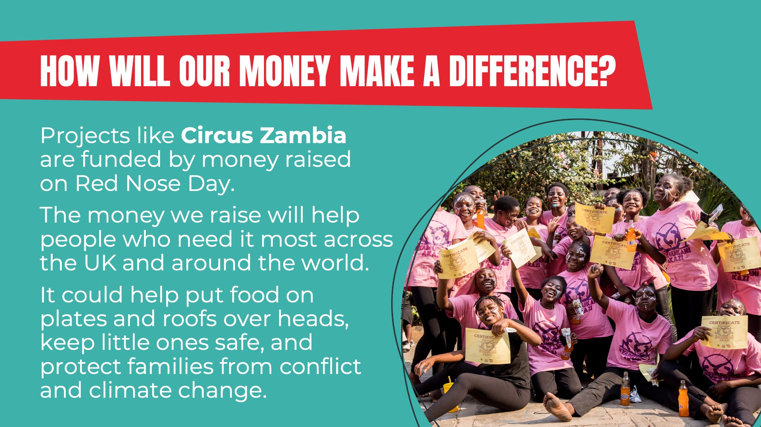

Slide 5
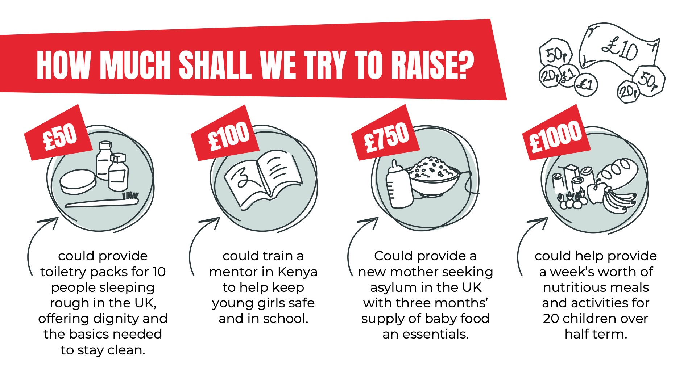

Slide 6


Slide 7

TEACHER:
This slide has been left blank for you to customise with your school’s fundraising plans.

Slide 8

TEACHER:
This slide has been left blank for you to customise with your school’s plans to join the Rebellion. What rules are going to be broken? Have you set a fundraising target and what will happen if you meet it? Are you using the Big Red Button of Rebellion?

Slide 9


Slide 10


