Slide 1


Slide 2


Slide 3
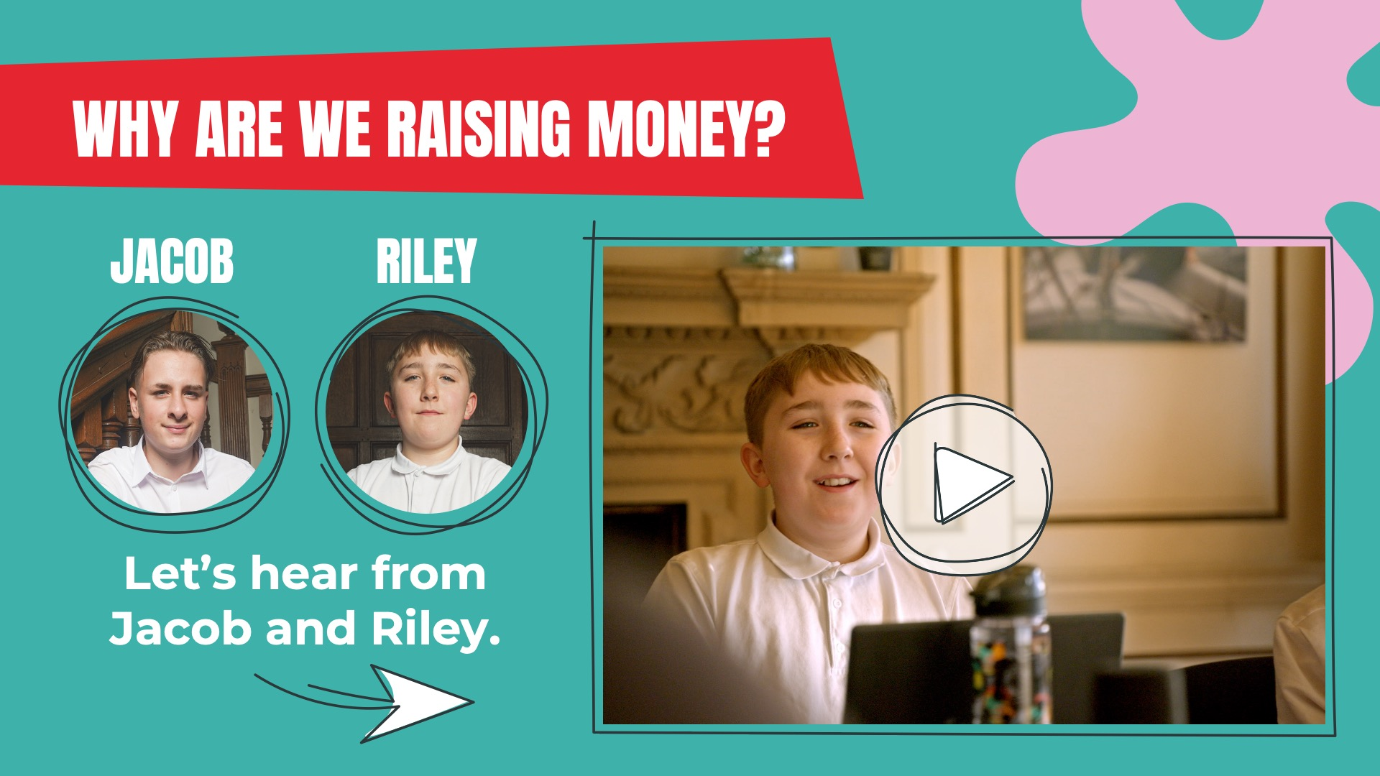

Slide 4


Slide 5
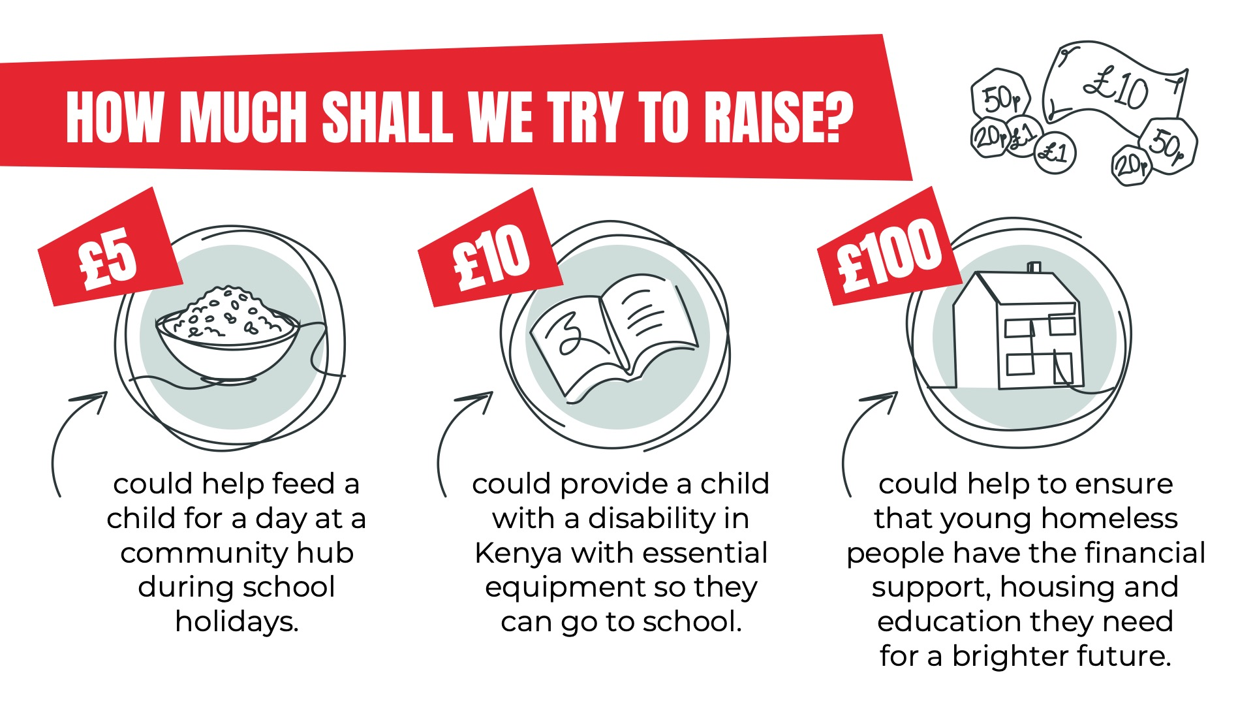

Slide 6
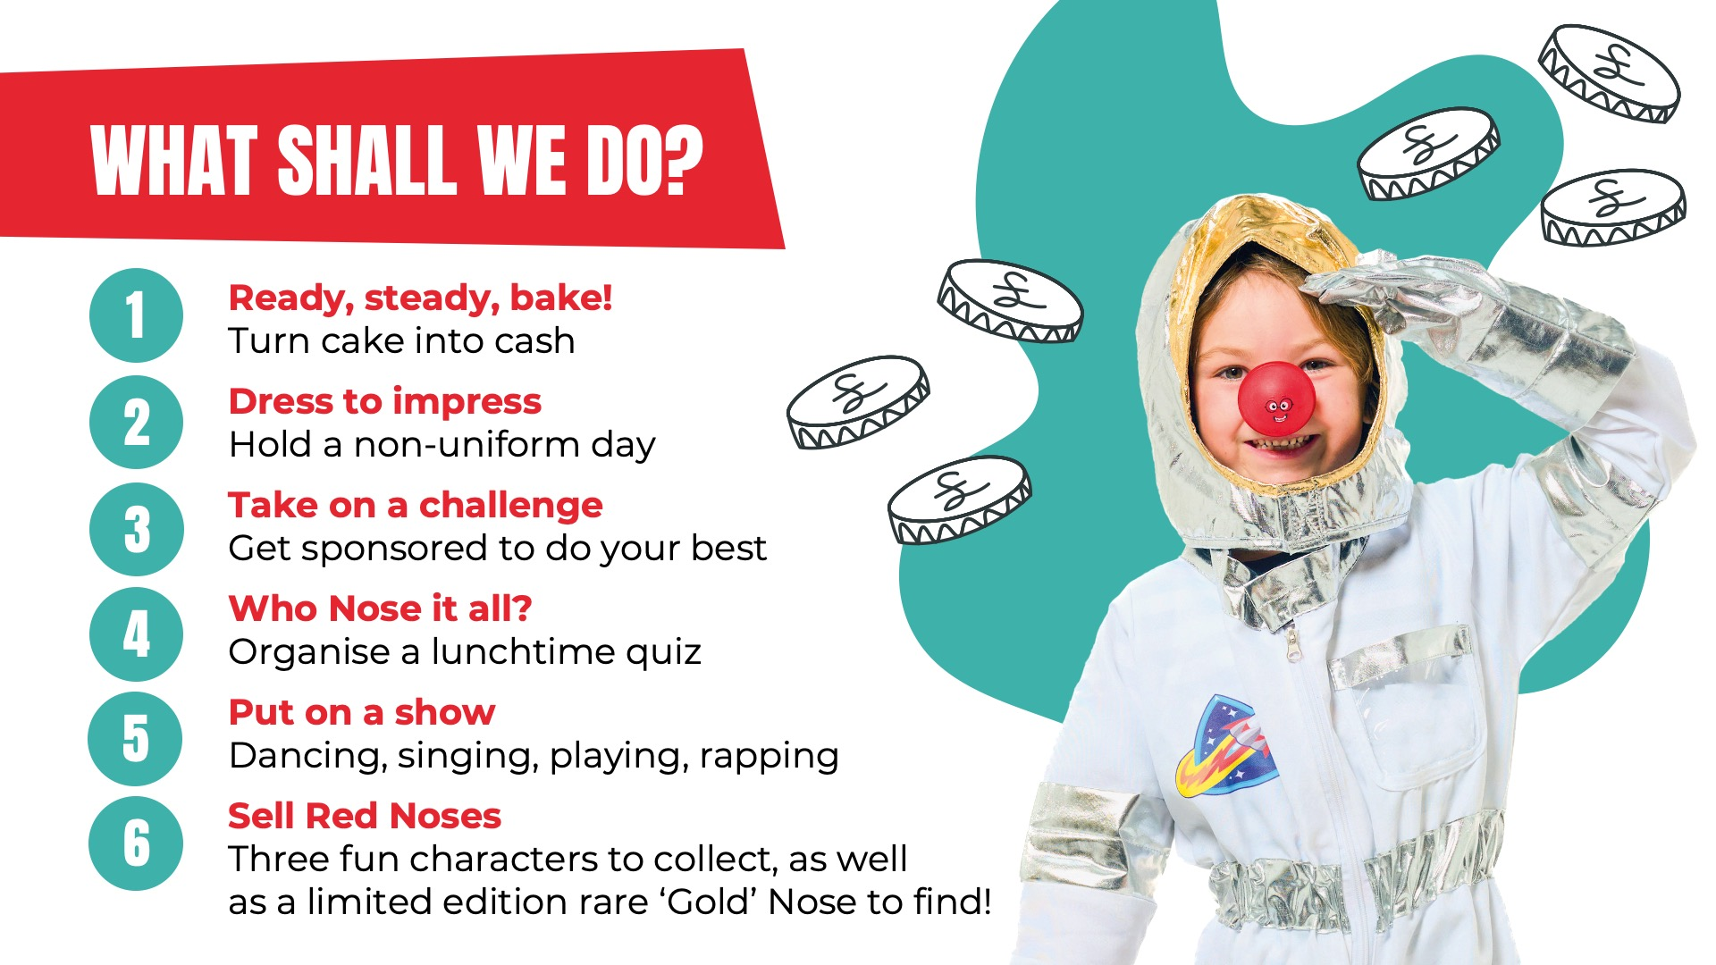

Slide 7

TEACHER:
This slide has been left blank for you to customise with your school’s fundraising plans

Slide 8


Slide 9


