Slide 1


Slide 2


Slide 3


Slide 4
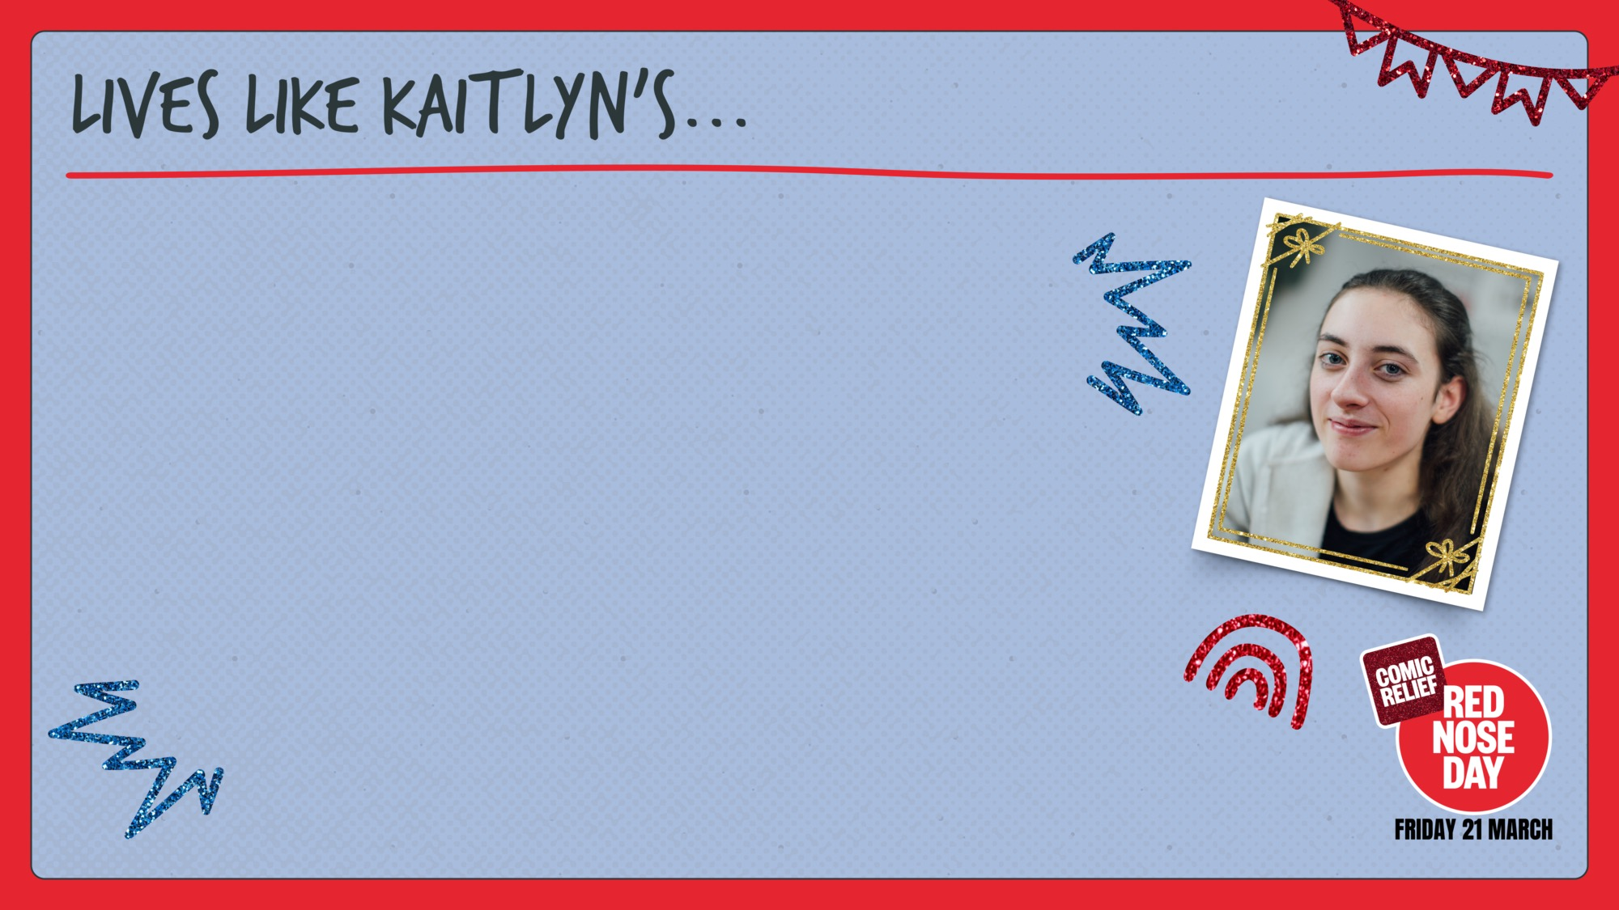
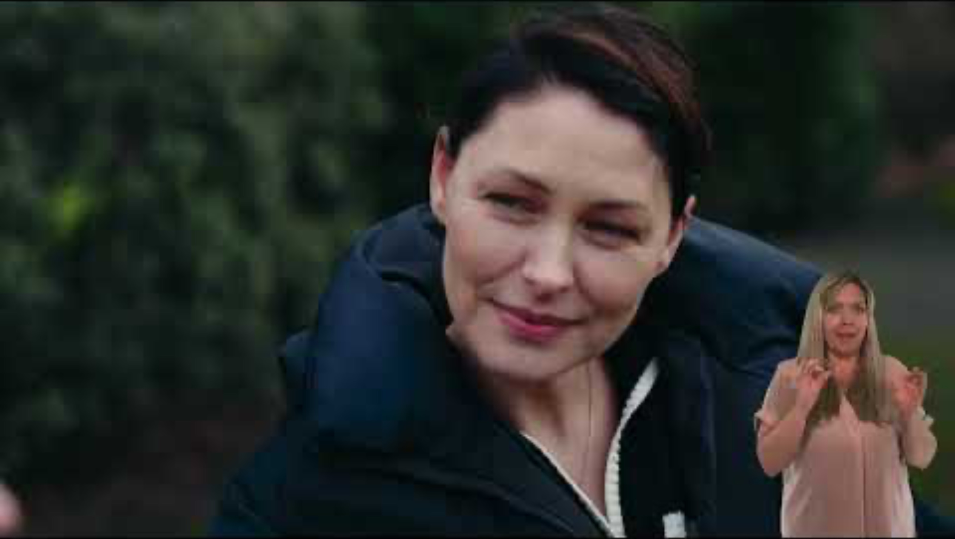

Slide 5
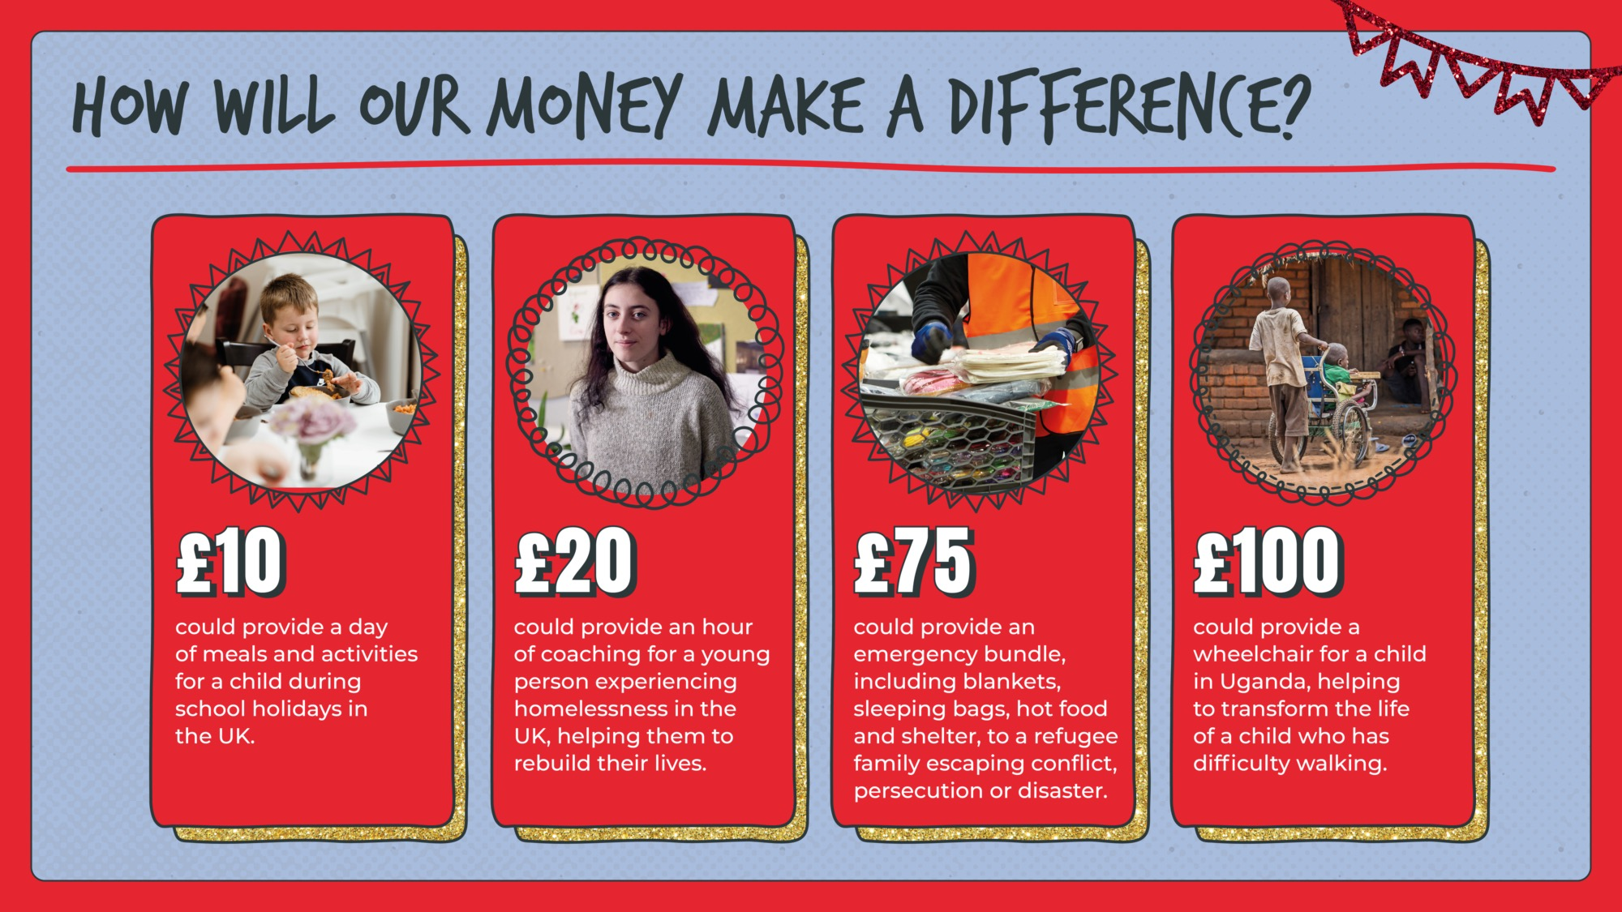

Slide 6

TEACHER:
Please customise this slide with your school’s fundraising plans.

Slide 7
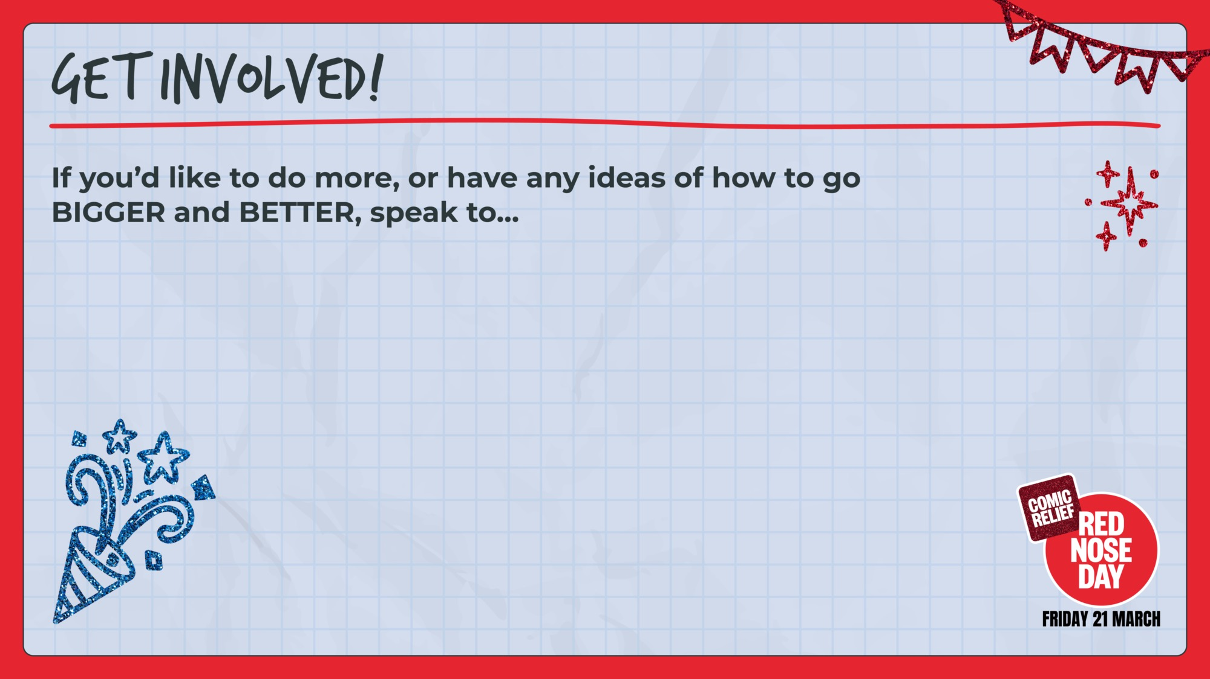
TEACHER:
Please customise this slide with details of who is running activities ( e.g. the school council, Head of Year)

Slide 8


