Slide 1


Slide 2


Slide 3
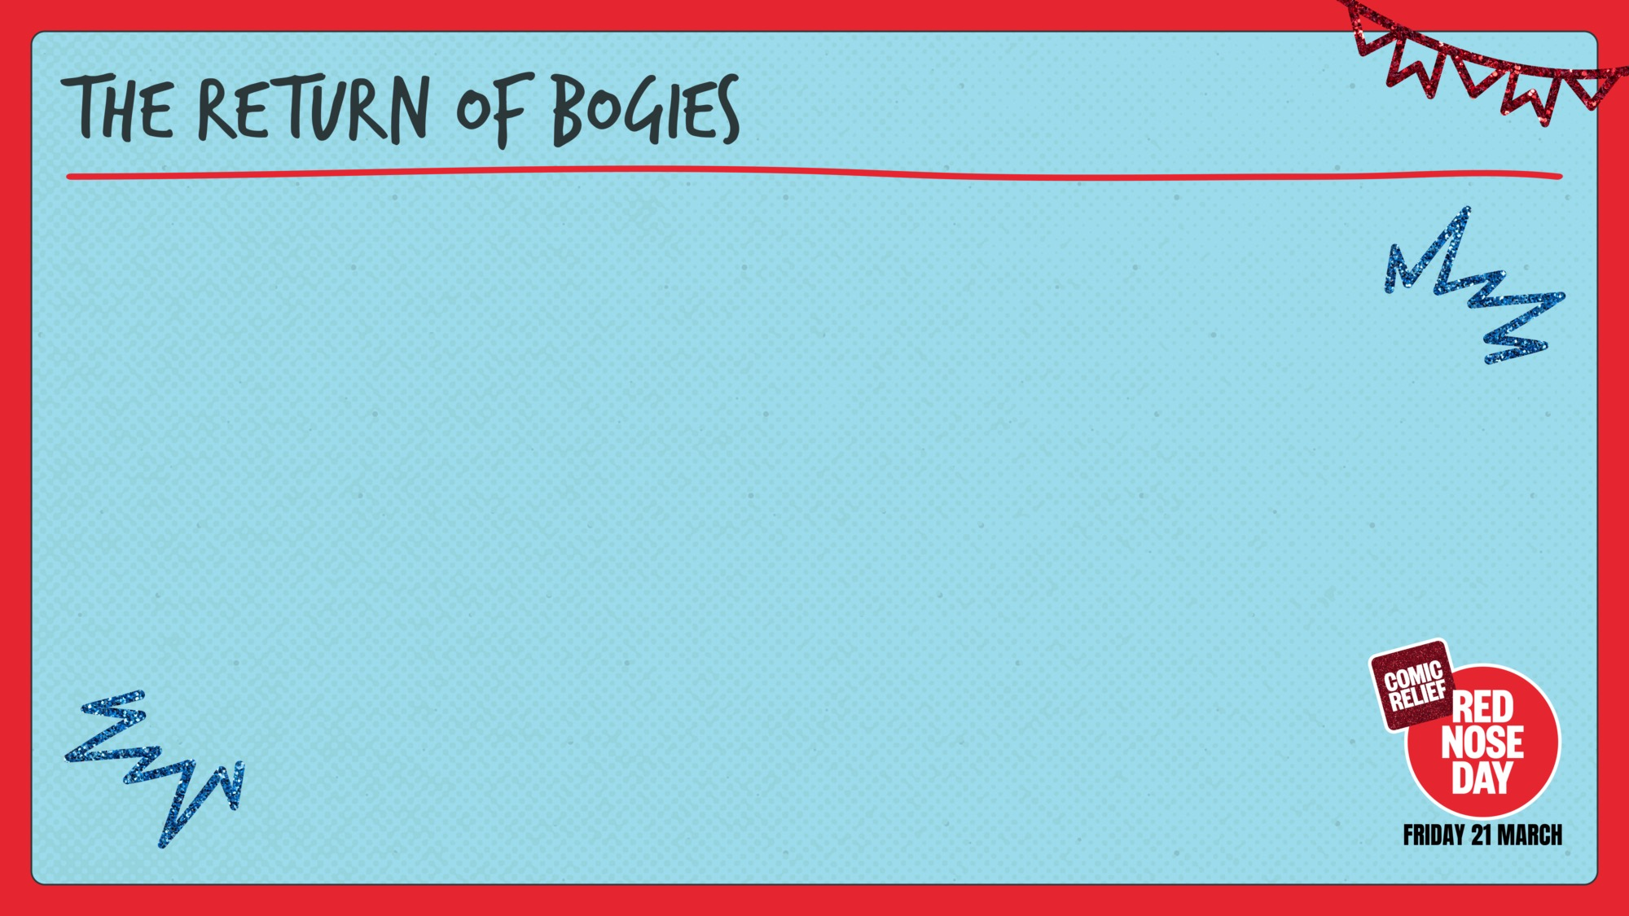

TEACHER:
Show as much of this clip as you like!

Slide 4


Slide 5


Slide 6
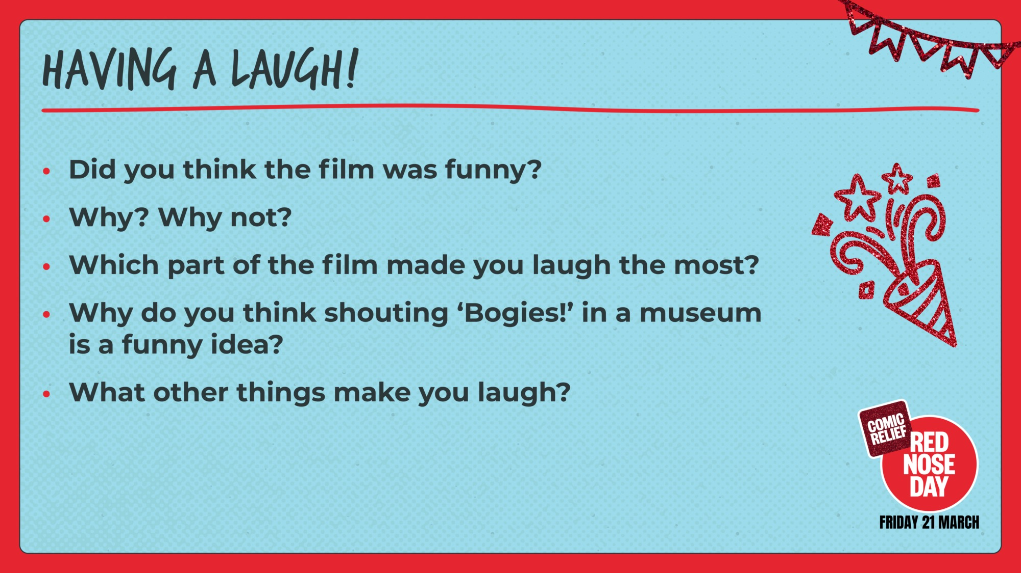

Slide 7
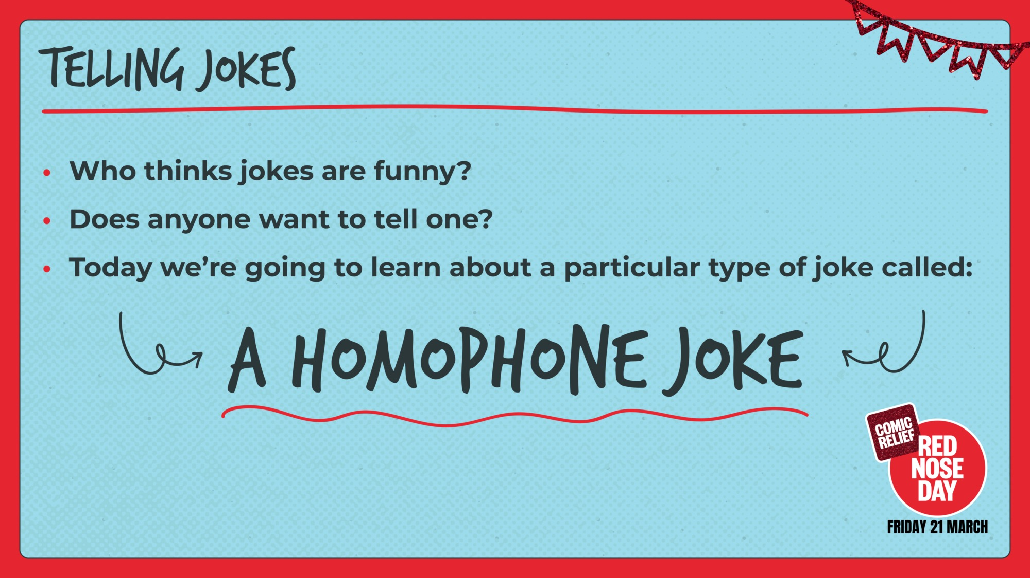

Slide 8
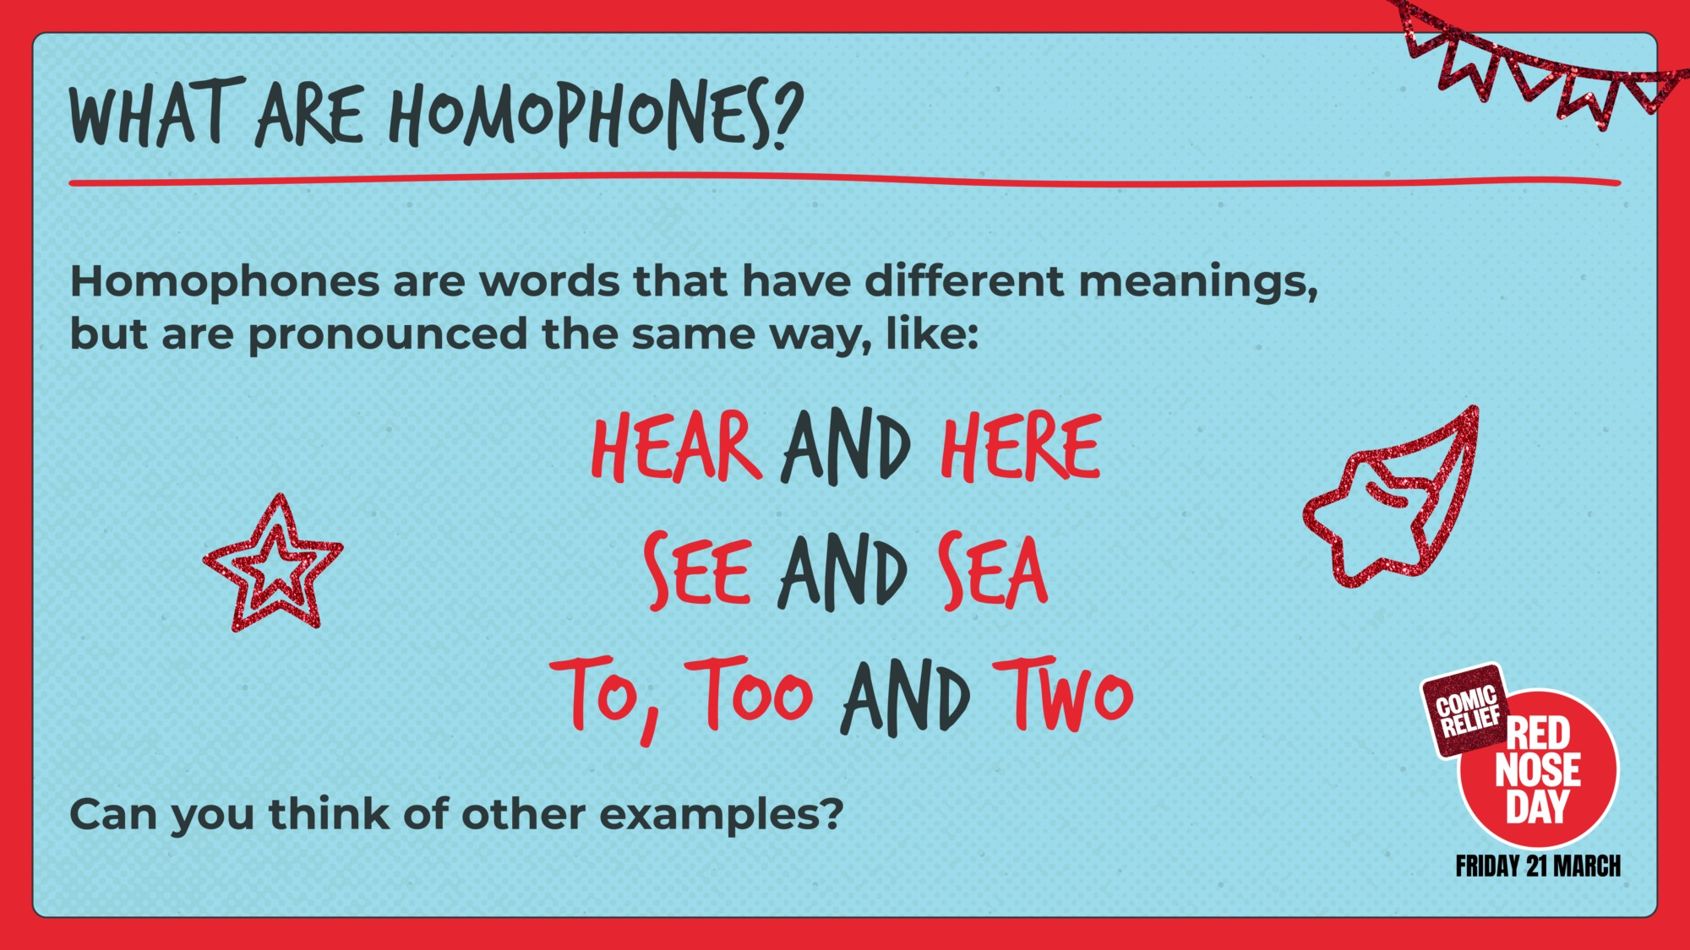

Slide 9
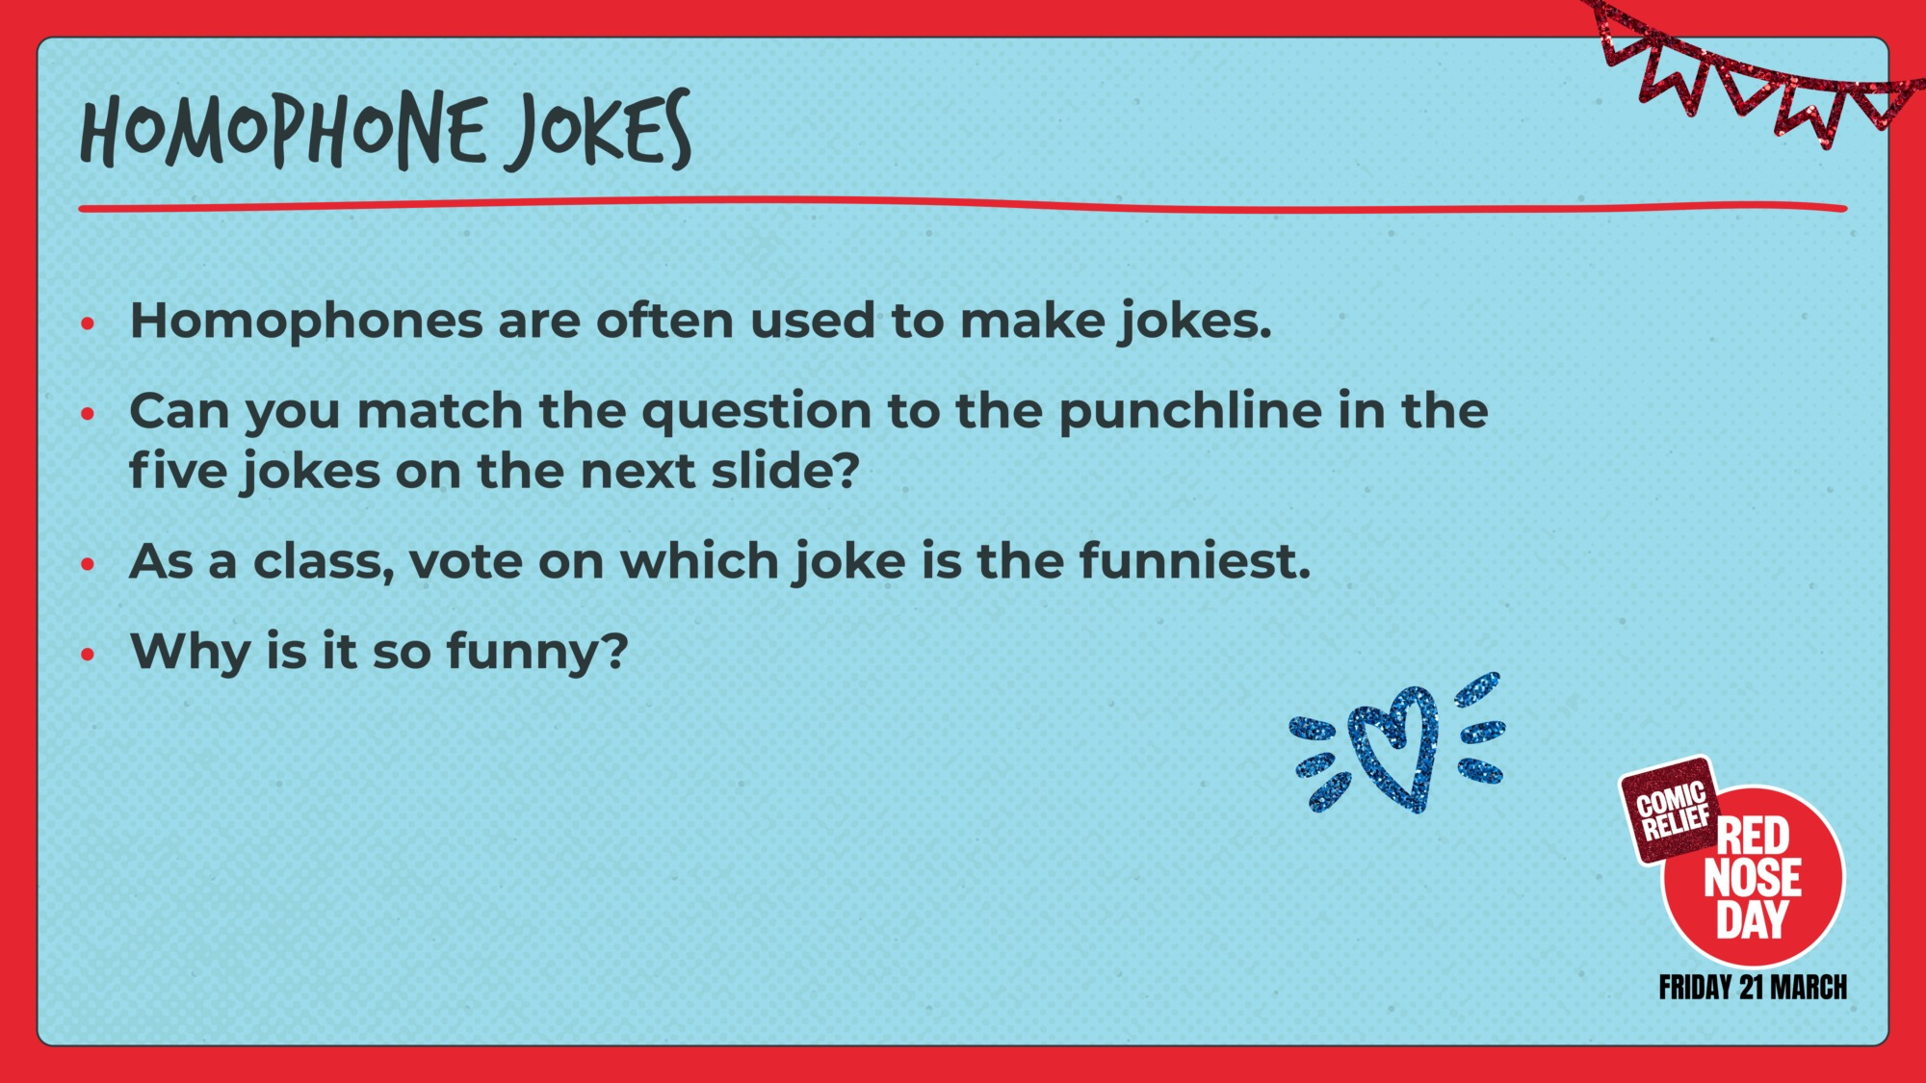

Slide 10
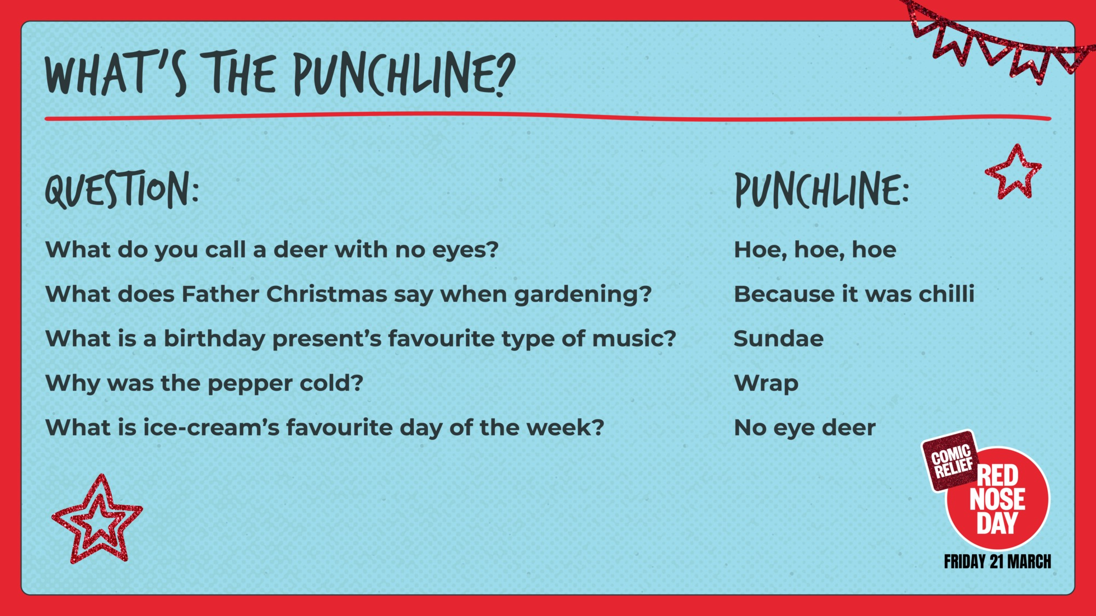

Slide 11
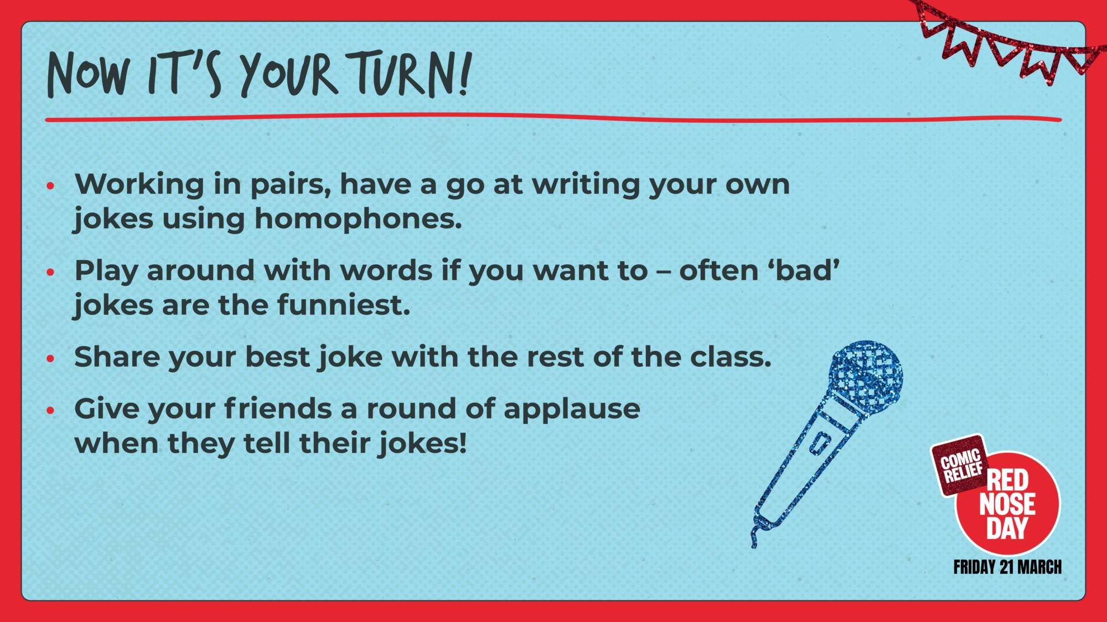

Slide 12
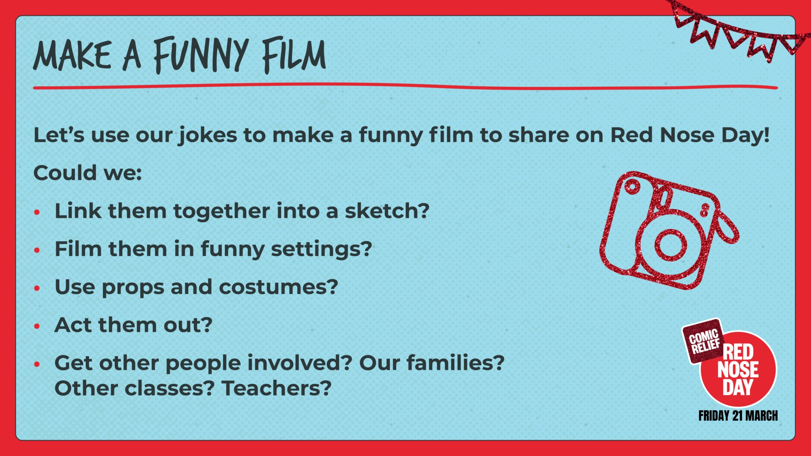
TEACHER:
Delete this slide if you do not want to use this activity.

Slide 13


